Slide 1
Advanced Materials 2030 Initiative
Lars Montelius
AMI2030 Steering Board Co-Chair

Slide 2
Overview Timeline
4
End 2023
3
A multidimensional initiative is in place to capture all value chains, innovation markets and stakeholders for inclusive and increased innovation
Feb 2023
Strategic Agenda for advanced materials
Proposal for future instrument(s)
2
Nov 2022
Analysis of available instrument options
Active stakeholder consultation and exchange for synergies with existing platforms
Finalised roadmap
Strategic Agenda Outline (areas of intervention)
1
Feb 2022
Materials 2030 Manifesto
Engaging Technology Platforms
in elaborating the roadmap
AMI2030 – 11 Janaury 2023

Slide 3
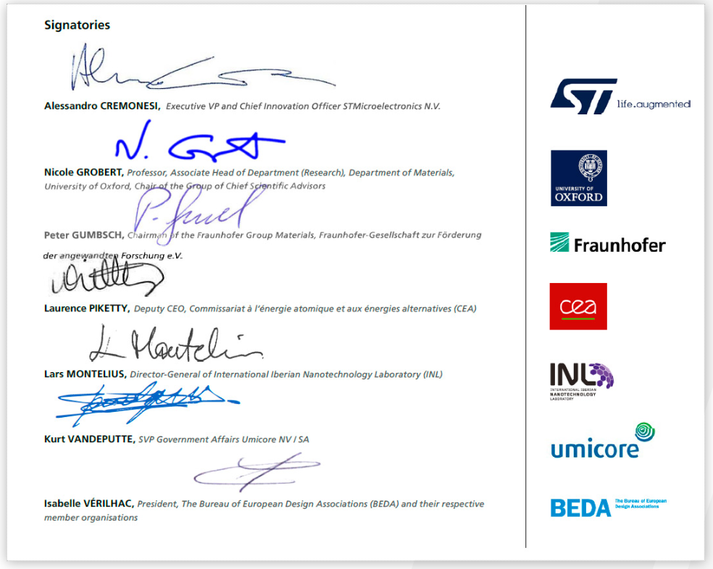
The Advanced Materials 2030 Initiative
Building on the Materials Manifesto
A call for action launched in February 2022 by key Industry and Reseach stakeholders
AMI2030 Vision
“A strong European Materials ecoystem to drive the green and digital transitions alongside a sustainable inclusive European society through systemic collaboration between upstream developers, downstream users, and citizens and all stakeholders in between.”

Slide 4




The Advanced Materials 2030 Initiative
The Materials 2030 roadmap in a nutshell
Inclusive governance
a new form of cooperation
MATERIALS DIGITALISATION
New research and dev. methologies
Merging computational and experimental material science with data science
MATERIALS PRODUCTION AND PROCESSING
Common manufacturing technologies & conditions for the production and processing of advanced materials
MATERIALS PRIORITY AREAS
The basis for the development of a novel European strategic agenda
Connecting “Blue sky” research with market demands
Evidence-based policy recommendations
AMI2030 – 11 Janaury 2023

Slide 5



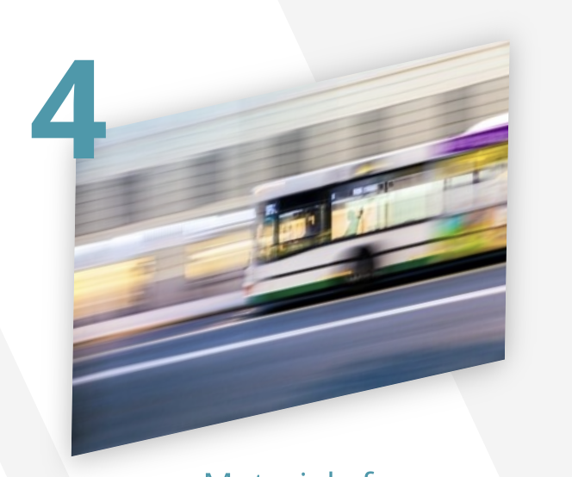





The Advanced Materials 2030 Initiative
The draft roadmap in a nutshell
A SPILL-OVER APPROACH FOR THE BENEFIT OF THE MATERIALS INNOVATION MARKETS
THE SPILL-OVER APPROACH
Focus on activities addressing needs & challenges common to as many innovation markets as possible;
In a first step:
identify 1 or 2 high-priority innovation market(s) as use case
In a second step:
replicate to the other relevant innovation markets (spill-over)
HEALTHCARE
CONSTRUCTION
NEW ENERGIES
TRANSPORT
HOME &
PERSONAL CARE
PACKAGING
AGRICULTURE
TEXTILES
ELECTRONICS APPLICANCES
AMI2030 – 11 Janaury 2023

Slide 6
The Advanced Materials 2030 Initiative
Some expected benefits
Combining digital technologies revolutionises
research &
development methodologies
Integrating materials development, production and processing creates
new opportunities
1 Accelerating advanced materials development for Europe’s innovation markets
2 Low resource utilisation, energy-efficiency and decarbonisation of materials processing
3 Industry-ready processes and technologies for establishing circular value chains in Europe
4 Alternative advanced materials processing solutions
5 Increased product customisation, warranty, and labelling
6 Support product traceability and lifecycle management
AMI2030 – 11 Janaury 2023

Slide 7
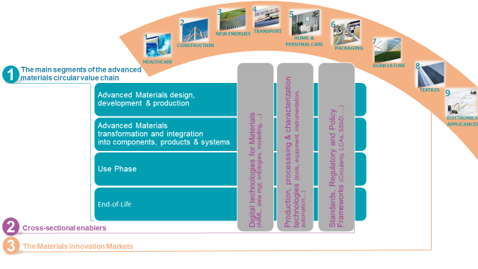
European Strategic Agenda for Advanced Materials
Areas of Intervention structured around 3 key dimensions
Innovative results will emerge from R&I activities addressing challenges at the crossroad of one or more segment(s) of the circular value chain with one or more of the cross-sectional enablers.
The challenges arising from the innovation markets are clustered into common needs.
AMI2030 – 11 Janaury 2023

Slide 8
Targeted activities
R&I Activities
Activities aiming at
market, regulatory and societal uptake
ACTIVITIES SUPPORTING A SUSTAINABLE FRAMEWORK FOR MATERIALS KNOWLEDGE & DATA
SCIENTIFIC INPUT FOR INFORMED REGULATIONS AND RELATED POLICIES
ACTIVITIES SUPPORTING CERTIFICATION AND STANDARDISATION BODIES
(especially on safety and sustainability aspects)
ACTIVITIES CONTRIBUTING TO THE EDUCATION AND TRAINING OF FUTURE SKILLED WORKFORCES
ACTIVITIES CONTRIBUTING TO ENTREPRENEURSHIP
ACTIVITIES CONTRIBUTING TO THE PUBLIC AWARENESS and CITIZEN INVOLVEMENT
…
TRL 1 – basic principles observed
TRL 2 – technology concept formulated
TRL 3 – experimental proof of concept
TRL 4 – technology validated in lab
TRL 5 – technology validated in relevant environment⁽¹⁾
TRL 6 – technology demonstrated in relevant environment⁽¹⁾
TRL 7 – system prototype demonstration in operational environment
TRL 8 – system complete and qualified
TRL 9 – actual system proven in operational environment⁽²⁾
AMI2030 extended coverage
AMI2030 Core
industrially relevant environment in the case of key enabling technologies
competitive manufacturing in the case of key enabling technologies
AMI2030 – 11 Janaury 2023

Slide 9
THE CURRENT PROBLEMS & NEEDS
PROBLEMS
The faced challenges, failures, gaps,…
NEEDS
R&I, Industrial, Regulatory,…
Increased complexity in the development of new materials due to a profound transformation towards a safe and sustainable society
Fragmentation among the different players
Challenged European leadership on Advanced Materials Innovation
Challenged European Advanced Materials manufacturing competitiveness
Vulnerable linear value chains unsuited for the exponential increase in demand driven by the green transition
New solutions to reduce costs and risks and to accelerate and shorten Materials development cycles and uptake
Stakeholders aligned & integrated on common goals with shared benefits
(Blue sky research – Materials producers – Products manufacturers – Strategic value chains – End users/Citizens – Different policy makers (EU/MS/Regions)),
Ambitious and coordinated investments (skills, resources, infrastructures…) to achieve critical mass for the innovation markets serving the twin green and digital transition
EU policy frameworks including aligned strategies towards industrial competitiveness and the twin green and digital transition
Increased autonomy on Raw and Advanced Materials
(Improve resources efficiency, reduce imports, develop substitutes,…)
Secured, circular symbiotic value chains maximising materials efficiency and materials knowledge sharing
AMI2030 – 11 Janaury 2023

Slide 10
GLOBAL EXPECTED OUTPUTS & RESULTS
EXPECTED OUTPUTS
(direct outcomes of the Initiative)
EXPECTED RESULTS
(benefits provided by the Initiative)
Game changers (e.g. MAPs, OITBs, digital twins, modeling tools, data spaces,…) for AdMat
Systemic collaborations integrating all stakeholders along the AdMat Value Chains
Common toolbox (the “Materials Commons”) to support the development of safe and sustainable Materials/Products compliant with regulations, standards, frameworks, product passport, …
Synergies between regional, national, European and international initiatives and programmes
Accelerated development of safe and sustainable advanced materials and associated process technologies
Rapid design of innovative materials and their integration into products & technos serving strategic innovation markets
Closing the « Materials loop » towards a circular safe and sustainable society
Maximising the overall impact of all funding & financing levels in Europe
AMI2030 – 11 Janaury 2023

Slide 11

THE AMI2030 OBJECTIVES
AMI 2030
  Operational objectives
  [EXPECTED OUTPUTS]
Game changers (e.g. MAPs, OITBs, digital twins, modeling tools, data spaces,…) for developing AdMat
Systemic collaborations integrating all stakeholders along the AdMat Value Chains
Common toolbox (the “Materials Commons”) to support the development of safe and sustainable Materials/Products compliant with regulations, standards, frameworks, product passport, …
Synergies between regional, national, European and international initiatives and programmes
  Specific objectives
  [EXPECTED RESULTS]
  Accelerated development of safe and sustainable advanced materials and associated process technologies
  Rapid design of innovative materials and their integration into products & technos serving strategic innovation markets
  Closing the « Materials loop » towards a circular safe and sustainable society
  Maximising the overall impact of all funding & financing levels in Europe
General objectives
[EXPECTED IMPACTS]
  Boost industrial competitiveness through interdisciplinary technology innovations
  Reinforce EU Sovereignty through global leadership and strategic autonomy in key areas, ensuring compatibility with EU values.
  Establish and strengthen sustainable, resilient and circular advanced materials value chains, supporting the Green Deal
  Contribute to the Digital Age, through smarter advanced materials and data

Slide 12
PROPOSED ACTIONS (preliminary list)
 | PROPOSED ACTIONS
CORE | Set up tools encompassing design, manufacturing, circularity and testing principles for fast and scalable advanced materials development (replicable from one IM to another)
 | Reduce and substitute critical raw materials
 | Create and promote sustainable material sourcing
 | Develop and implement recycling technologies, business models and markets for closing the advanced materials circular value chain
COLLABORATION | Facilitate Innovation uptake (funding instruments pipeline, cross-fertilisation/ results dissemination /upscaling facilities ...)
 | Facilitate/ensure access for industry (incl. SMEs, Mid-Caps and start-ups) to product innovation services integrating performant, cost-competitive and sustainable advanced materials
 | Engage and coordinate EC, MS, Industry, Research and citizens to leverage collaboratively the interplay between advanced materials, digital technologies and circular strategies, funding and investments.
 | Foster the presence of the entire value chain in innovation/development programs
 | Promote upskilling and re-skilling
DATA | Building a common Data Space ensuring a true ‘materials centric’ partnership across the materials stakeholders / ecosystems with materials data & information at the core
 | Enable, ensure and guarantee product & service digitalization along VCs based on materials transparency, traceability,…
REG & Policies | Support the deployment of the SSbD framework; Contribute to a common understanding regarding health, safety and sustainability issues
 | Demonstrate the key enabling role of advanced materials in achieving the twin green and digital transition, EU resilience and strategic open autonomy
 | Contribute to policy development with the objective to enable the development and uptake of safe and sustainable advanced materials

Slide 13
PROPOSED ACTIONS
HIGHLIGHTING SOME KEY COLLABORATION ACTIONS
Engage and coordinate EC, MS, Industry, Research and citizens to leverage collaboratively the interplay between advanced materials, digital technologies and circular strategies, funding and investments.
Facilitate Innovation uptake (consistent funding instruments pipeline, cross-fertilisation/ results dissemination /upscaling facilities ...)
Foster the presence of the entire value chain in innovation/development programs
AMI2030 – 11 Janaury 2023

Slide 14
A new European Partnership appears the most suitable instrument to bring all Advanced Materials stakeholders together
Only a partnership, i.e. a long-lasting and coordinated effort reinforcing collaboration between industry, research and the public sector (EC and MS), can live up to the challenge and bring predictability to the European advanced materials value chains stakeholders
By pooling Europe’s resources and knowledge, partnerships have demonstrated their efficiency for accelerating the development, industrialisation and deployment of strategic technologies that underpin growth and jobs in key sectors of the European economy

Slide 15
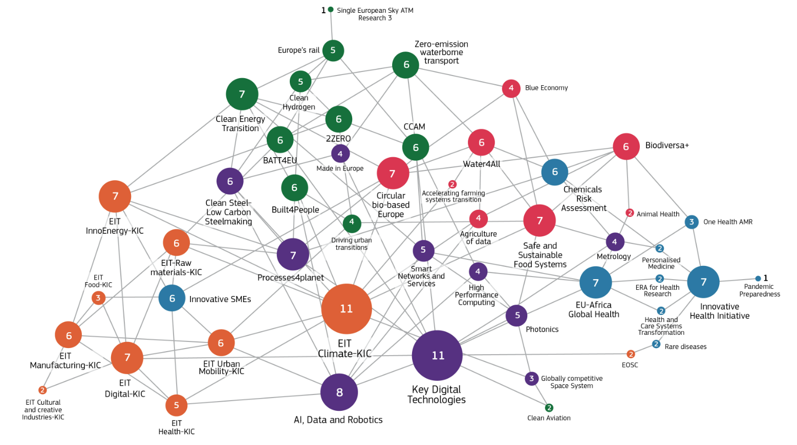
AMI2030 within the EU R&I landscape
Cross-enablers/complementary
« Customers »
AMI
AMI2030 – 11 Janaury 2023

Slide 16
Building common added-value with each initiative
ERA-NET
(M-ERA.NET, MANUNET,
ERA-MIN,...)
« CUSTOMERS »
KDT
Clean Steel
Photonics
Construction (B4P)
ENERGY (Clean H2, BATT4EU, CET …)
MOBILITY (2ZERO, Waterborne, Rail,…)
Innovative Health initiative / EIT Health
EIT Food
MEMBER STATES
S3 VANGUARD INITIATIVE
…
AMI2030
P4P / Circ. Bio-based / EIT Raw Materials
CROSS-ENABLERS
Made in Europe / EIT Manufacturing
AI – DATA – Robotics / EIT Digital
European Metrology

Slide 17
WG1
Materials Digitalisation
Gerhard Goldbeck, EMMC, WG1 Chair

Slide 18
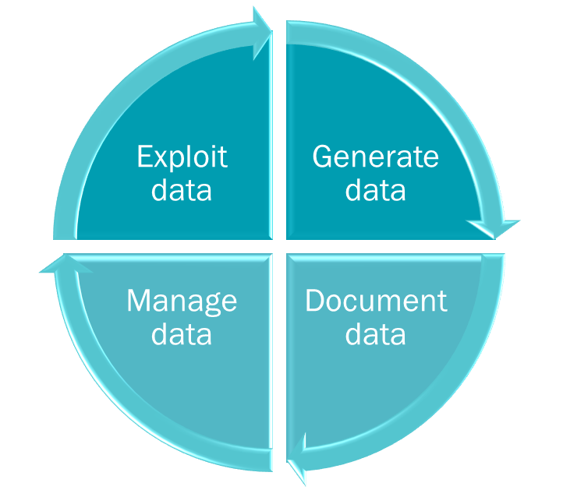
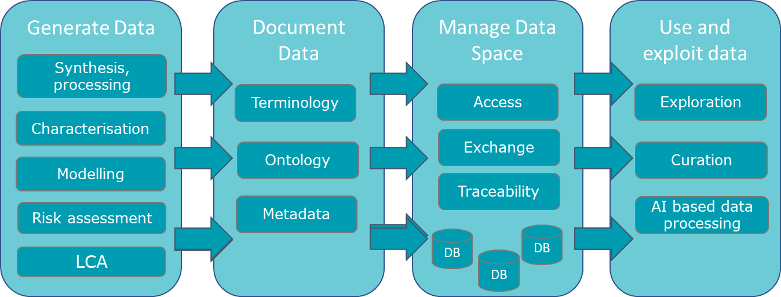
WG1 – Materials Digitalisation
SCOPE & Priorities identified in the MATERIALS 2030 Roadmap
Digitalise and integrate materials investigation technologies Generate
Harmonised and interoperable data across all domains Document
Federated data space with trusted data access and exchange Manage
Created value from data using digital and AI strategies Exploit

Slide 19
GLOBAL PROBLEMS & NEEDS
Leverage digitalisation methodologies and tools
PROBLEMS
The faced challenges, failures, gaps,…
NEEDS
R&I, Industrial, Regulatory,…
Increased complexity in the development of new materials due to a profound transformation towards a safe and sustainable society
Fragmentation among the different players
Challenged European leadership on Advanced Materials Innovation
Challenged European Advanced Materials manufacturing competitiveness
Vulnerable linear value chains unsuited for the exponential increase in demand driven by the green transition
New solutions to reduce costs and risks and to accelerate and shorten Materials development cycles and uptake
Stakeholders aligned & integrated on common goals with shared benefits
(Blue sky research – Materials producers – Products manufacturers – Strategic value chains – End users/Citizens – Different policy makers (EU/MS/Regions)),
Ambitious and coordinated investments (skills, resources, infrastructures…) to achieve critical mass for the innovation markets serving the twin green and digital transition
EU policy frameworks including aligned strategies towards industrial competitiveness and the twin green and digital transition
Increased autonomy on Raw and Advanced Materials
(Improve resources efficiency, reduce imports, develop substitutes,…)
Secured, circular symbiotic value chains maximising materials efficiency and materials knowledge sharing
AMI2030 – 11 Janaury 2023

Slide 20
Materials digital efforts so far are patchy
Materials and Products lack integration
Obstacle to circularity
Manufacturing Digitalisation and Data Spaces
Product requirements
Design and development
Manufacturing
EoL, Recycle
Use
Materials Information Management
Available Materials
Materials (which ?)
Materials R&D Data, Digital tools
Materials Upscaling
Materials Research, Design

Slide 21
AMI2030 EXPECTED OUTPUTS & RESULTS
Digitalisation leveraged to support outputs and results
EXPECTED OUTPUTS
EXPECTED RESULTS
Game changers (e.g. MAPs, OITBs, digital twins, modeling tools, data spaces,…) for AdMat
Systemic collaborations integrating all stakeholders along the AdMat Value Chains
Common toolbox (the “Materials Commons”) to support the development of safe and sustainable Materials/Products compliant with regulations, standards, frameworks, product passport, …
Synergies between regional, national, European and international initiatives and programmes
Accelerated development of safe and sustainable advanced materials and associated process technologies
Rapid design of innovative materials and their integration into products & technos serving strategic innovation markets
Closing the « Materials loop » towards a circular safe and sustainable society
Maximising the overall impact of all funding & financing levels in Europe
AMI2030 – 11 Janaury 2023

Slide 22
AMI2030 EXPECTED OUTPUTS & RESULTS
FOCUSING ON MATERIALS DIGITALISATION
EXPECTED OUTPUTS
EXPECTED RESULTS
Exploit existing and generate new data with harmonised and digitalised techniques: modelling, characterisation, production and testing technologies, semantic tech and AI
Game changers (e.g. MAPs, OITBs, digital twins, modeling tools, data spaces,…) for AdMat
Systemic collaborations integrating all stakeholders along the AdMat Value Chains
Common toolbox (the “Materials Commons”) to support the development of safe and sustainable Materials/Products compliant with regulations, standards, frameworks, product passport, …
Synergies between regional, national, European and international initiatives and programmes
Accelerated development of safe and sustainable advanced materials and associated process technologies
Rapid design of innovative materials and their integration into products & technos serving strategic innovation markets
Closing the « Materials loop » towards a circular safe and sustainable society
Maximising the overall impact of all funding & financing levels in Europe
Develop and disseminate a common documentation language (ontology) for data exchange and knowledge management and in support of materials standards and regulations
Common materials data space using distributed data repositories with trusted data management, access and exchange for all stakeholders
AMI2030 – 11 Janaury 2023

Slide 23
PROPOSED ACTIONS
FOCUS ON MATERIALS DIGITALISATION
PROPOSED ACTIONS
Set up tools encompassing design, manufacturing, circularity and testing principles for fast and scalable advanced materials development (replicable from one IM to another)
Create and promote sustainable material sourcing
Facilitate/ensure access for industry (incl. SMEs, Mid-Caps and start-ups) to product innovation services integrating performant, cost-competitive and sustainable advanced materials
Foster the presence of the entire value chain in innovation/development programs
Promote upskilling and re-skilling
Building a common Data Space ensuring a true ‘materials centric’ partnership across the materials stakeholders / ecosystems with materials data & information at the core
Enable, ensure and guarantee product & service digitalization along VCs based on materials transparency, traceability,…
AMI2030 – 11 Janaury 2023

Slide 24
PROPOSED ACTION
Building a common Data Space ensuring a true ‘materials centric’ partnership across the materials stakeholders / ecosystems with materials data & information at the core (WG1-4)
A Materials Commons data space system, a game changer which enables systemic collaboration, overcoming traditional barriers
  Chemicals | Processing | Materials | Manufacturing | Products
  Value chains
  Cross industries and organisations
Aspects of the common Data Space
Distributed data repositories
Trusted data management and exchange
Supported by a common language (ontologies): overcoming fragmentation
Meaningful, reliable, trusted, FAIR data
Digital standards, supporting regulations, e.g. Material/Product Passport
AMI2030 – 11 Janaury 2023

Slide 25
PROPOSED ACTION
Enable, ensure and guarantee product & service digitalization along VCs based on materials transparency, traceability,… (WG1-4)
Ensure availability of relevant materials data for product innovations and services throughout value chain
Enable new services and business models based on richer materials data
Closing the loop decisions for sustainability
Transparency of materials information in products (for consumers etc)
AMI2030 – 11 Janaury 2023

Slide 26
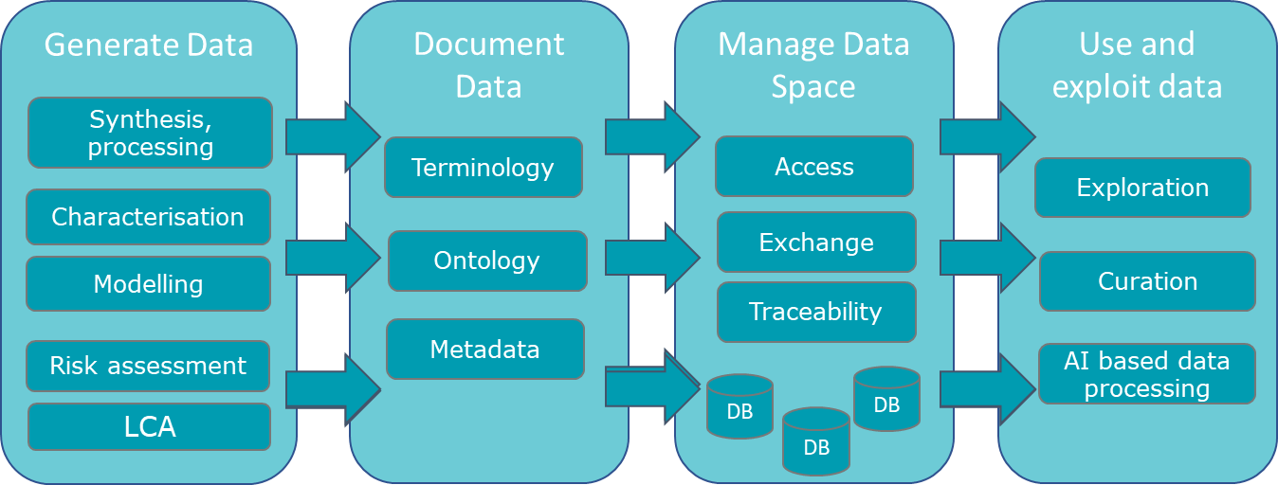
A Common Materials Data Space interconnected with Manufacturing and PLM
Manufacturing and Product Life Cycle
Materials, Product and Service Digitalisation
Materials Development, Use and Management

Slide 27
WG2
Materials Production
and Processing
Marta Candeias, ETP MANUFUTURE
José Carlos Caldeira, ETP Manufuture

Slide 28
Materials Production & Processing
Priorities identified in the MATERIALS 2030 Roadmap
Strengthen the strategic collaboration between materials, digital and production technologies ETPs
Include the development/adaptation of respective digital and production technologies in advanced materials, components and products R&D projects, to increase the TRLs and reduce time-to-market of the complete solution (link to ‘Value Chain’)
Eco-develop materials, production, processing, and products for sustainable solutions
Develop ‘channels’ to support data exchange/sharing between materials development, digital and production technologies development and user companies (link to ‘Data’)
Promote collaboration between materials developers with relevant digital and production technologies initiatives

Slide 29
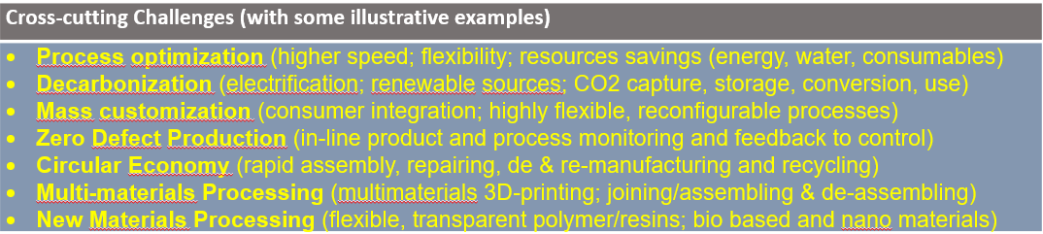
Materials Production & Processing
Cross-cutting challenges
Development
Production
Processing
Integration
Use
End of Use

Slide 30
GLOBAL PROBLEMS & NEEDS
What it means regarding MATERIALS PRODUCTION & PROCESSING?
Pressure to develop new (or improved) sustainable production and processing technologies and solutions, integrating new requirements on sustainable materials, circularity , CO₂ emissions…
PROBLEMS
The faced challenges, failures, gaps,…
NEEDS
R&I, Industrial, Regulatory,…
New solutions to reduce costs and risks and to accelerate and shorten Materials development cycles and uptake
Stakeholders aligned & integrated on common goals with shared benefits
(Blue sky research – Materials producers – Products manufacturers – Strategic value chains – End users/Citizens – Different policy makers (EU/MS/Regions)),
Ambitious and coordinated investments (skills, resources, infrastructures…) to achieve critical mass for the innovation markets serving the twin green and digital transition
EU policy frameworks including aligned strategies towards industrial competitiveness and the twin green and digital transition
Increased autonomy on Raw and Advanced Materials
(Improve resources efficiency, reduce imports, develop substitutes,…)
Secured, circular symbiotic value chains maximising materials efficiency and materials knowledge sharing
Increased complexity in the development of new materials due to a profound transformation towards a safe and sustainable society
Fragmentation among the different players
Challenged European leadership on Advanced Materials Innovation
Challenged European Advanced Materials manufacturing competitiveness
Vulnerable linear value chains unsuited for the exponential increase in demand driven by the green transition
Collaborative developments between value chain stakeholders, namely materials developers & producers / products manufacturers / recyclers / ...
Framework guidance on digital and production technologies in advanced materials, components and products for R&D, technological infrastructures; pilot lines, test-beds, hubs, etc.
More efficient production and processing technologies, including for recycling and quality assurance activities
Recycling technologies, business models and markets for closing the advanced materials circular value chain
AMI2030 – 11 Janaury 2023

Slide 31
GLOBAL EXPECTED OUTPUTS & RESULTS
Contribution from MATERIALS PRODUCTION & PROCESSING
EXPECTED OUTPUTS
EXPECTED RESULTS
The collaborative development of materials and related production and processing technologies will be a game changer, namely in what concerns time to market of the new materials, components and products
Game changers (e.g. MAPs, OITBs, digital twins, modeling tools, data spaces,…) for AdMat
Systemic collaborations integrating all stakeholders along the AdMat Value Chains
Common toolbox (the “Materials Commons”) to support the development of safe and sustainable Materials/Products compliant with regulations, standards, frameworks, product passport, …
Synergies between regional, national, European and international initiatives and programmes
Accelerated development of safe and sustainable advanced materials and associated process technologies
Rapid design of innovative materials and their integration into products & technos serving strategic innovation markets
Closing the « Materials loop » towards a circular safe and sustainable society
Maximising the overall impact of all funding & financing levels in Europe
New efficient dismantling and recycling technologies, solutions and business models will bring circular economy closer to reality
Taking full advantage of the horizontal nature of these technologies, via cross fertilization, efficient utilization of existing and new infrastructures and appropriate multi-level public policies and programmes, will make them available and accessible for a large number of companies, sectors and regions
AMI2030 – 11 Janaury 2023

Slide 32
PROPOSED ACTIONS
WG2 – MATERIALS PRODUCTION & PROCESSING
PROPOSED ACTIONS
Set up tools encompassing design, manufacturing, circularity and testing principles for fast and scalable advanced materials development (replicable from one IM to another)
Develop and implement recycling technologies, business models and markets for closing the advanced materials circular value chain
Facilitate/ensure access for industry (incl. SMEs, Mid-Caps and start-ups) to product innovation services integrating performant, cost-competitive and sustainable advanced materials
Promote upskilling and re-skilling
Building a common Data Space ensuring a true ‘materials centric’ partnership across the materials stakeholders / ecosystems with materials data & information at the core
Enable, ensure and guarantee product & service digitalization along VCs based on materials transparency, traceability,…
AMI2030 – 11 Janaury 2023

Slide 33
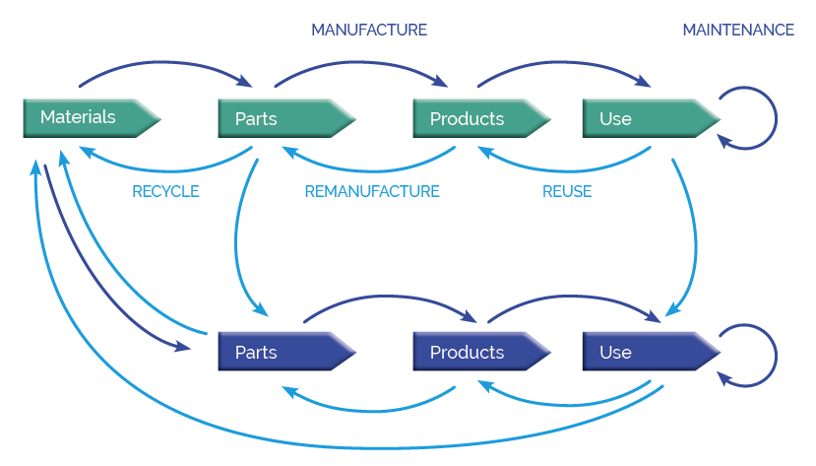
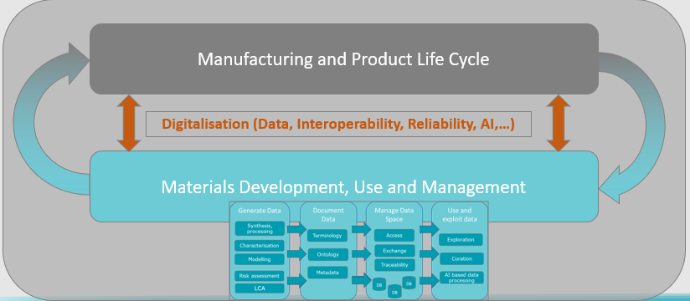
PROPOSED ACTIONS
Develop and implement recycling technologies business models and markets for closing the advanced materials circular value chains
(Source: MANUFUTURE SRIA 2030)
MATERIALS PRODUCTION AND PROCESSING
We need the appropriate technologies and solutions to address the entire value chain
We need stronger links (including Data links) between the materials development, production and processing (ex.: frequently, the “relation” between materials and parts/products is established/defined in the processing stage)

Slide 34
PROPOSED ACTIONS
Facilitate/ensure access for industry (incl. SMEs, Mid-Caps and start-ups) to product innovation services integrating performant, cost-competitive and sutainable advanced materials
Support the development/test/validation of advanced materials and the respective production and processing technologies (from proof of concept till industrial validation)
  Open Innovation Test Beds
  Innovation hubs
  Pilot lines
Dissemination and cross fertilization
  Demonstrators
  Incentives and support for further exploitation
AMI2030 – 11 Janaury 2023

Slide 35
WG3
Policy Support
Justin van Schepen, CEFIC
Flemming Cassee, RIVM
Christian Seitz, SusChem ETP

Slide 36
Policy support
Priorities identified in the MATERIALS 2030 Roadmap
Promote and facilitate measures for safe and sustainable-by-design
Promote and facilitate harmonization of norms and standards to enhance Europe’s global competitiveness
Ensure robust health and safety protocols are followed to protect Europe’s citizens and the environment
Foster education and training across the value chains
AMI2030 – 11 Janaury 2023

Slide 37
GLOBAL PROBLEMS & NEEDS
What it means regarding POLICY SUPPORT ?
PROBLEMS
The faced challenges, failures, gaps,…
NEEDS
R&I, Industrial, Regulatory,…
Materials diversity of “Advanced Materials”
Regulatory approaches in its infancies (SSbD)
Long times-to-market for AMs
New stakeholders in the transition to circular value chains
Massive investments in technology and manufacturing in other regions (i.e. IRA)
Separate policy frameworks in value chains
Exchange and dialogue between policy makers, science and manufacturing
Cross-segmental collaboration along the value chain steps into the down-stream applications
(9 Materials Innovation Markets)
Materials transparency (DPP)
A coherent EU policy framework including aligned strategies towards industrial competitiveness and the twin green and digital transition
Focused innovation and funding activities (maximising the impact of funding measures as part of innovation strategies )
AMI2030 – 11 Janaury 2023

Slide 38
GLOBAL EXPECTED OUTPUTS & RESULTS
Contribution from POLICY SUPPORT
EXPECTED OUTPUTS
EXPECTED RESULTS
Strategically aligned, joint R&I activities to support the development of SSbD advanced materials supporting the targets of the twin transition
Leveraged benefits of digitalization in all aspects of Advanced Materials development, manufacturing, use and EoL management integrating all stakeholders along the AdMat Value Chains
Transparency of regulations, legislation, specifications and norms and defined approaches for a seamless material and information flow among AM stakeholders
Synergies between regional, national, European and international initiatives and programmes
Transparency of global regulatory aspects regarding Advanced Materials
Accelerated development of safe and sustainable advanced materials and associated process technologies
  Proposals for implementation of SSbD standards in the innovation process
  Suggestions for supportive policy actions
Rapid design of innovative materials and their integration into products & technologies serving strategic innovation markets
Closing the « Materials loop » towards a circular safe and sustainable society
  Support of universally applicable material standards for material circularity
  Support of common understanding of issues and a joint “language” of AM along the VC
Maximising the overall Impact of all funding & financing levels in Europe
AMI2030 – 11 Janaury 2023

Slide 39
PROPOSED ACTIONS
WG3 – POLICY SUPPORT
PROPOSED ACTIONS
Set up tools encompassing design, manufacturing, circularity and testing principles for fast and scalable advanced materials development (replicable from one IM to another)
Promote upskilling and re-skilling
Building a common Data Space ensuring a true ‘materials centric’ partnership across the materials stakeholders / ecosystems with materials data & information at the core
Enable, ensure and guarantee product & service digitalization along VCs based on materials transparency, traceability,…
Support the deployment of the SSbD framework; Contribute to a common understanding regarding health, safety and sustainability issues
Demonstrate the key enabling role of advanced materials in achieving the twin green and digital transition, EU resilience and strategic open autonomy
Contribute to policy development with the objective to enable the development and uptake of safe and sustainable advanced materials
AMI2030 – 11 Janaury 2023

Slide 40
PROPOSED ACTIONS
WG3 – POLICY SUPPORT
Contribute to policy development with the objective to enable the development and uptake of safe and sustainable advanced materials
  Identification of road blocks and proposals for a supportive legislative framework
  Define use cases for implementation of DPPs
  Definition of « regulatory sandboxes »
  Support and contribute to FAIR data
Support the deployment of the SSbD framework; contribute to a common understanding regarding health, safety and sustainability issues
  Establish collaborations with downstream users (leverage on existing intiatives like IRISS)
  Elaborate and engage in use cases for SSbD focused on AMs
Promote upskilling and re-skilling
  Foster communication across stakeholder groups
AMI2030 – 11 Janaury 2023

Slide 41
WG4
Materials Innovation Markets
Eva Schillinger, ETP SusChem

Slide 42
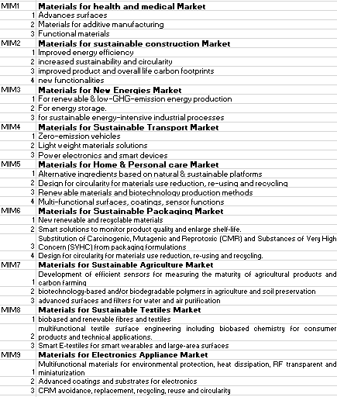
WG4 – Materials Innovation Markets (MIMs)
SCOPE
Focus on advanced materials by and across 9 MIMs (initial selection, spill-over approach to be applied)
Priorities identified in MATERIALS 2030 Roadmap
HEALTHCARE
PACKAGING
CONSTRUCTION
AGRICULTURE
NEW ENERGIES
TEXTILES
TRANSPORT
ELECTRONICS APPLICANCES
HOME &
PERSONAL CARE
AMI2030 – 11 Janaury 2023

Slide 43
(Digital) tools and overarching design/R&I/… guidelines for each MIM
Efficient and seamless translation of basic R&I into upscaling/
manufacturing processes/systems integration/final products along the value chains
GLOBAL PROBLEMS & NEEDS
What does it mean for MATERIALS INNOVATION MARKETS?
PROBLEMS
The faced challenges, failures, gaps,…
NEEDS
R&I, Industrial, Regulatory,…
Increased complexity in the development of new materials due to a profound transformation towards a safe and sustainable society
Fragmentation among the different players
Challenged European leadership on Advanced Materials Innovation
Challenged European Advanced Materials manufacturing competitiveness
Vulnerable linear value chains unsuited for the exponential increase in demand driven by the green transition
New solutions to reduce costs and risks and to accelerate and shorten Materials development cycles and uptake
Stakeholders aligned & integrated on common goals with shared benefits
(Blue sky research – Materials producers – Products manufacturers – Strategic value chains – End users/Citizens – Different policy makers (EU/MS/Regions)),
Ambitious and coordinated investments (skills, resources, infrastructures…) to achieve critical mass for the innovation markets serving the twin green and digital transition
EU policy frameworks including aligned strategies towards industrial competitiveness and the twin green and digital transition
Increased autonomy on Raw and Advanced Materials
(Improve resources efficiency, reduce imports, develop substitutes,…)
Secured, circular symbiotic value chains maximising materials efficiency and materials knowledge sharing
Complementing previous point
R&I friendly policy frameworks that support accelerated activities
MIMs mainly driven by key raw /advanced materials
Crucial advanced materials technology enabling building blocks in moving towards green and sustainable materials. Cross-fertilization across MIMs & value chains
AMI2030 – 11 Janaury 2023

Slide 44
EXPECTED OUTPUTS & RESULTS
MATERIALS INNOVATION MARKETS
Platforms providing (digital) tools and overarching design/R&I/… guidelines for each MIM for faster delivery of safe and sustainable of advanced materials solutions
MIMs specific and cross-MIMs designs for faster technology adoption and uptake
EXPECTED OUTPUTS
EXPECTED RESULTS
Game changers (e.g. MAPs, OITBs, digital twins, modeling tools, data spaces,…) for AdMat
Systemic collaborations integrating all stakeholders along the AdMat Value Chains
Common toolbox (the “Materials Commons”) to support the development of safe and sustainable Materials/Products compliant with regulations, standards, frameworks, product passport, …
Synergies between regional, national, European and international initiatives and programmes
Accelerated development of safe and sustainable advanced materials and associated process technologies
Rapid design of innovative materials and their integration into products & technos serving strategic innovation markets
Closing the « Materials loop » towards a circular safe and sustainable society
Maximising the overall impact of all funding & financing levels in Europe
Advanced material solutions enabling circular value chains for MIMs
Strategic and competitive advanced materials solutions acceleration to market
AMI2030 – 11 Janaury 2023

Slide 45
PROPOSED ACTIONS
WG4 – INNOVATION MARKETS
PROPOSED ACTIONS
Set up tools encompassing design, manufacturing, circularity and testing principles for fast and scalable advanced materials development (replicable from one IM to another)
Reduce and substitute critical raw materials
Create and promote sustainable material sourcing
Develop and implement recycling technologies, business models and markets for closing the advanced materials circular value chain
Facilitate Innovation uptake (consistent funding instruments pipeline, cross-fertilisation/ results dissemination /upscaling facilities ...)
Facilitate/ensure access for industry (incl. SMEs, Mid-Caps and start-ups) to product innovation services integrating performant, cost-competitive and sustainable advanced materials
Foster the presence of the entire value chain in innovation/development programs
Promote upskilling and re-skilling
Building a common Data Space ensuring a true ‘materials centric’ partnership across the materials stakeholders / ecosystems with materials data & information at the core
Enable, ensure and guarantee product & service digitalization along VCs based on materials transparency, traceability,…
Support the deployment of the SSbD framework; Contribute to a common understanding regarding health, safety and sustainability issues
Demonstrate the key enabling role of advanced materials in achieving the twin green and digital transition, EU resilience and strategic open autonomy
AMI2030 – 11 Janaury 2023

Slide 46
PROPOSED ACTION
Set up tools encompassing design, manufacturing, circularity and testing principles for fast and scalable advanced materials development (replicable from one IM to another) (WG1-4)
Create common data space for FAIR data
Identify common enabling parameters/design principles/(manufacturing) technologies/testing needs to be leveraged between the MIMs
Develop & implement base tools and methodologies on these common principles
Generate recommendations towards regulations & standardization
AMI2030 – 11 Janaury 2023

Slide 47
PROPOSED ACTION
Reduce and substitute critical raw materials (WG4)
Identify critical raw material (classes) across 9 MIMs with strategic focus
Devise strategy for reduction of raw material needs (efficiency increases, manufacturing technologies etc…)
Develop innovation strategies and substitution timelines of critical raw materials
Explore potential scope of international cooperation on critical raw materials reduction/substitution
AMI2030 – 11 Janaury 2023

Slide 48
PROPOSED ACTION
Create and promote sustainable material sourcing (WG1+4)
Analyse 9 MIM value chains as to common raw material needs (also taking into consideration needed quality of raw material)
Identify existing possibilities and gaps for sustainable material sourcing
Devise strategy to implement sustainable material sourcing for the existing options and identified gaps
Develop timelines for implementation of sustainable material sourcing for the existing options and identified gaps
Explore potential scope of international cooperation on sustainable material sourcing
Action strongly connected to the need for identification of enabling technologies for achievement of circularity
AMI2030 – 11 Janaury 2023

Slide 49
PROPOSED ACTION
Demonstrate the key enabling role of advanced materials in achieving the twin green and digital transition, EU resilience and strategic open autonomy (WG3, 4, 5)
Analysis for common gaps/needs/enablers for 9 MIMs (e.g. need for circularity, energy storage…)
Identify case studies based on advanced materials that address these gaps/needs/enablers serving strategic innovation markets
Evaluate case studies in the dimension of sustainability, digitalization, EU resilience (e.g. raw material usage) and strategic open autonomy (e.g. translation of high R&I expertise in EU into superior advanced materials products)
AMI2030 – 11 Janaury 2023

Slide 50

Your feedback
Possibility to send comments on the slides to AMI (with copy to DG RTD under functional mailbox) – preferably for AMI 2030 until 25/01
  Commission: RTD-E3-EXPGRP-ADVANCED-MATERIALS@ec.europa.eu
  AMI2030: info@ami2030.eu
Presentations and recording from this workshop will be available on:
  Commission website: Advanced materials and chemicals
  AMI website: https://www.ami2030.eu/

Slide 51
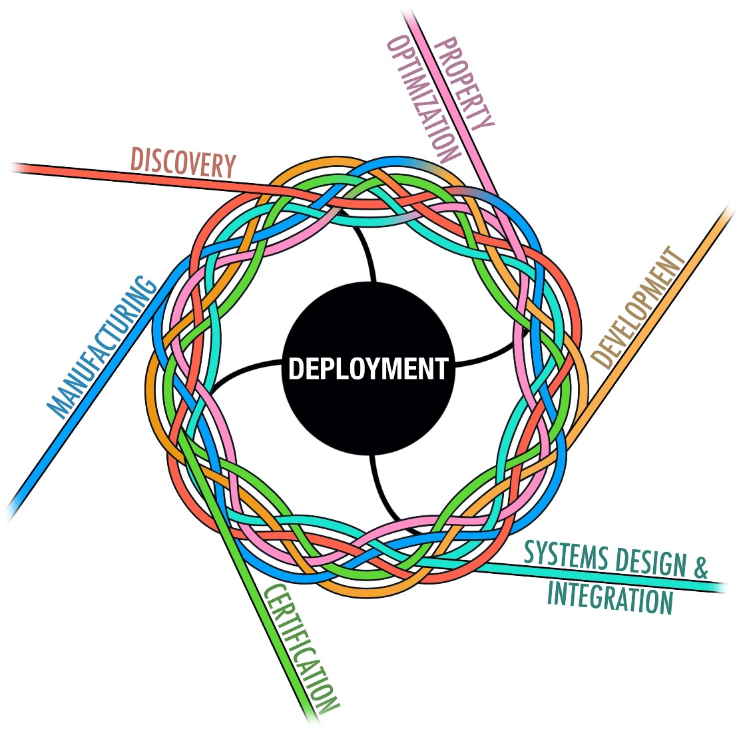
Do not forget the international dimension: Example I
US: Materials Genome Initiative www.mgi.gov
The 2021 strategic plan identifies three goals to expand the impact of the initiative over the coming five years:
  Unify the Materials Innovation Infrastructure (MII), a framework of integrated advanced modeling, computational and experimental tools,
  and quantitative data
  Harness the power of materials data
  Educate, train, and connect the materials research and development workforce

Slide 52
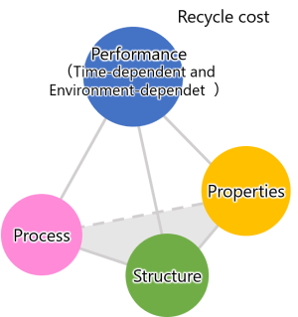
Do not forget the International dimension
Example II: Japan
Japan: Materials Integration by Network Technology https://www.nims.go.jp/MaDIS/en/MInt.html
Initiative of National Institute of Materials Sciences (NIMS)
The goal is to accelerate the development of materials
by connecting the four elements of materials engineering:
  process,
  structure,
  properties,
  and performance,
using computers and information science methods, including AI
NIMS in collaboration with industry developed an AI technique capable of increasing
the accuracy of machine learning-based predictions of material properties
  https://www.nims.go.jp/eng/news/press/2021/10/202110250.html

Slide 53
Further background :
Open Innovation Test Beds
Physical facilities for development, testing, upscaling of nanotechnology and advanced materials in industrial environments
Horizon 2020 and Horizon Europe: € 319M granted to 29 projects in 10 different fields:
  Characterization
  Lightweight, nano-enabled multifunctional composite materials and components
  Materials for building envelopes
  Nano-enabled bio-based materials
  Nano-enabled surfaces and membranes
  Nano-pharmaceuticals production
  Safety testing of medical technologies for health
  Open innovation platform for materials modelling
  Climate neutral and circular innovative materials technologies
  Hydrogen production technologies
Ongoing analysis of the first OITBs on lessons learnt

Slide 54
Recap: HORIZON-CL4-2023-RESILIENCE-01-39: Coordination and knowledge sharing across materials development communities (CSA)
Indicative budget of the call: 2 million EUR
EU contribution per project: 2 million EUR
Type of Action: Coordination and support action (CSA)
This action contributes to the aim for an accelerated materials development supporting the goals of the twin transition.
This action considers precisely that aspect of the data generated, and the knowledge required to achieve the target of a faster and outcome-driven materials.
This action is meant to contribute to the systemic approach called for in the Manifesto:
  to ensure that data and knowledge from a wide range of methods employed in materials R&I is well integrated and available along value chains
  to ensure that data and knowledge obtained in one field of materials development (targeted towards a particular market) can also be used/re-used on other value chains/innovation markets.
  to ensure that this data and knowledge system works better for the end users.

