Slide 2

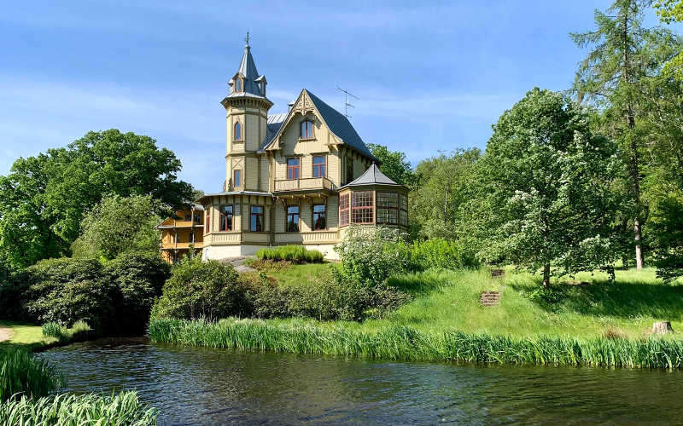

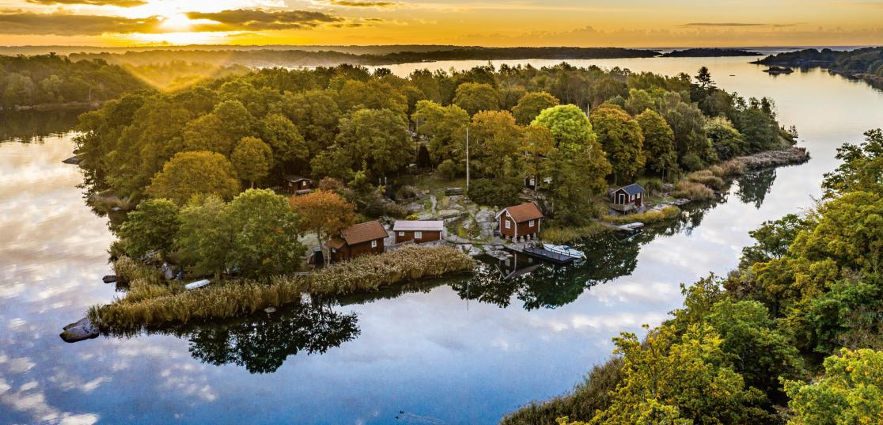
Welcome to
Blekinge

Slide 4
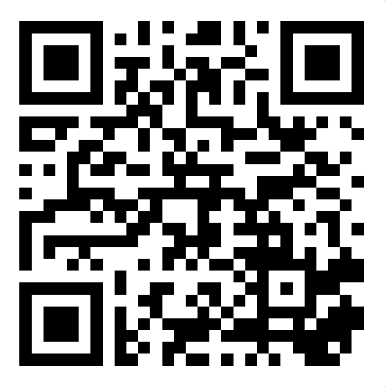
Slido
To access Slido on your mobile phone, either:
Scan the QR code or
Go to slido.com and enter the passcode 9324656

Slide 5
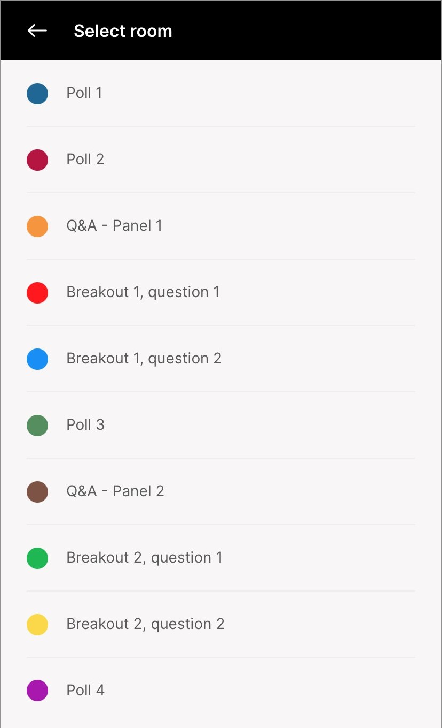
Slido – Poll 1
From which country are you
joining us today?

Slide 6
Social media
#EUmissions
#HorizonEU
#MissionClimateAdaptation
#MissionForum23

Slide 7
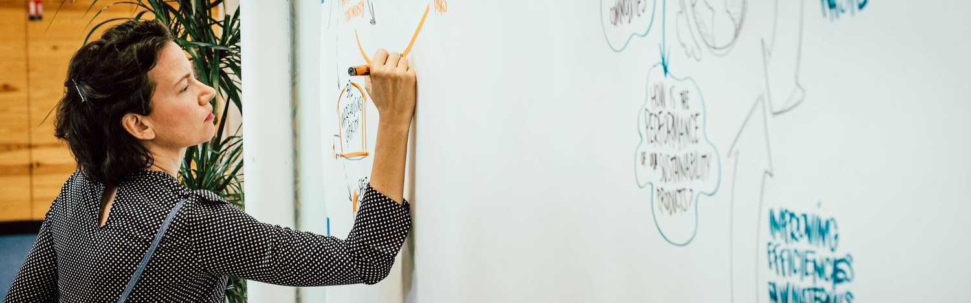
Carlotta Cataldi graphic recorder

Slide 8
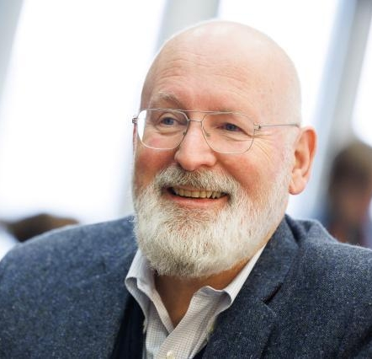
Frans Timmermans
European Commission’s Executive Vice-President for the European Green Deal and Commissioner for Climate Action Policy

Slide 9
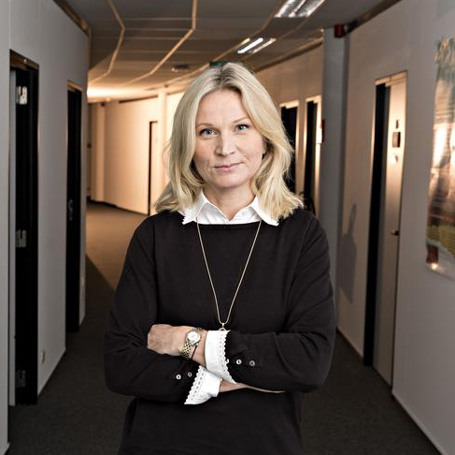
Elina Bardram
Mission Manager (Director DG CLIMA) European Commission

Slide 10
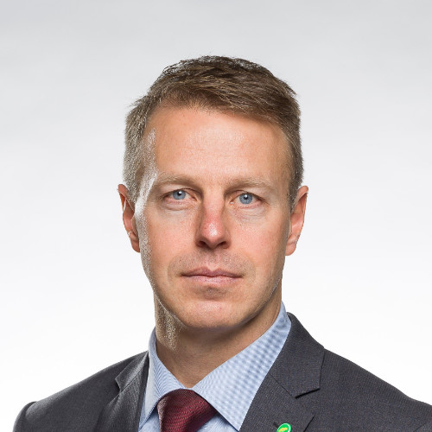
Lars Friberg
Climate Strategist, Vinnova

Slide 11
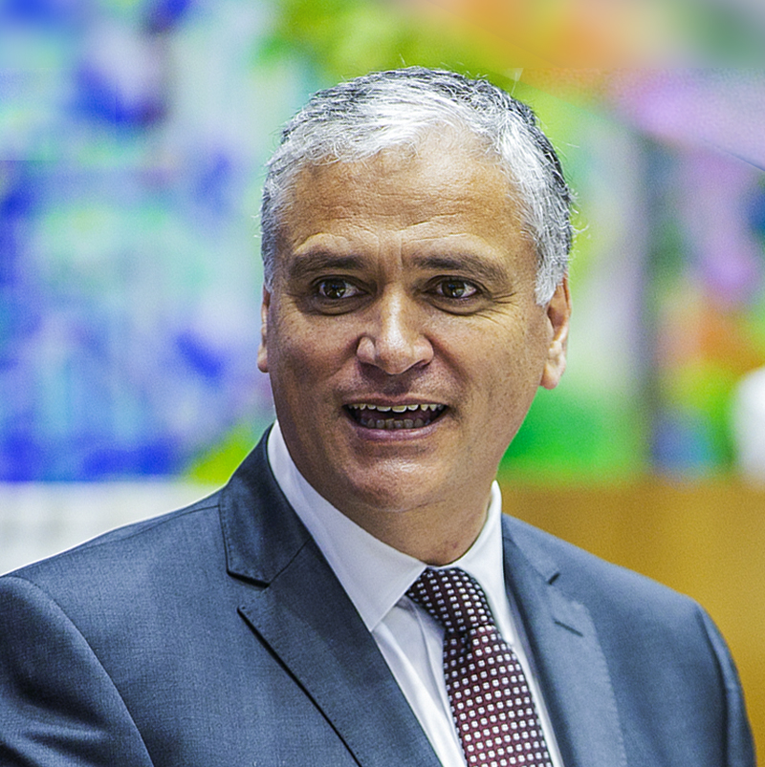
Vasco Alves Cordeiro
President of the European Committee of the Regions

Slide 12
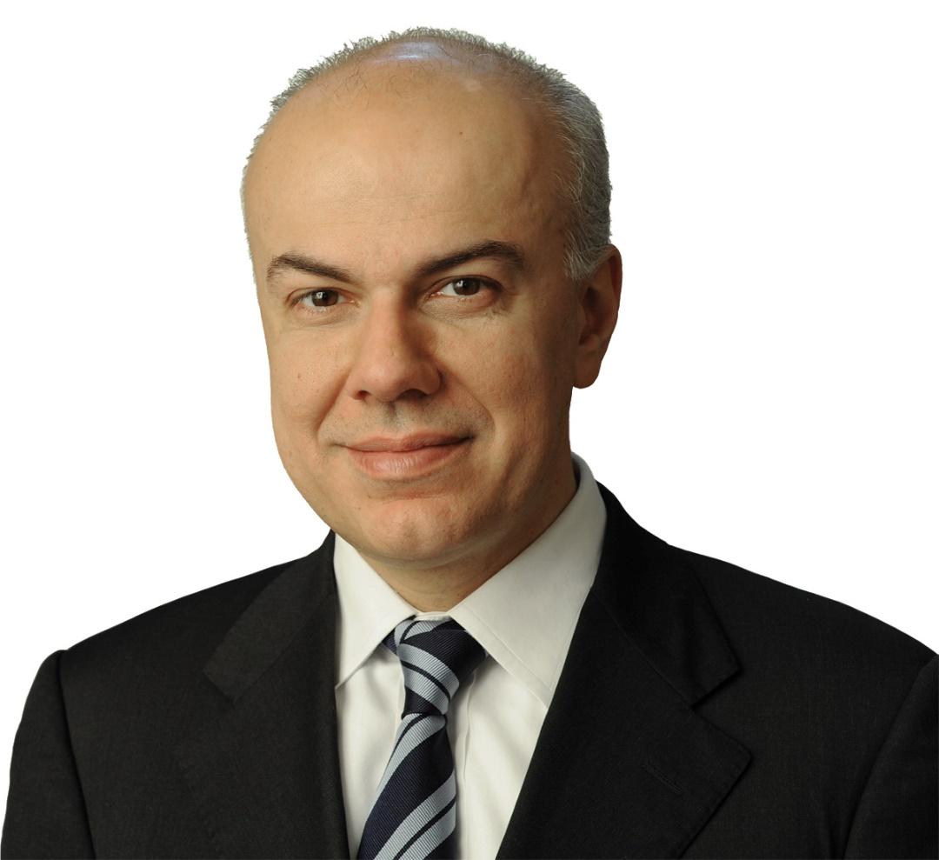
Lightening talk
Edoardo Croci
Professor of Practice and Director of the Sustainable Urban Regeneration Lab at Bocconi University

Slide 13
Slido - Poll 2
Since its launch, the Mission helped
improve the collaboration between
national, regional, local, and other
actors on climate adaptation?

Slide 14
Panel discussion: How to increase collaboration between national authorities, regions and other Mission actors to deliver on adaptation?
Moderated by Philippe Tulkens
Deputy Mission Manager, Head of Unit (DG for Research & Innovation) European Commission

Slide 15
Q&A
Please go to ‘Q&A - Panel 1’ in Slido

Slide 16
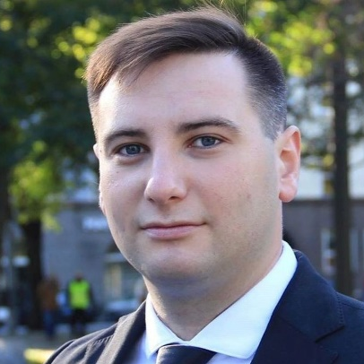
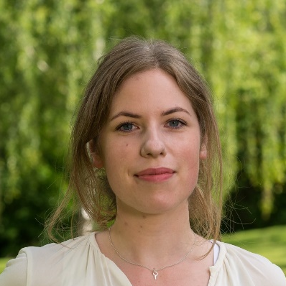
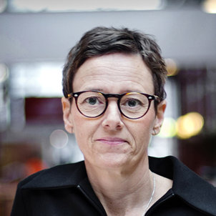
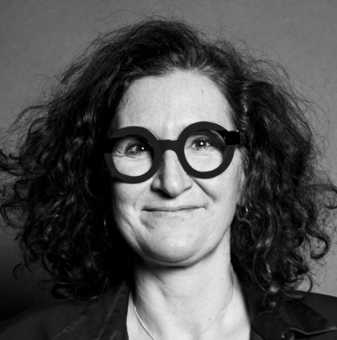
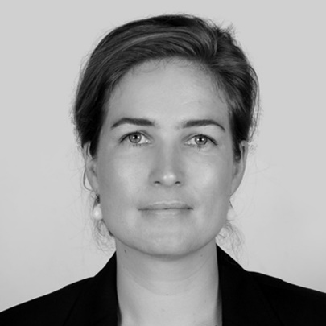
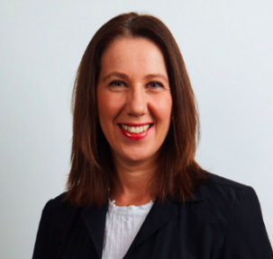
Vladimir Svet
Deputy Mayor of Tallinn, Estonia
Klara Ellström
Committee of the Regions Young Elected Politician and local elected politician for Uppsala kommun, Sweden
Erika Augustinsson
Innovation Strategist, Region Blekinge, Sweden
Miriam Haritz
President of International Commission for the Protection of the Rhine
Nina Alsen
Senior Policy Officer, Ministry for the Environment of Germany
Alison Gilliland
Dublin City Councillor and member of the Committee of the Regions

Slide 17
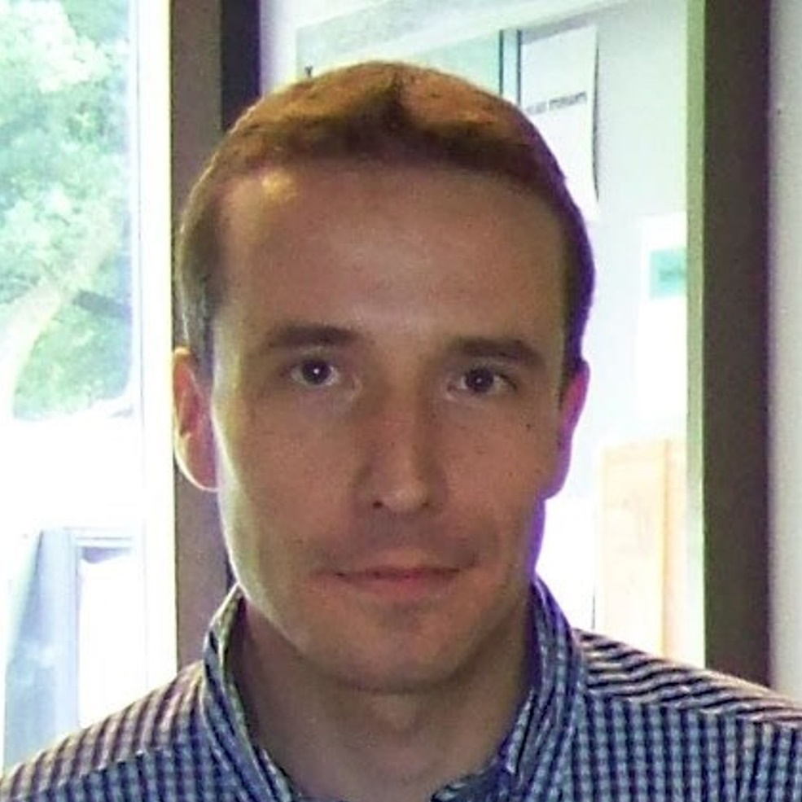
Project showcase
Benjamin Dewals
Professor in Hydraulic Engineering and Water Resources Management, University of Liege

Slide 18

Benjamin Dewals, University of Liège (BE)

Slide 19
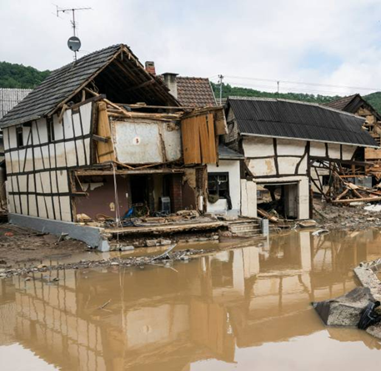
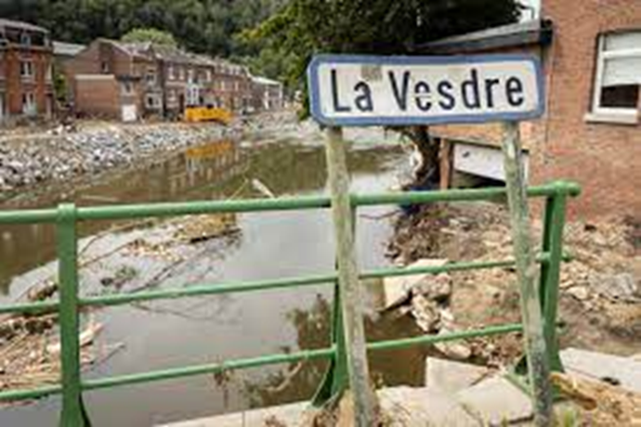
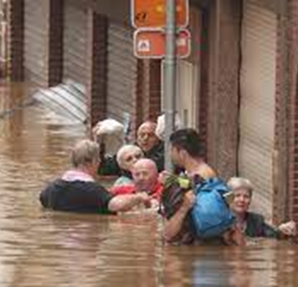
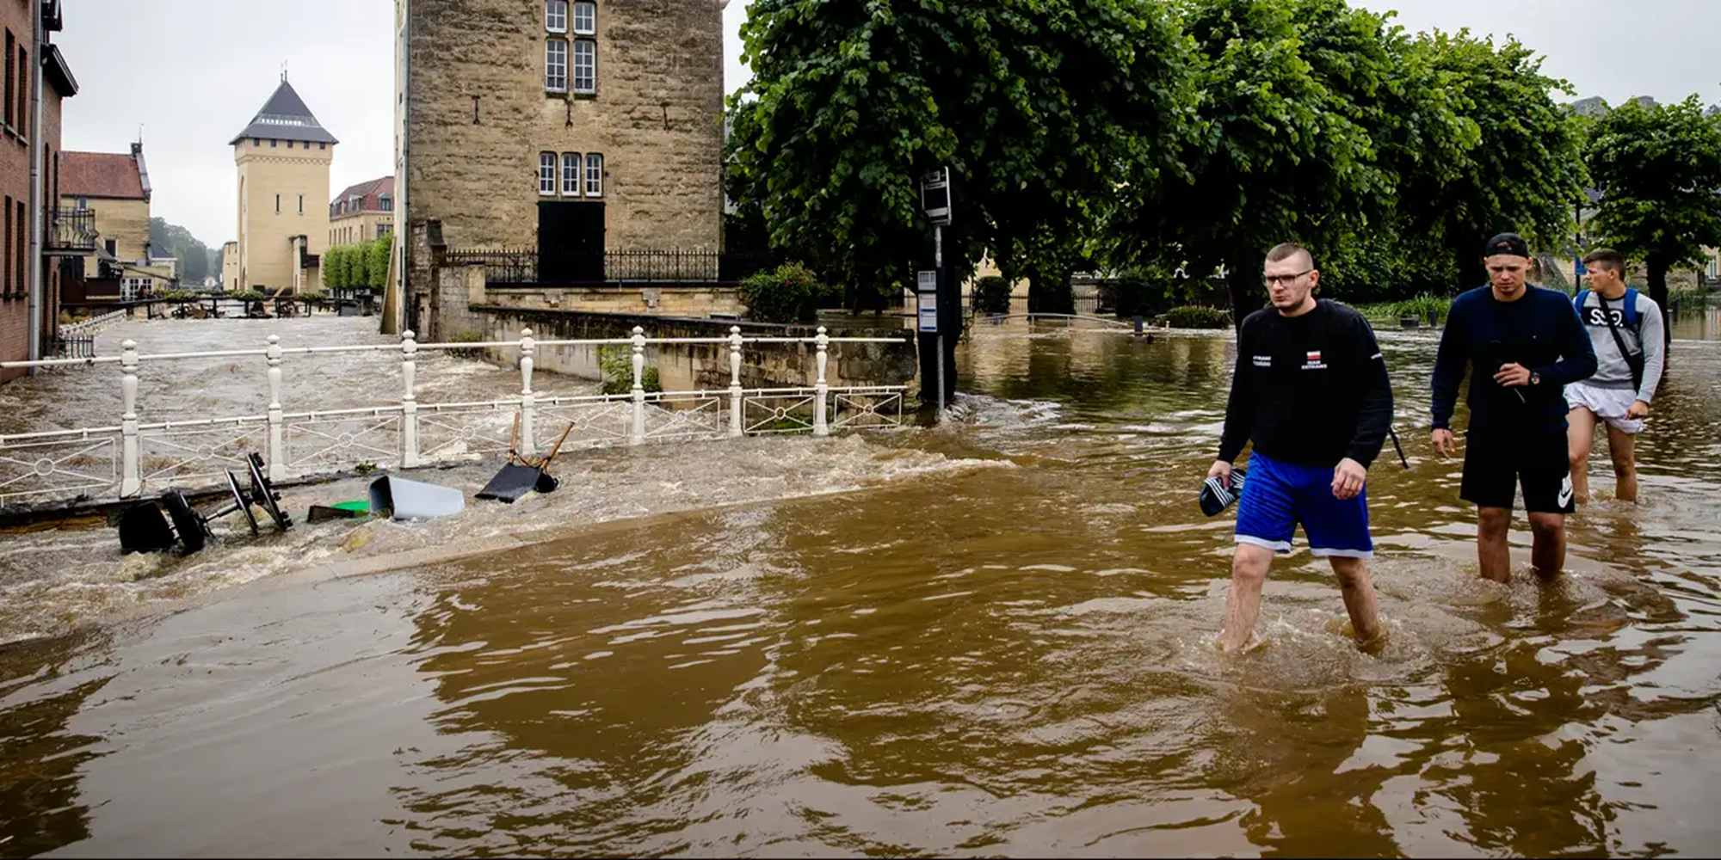
The 2021 summer floods caused devastation in north-west Europe
220+ fatalities
30+ billion Euros in damage
Notes:
Severe flooding across GE, BE, NL
Rain
Impacts
The tragic result:
In total 225 people lost their lives
Many ten-thousend people were evacuated
Great number still not returned to their homes
Of which many will never return to their former home
More than 30 billion euro damage

Slide 20
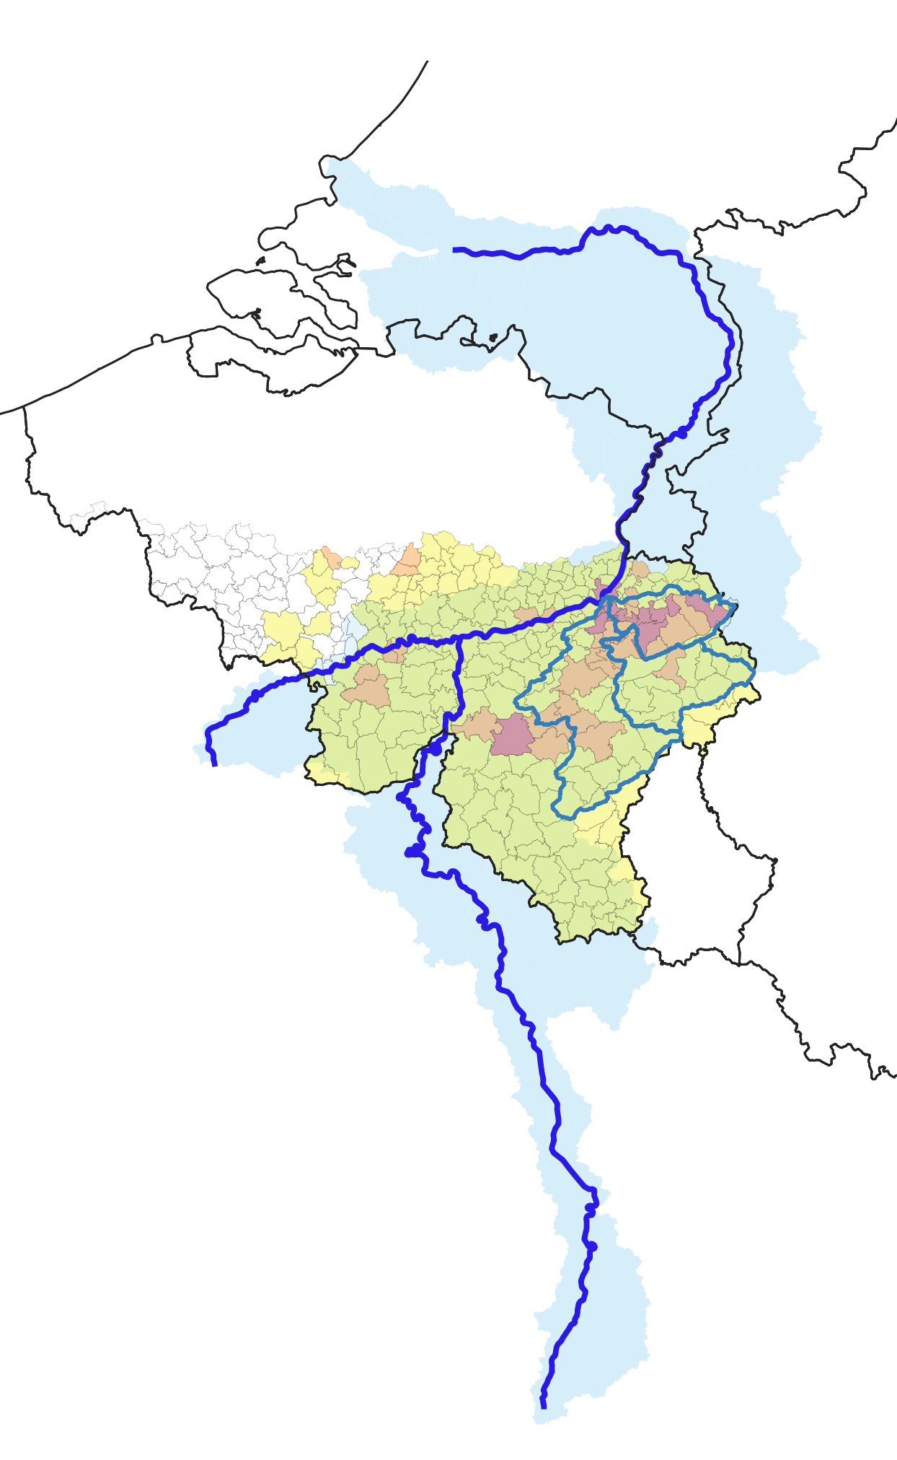
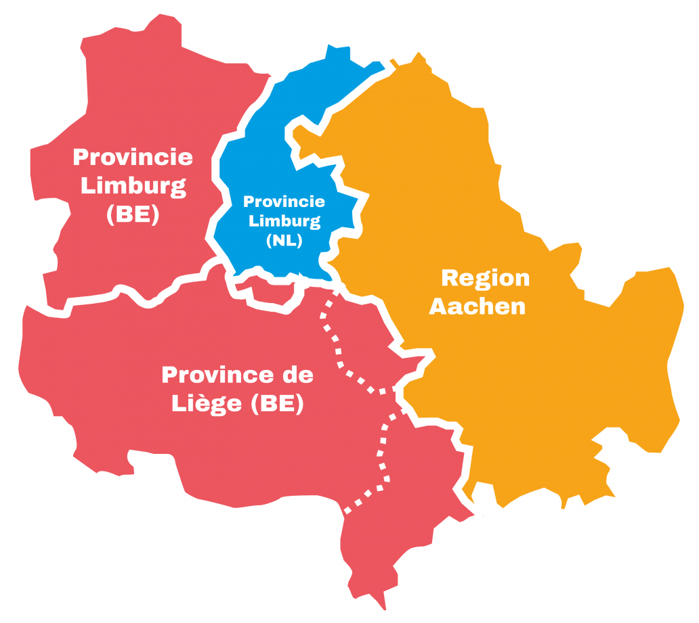
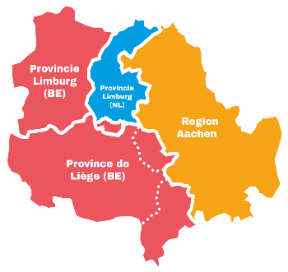
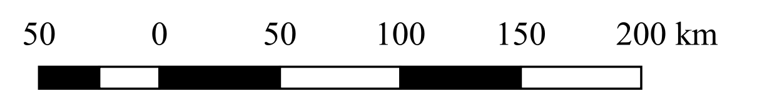
Opportunity through Interreg EMR
THE NETHERLANDS
Partnership
National, regional,
and local authorities
Knowledge institutes
NORTH SEA
GERMANY
BELGIUM
FRANCE
Meuse basin
Budget
5.1 M Euros
Notes:
Because it can and it will happen again
To work together on a necessary international level
To increase insights and improve preparedness
To stimulate awareness and set up early warning systems
As a stepping stone to a lasting alliance
For the challenge we are facing is huge

Slide 21









WP 1. Improving weather measurements
WP 2. Improving flow measurements
WP 3. Improving forecast models
Starting condition
Physically plausible
Q
forecast time
Q
Meuse catchment
time
T (return period)

Slide 22
WP 1. Improving weather measurements
WP 2. Improving flow measurements
WP 3. Improving forecast models
WP 4. Influence of debris and vegetation
WP 5. Risk maps, impact and effects
WP 6. Masterplan

Slide 23



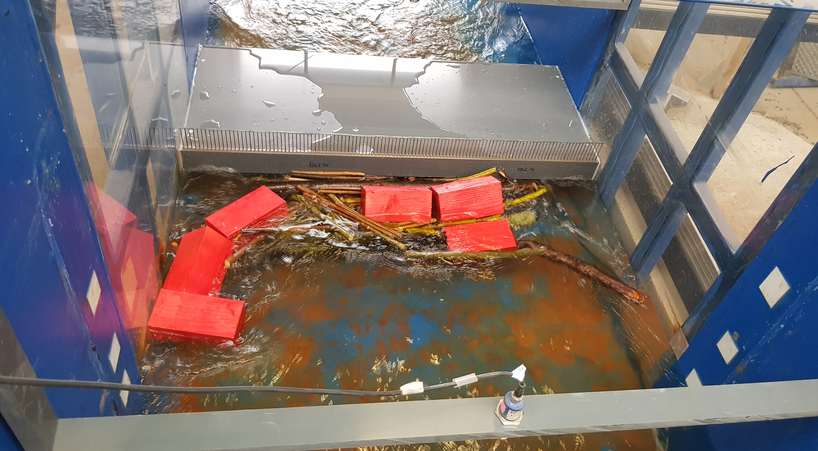
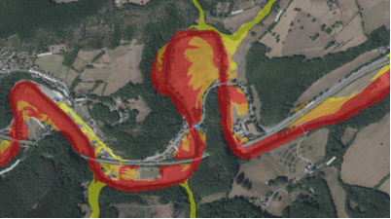

Intense cross-border collaboration
Addressing consequences of bridge clogging by floating debris
Field evidence (transboundary coverage)
Laboratory experiments
(in labs in three countries)
Design recommendations
and operational procedure

Slide 24

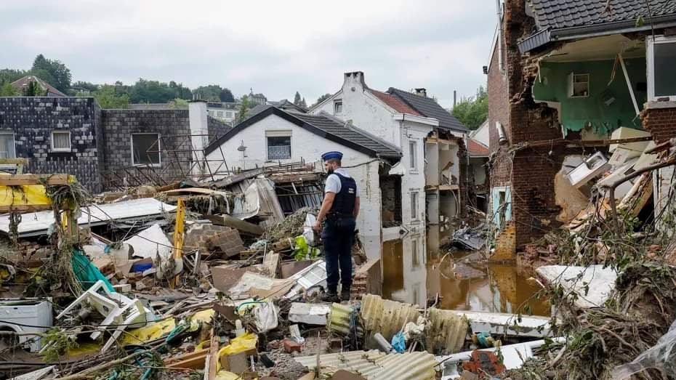
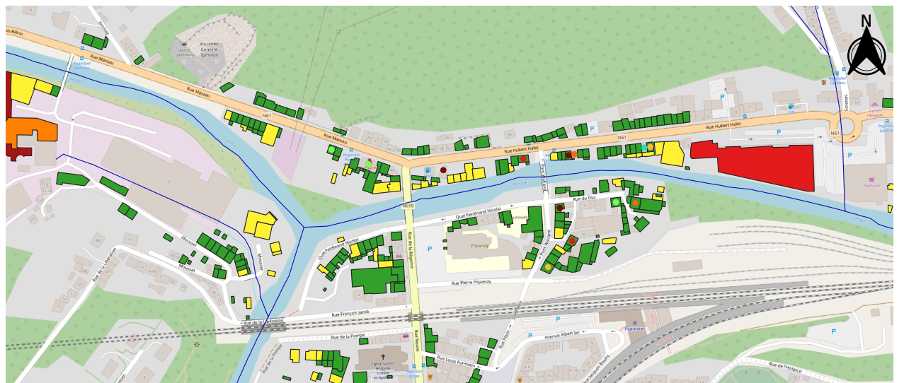
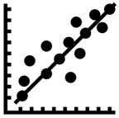
Intense cross-border collaboration
Predictive modelling of flood impacts (monetary losses)
Survey on current procedures across EMR
Transboundary
field data collection
Upgrade of flood impact
models and procedures

Slide 25
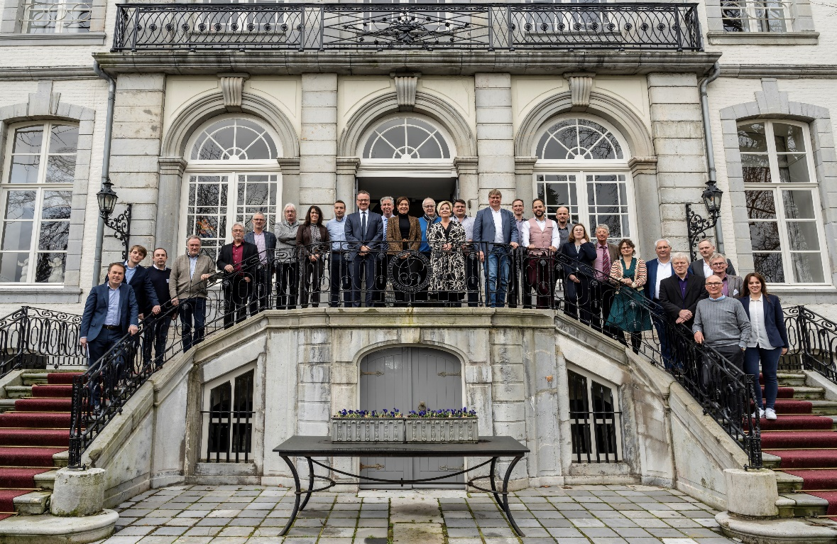
Paving the way for climate resilience across the EMR
International Agenda on Floods and Water Safety -
Climate Resilience in the Euregion Meuse-Rhine (EMR)
Strong and lasting commitment of parties, capitalizing on the momentum created by the 2021 floods
Work on the facilities and instruments needed to make it all possible
Set an example on a European level

Slide 26


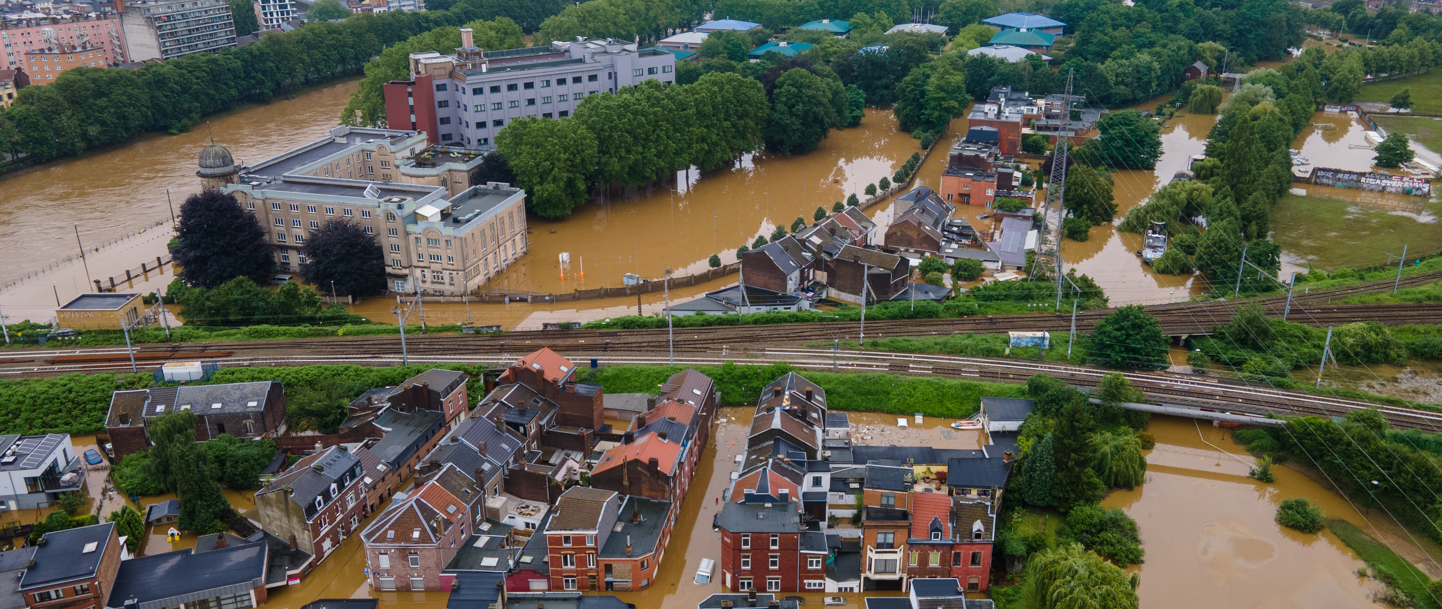

Benjamin Dewals, University of Liège (BE)
www.uliege.be

Slide 27
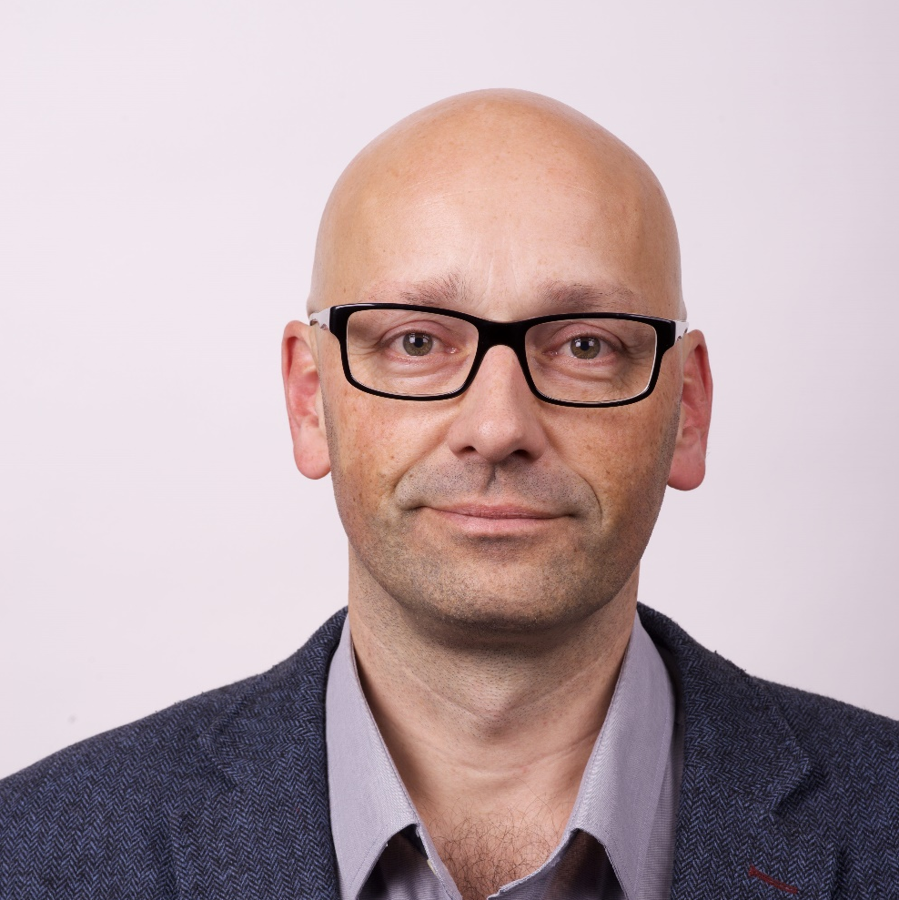
Project showcase
Robert Johannesson
Head of Urban and Rural Unit at Boverket, the Swedish National Board of Housing, Building and Planning

Slide 28
New European Bauhuas
Examples from Sweden
Robert Johannesson

Slide 29


The planning and building act
1 § This Act contains provisions on the planning of
land and water and on construction. The provisions aim to, with regard to the freedom of the individual, promote
a societal development with equal and good social living
conditions and a good and long-term sustainable living environment for the people in today's society and for future generations.
Foto: Scandinav
Notes:
The theme of today is sustainability and of course in connection to the building of the nobel center here in stockholm
Sustainable living environments is actually the fundation for the swedish planning and building act.
(The provisions aim to, with regard to the freedom of the individual, promote
a societal development with equal and good social living conditions and a good and long-term sustainable living environment for the people in today's society and for future generations. )
It points out that sustainability is about environmental issues but also about equal and good social living conditions for people now and in the future. The act has a life centered and longterm perspective.

Slide 30
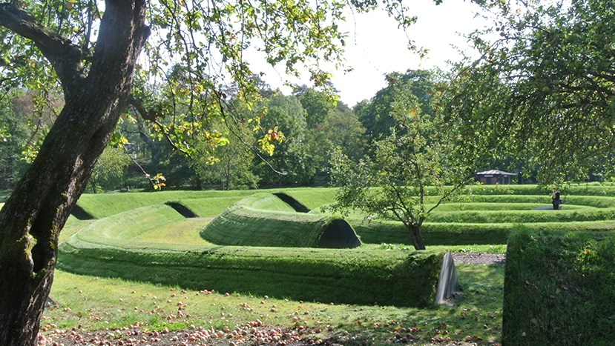
Designed living environments
Architecture and design will help to create a sustainable, equitable and less segregated society with carefully designed living environments in which everyone is well placed to influence the development of their shared environment.
Foto: Ricard Estay
Notes:
We also have a national policy for architecture, design, culture heritage and art in Sweden. It is called Policy for designed living environments. It points out what architecture can do for our society and the incoorporated values could be summarized as sustainable, inclusive and carefully designed living environments…..
It has a human centered perspective
the Inclusivness that it points out is both about the feeling of a place…if you have a sense of belonging to the place, if you feel welcome and comfortable….and about that it takes an inclusive and multidiciplinary designprocess to go from polícy to action and to actually achieve designed living environments for all.

Slide 31
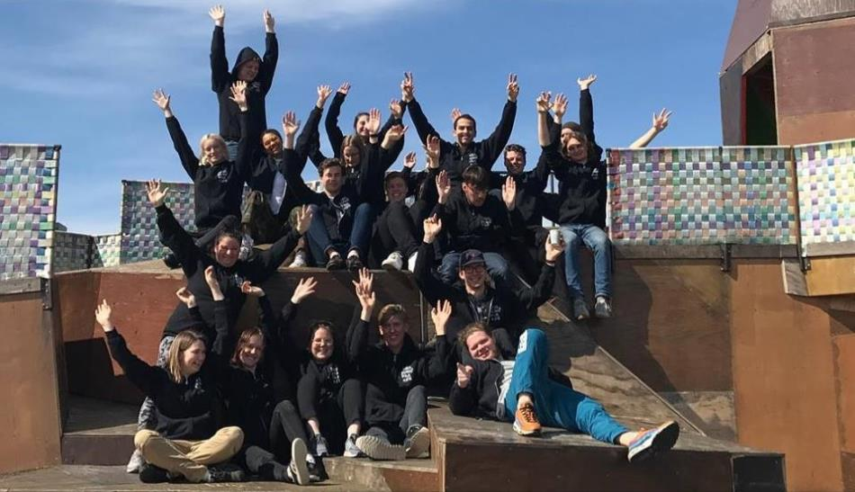
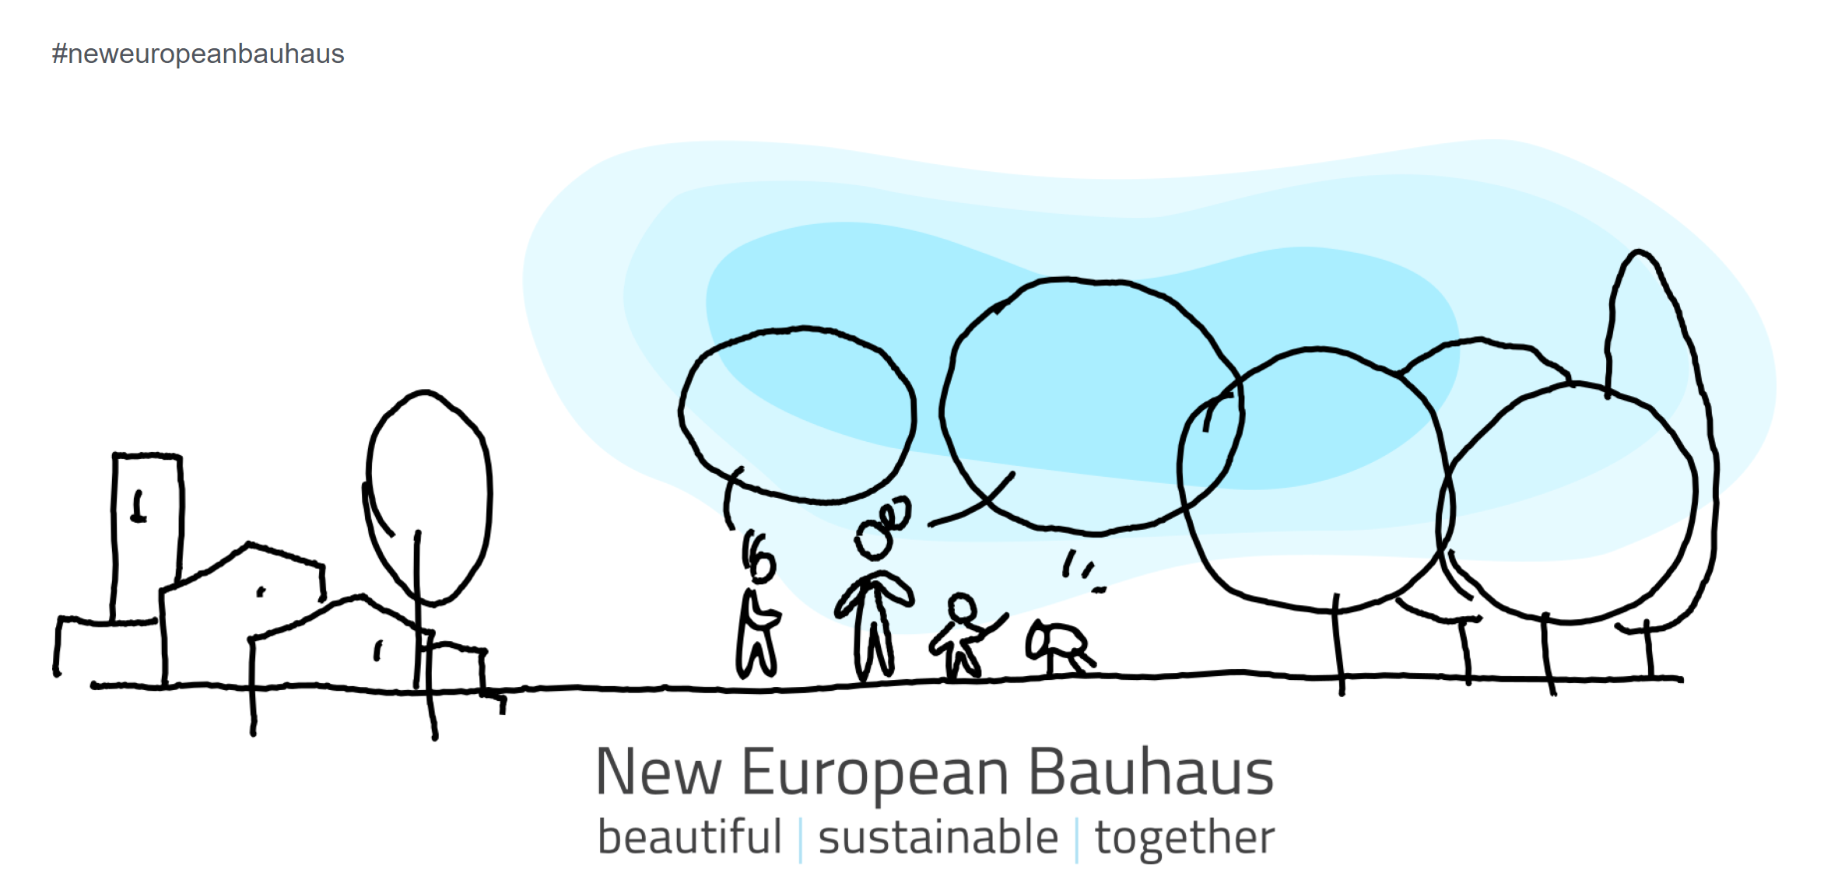
New European Bauhaus
The New European Bauhaus initiative calls on all of us to imagine and build together a sustainable and inclusive future that is beautiful for our eyes, minds, and souls.
Beautiful are the places, practices, and experiences that are:
Enriching, inspired by art and culture, responding to needs beyond functionality.
Sustainable, in harmony with nature, the environment, and our planet.
Inclusive, encouraging a dialogue across cultures, disciplines, genders and ages.
Foto: Jubileumsparken Göteborgs Stad
Notes:
2020 the EU commission launched the NEB initiative. It is very close to the swedish policy designed living environments.
It says that :The NEB initiative calls on all of us to imagine and build together a sustainable and inclusive future that is beautiful for our eyes, minds and souls. Beautiful are the places, practices and experiences that are enriching, sustainable and inclusive…..heard it before? Very close connected to the swedish policy.
It connects to the european green deal and lifts the importance of developing the places on the ground, taking inspiration from nature, working multidiciplinary and togehter in inclusive desingprocesses to be able to reach our goals for the climate. It also connects the design of living environments to the innovation and research sector and to building of knowledge and skills.

Slide 32

Exampel strategic level
Commission from the government to the Board for housing building and planning
Coordinate and spread knowledge about NEB
The Council for sustianable cities as a driver
International – Nordic – National and Local perspective
Notes:
Boverket har av regeringen blivit utsedda att vara kontaktpunkt för detta arbetet
Det innebär både att vi leder ett koordinerings uppdrag för att sprida kunskap och information om NEB.
Detta gör vi både nationellt tillsammans med de 11 officiella partners tillsammans med Rådet för hållbara stöder ( som är en av dessa partners)
Vi representerar även NCP i Europa som en nationell kontaktpunkt för att samordna oss tillsammans med alla övriga kontaktpunkter runt om i Europa.
Så arbetet verkar inom en lokalt-nationell- nordiskt och euopersik skala-

Slide 33
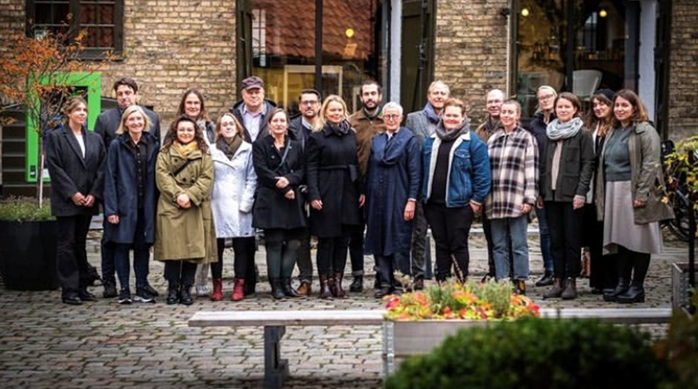
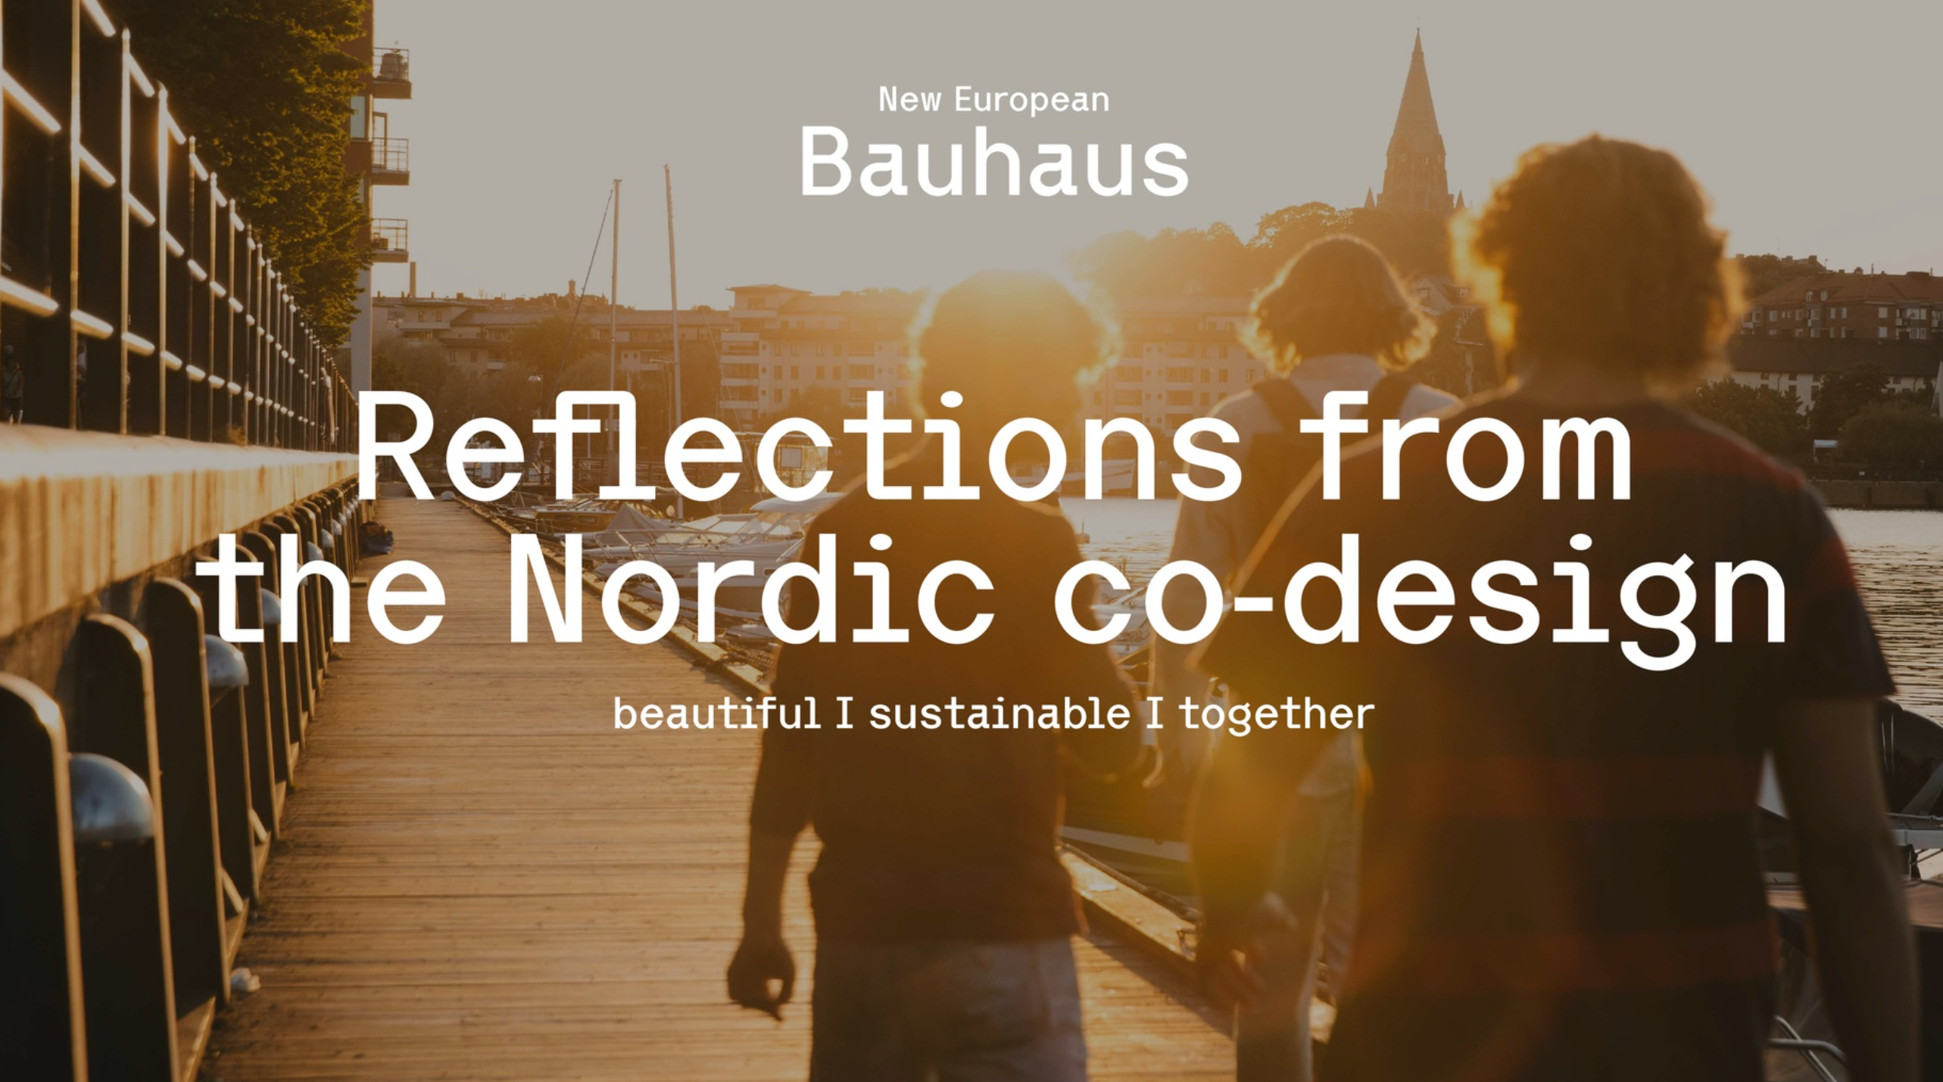
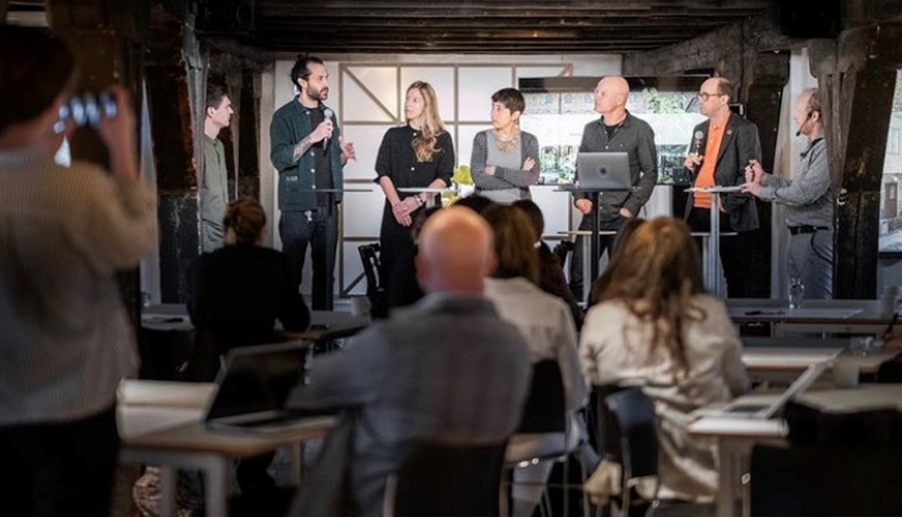
Example Networks
Networks with partners in Sweden and network within the Nordic council for ministers
Notes:
Konkret sker det både genom en rad olika träffar med dessa parters men även övriga intressenter och vänner.
Det handlar om att bygga broar mellan kompetens i Svergie
Där reprensetater finns från såväl akademin, Rise och tankesmedjor som
Göteborg stad och Navet etc.
Vi har haft en träff i Borås, en i Lund/Malmö och det kommer ske en till våren som arrangeras av Rise i Sthlm.
Vi kommer även att ha en anslutande träff i Malmö i anslutning till konferensen i juni.
ONC gruppens rapport
DAVOS rapporten
NEB rapport vad är konkret

Slide 34
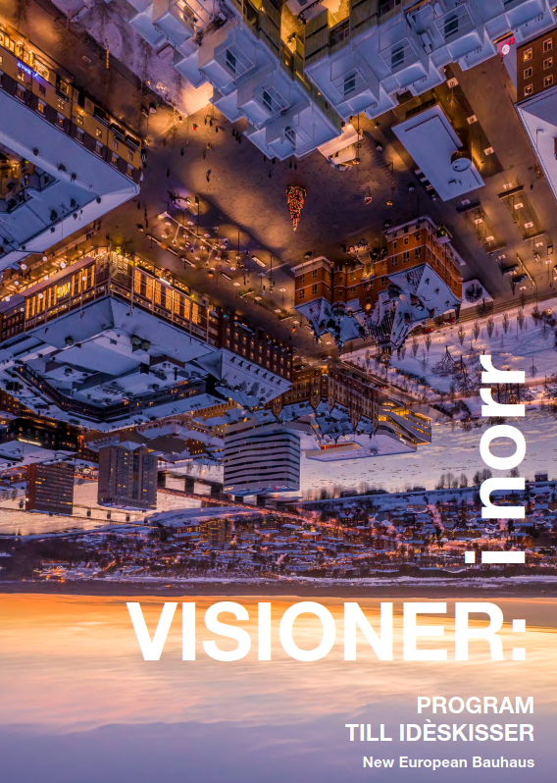
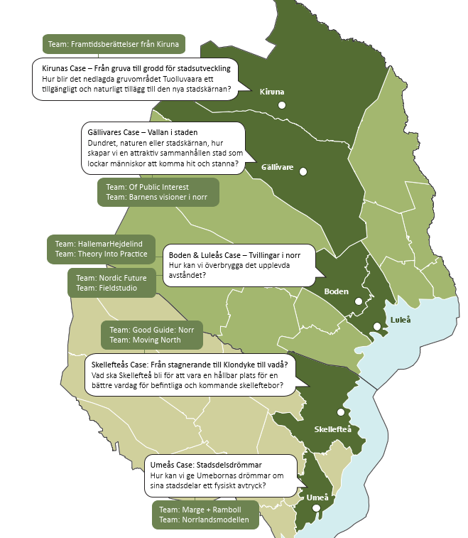
Example project Visions in the north
The Council for sustainable cities
What can Sustianable, inclusive and enriching places in the arctic part of Sweden be?
11 multidiciplinary teams
6 municipalities
5 national agencies

Slide 35
Example from the Kiruna team architects, sami artists, schoolchildren etc
Adaptive re:use, memories, sami art in the development of the living environments
Notes:
Several of the teams lifted….sustainable materials and constructions and re:use ….but most of all they pointed out the uniqueness of the places, the context, they took peoples stories and made them inte skethes of places for the future…..they developed local art to architecture….
This also inspired the nordic pavillion at the biennale this year…..
How can you take the nordic culture into the building that you will design?

Slide 36

Exampel NEB Academy
Cooperation Sweden Finland Estonia
Skillbuilding activities about wood/nature based materials in architecture and construction and adaptive re:use in architecture and construction.
Skills building
Themes
Carbon neutrality
Nature-inspired architecture
Schedule
Planning and production 2023
Launch 2024
Wood construction
Circular economy
Online learning materials
Summer school
Target groups
Students
Building designers
Project managers
Municipal sector

Slide 37
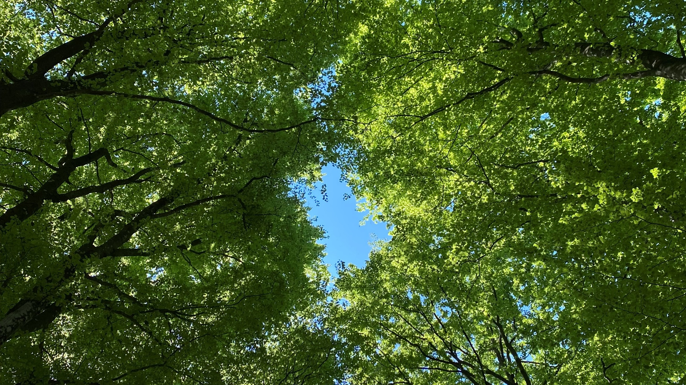
Bild på det grönskande taket
Notes:
Om ett byggnad fått nobelpris….
If there was a nobel prize for builidings…..

Slide 38
Update from Carlotta Cataldi

Slide 39
Breakout session 1
How to increase collaboration between national authorities, regions and other Mission actors to deliver on adaptation?

Slide 40

Breakout Session 1
Guiding questions:
What are the barriers to collaboration on climate change adaptation in your region?
How can the Mission help overcome them?
Action:
Breakout groups (online) / Breakout tables (in person)
8 people per group/table:
  Introduce each other
  Discussion
  Record on Slido: each member can write key thoughts and take aways from the discussion.
Next steps: We will analyse all notes and generate a summary report of the Mission Forum, which will be available online. All this will help on the analyses of the current work under the Mission.
45 minutes
Notes:
The guiding questions are a way of supporitng discusison and unpacking
Each participant will be able to write down their take aways on Slido. The tables also have the choice of assigning one note-taker to record key thoughts and contributions from the other participants using Slido
The aim is not to fill as many sticky notes as possible, but rather discuss together and then write on Slido

Slide 41
Break
Breakout Session 1 will start in 15 minutes

Slide 42

Breakout session 1
How to increase collaboration between national authorities, regions and other Mission actors to deliver on adaptation
Online attendees, please go to
‘Breakout rooms’ area

Slide 43
Lunch
Please go to Ronneby Brunn Hotel restaurant
The Forum will resume at 14:00

Slide 44
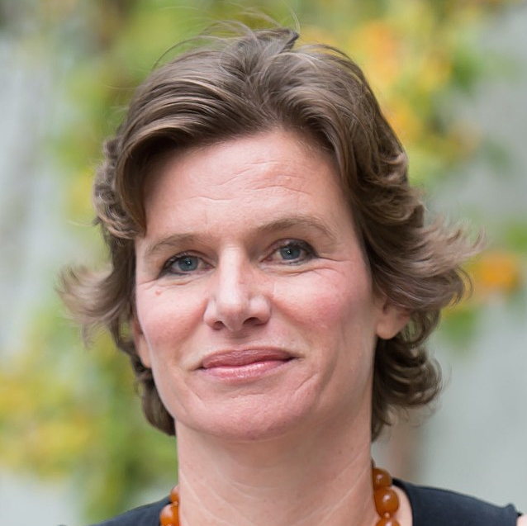
Lightening talk
Mariana Mazzucato
Professor in the Economics of Innovation and Public Value at University College London

Slide 45
Wrap-up from Breakout Session 1

Slide 46
Bullets to be added here

Slide 47
Slido - Poll 3
What is most important for successful
climate adaptation?

Slide 48
Panel discussion: From knowledge to solutions. How to scale up adaptation solutions?
Moderated by Elina Bardram
Mission Manager (Director DG CLIMA) European Commission

Slide 49
Q&A
Please go to ‘Q&A - Panel 2’ in Slido

Slide 50
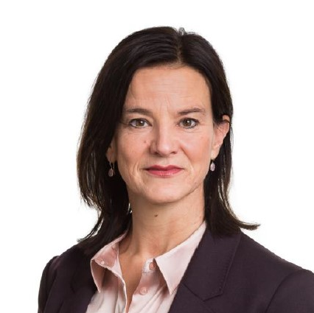
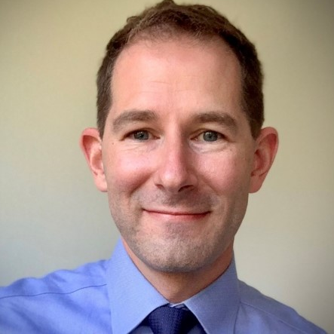
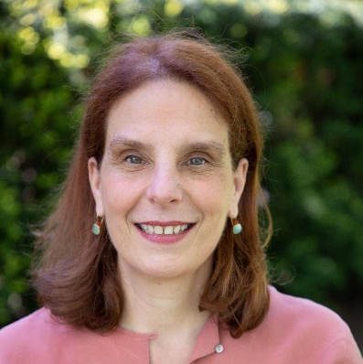
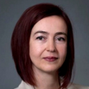
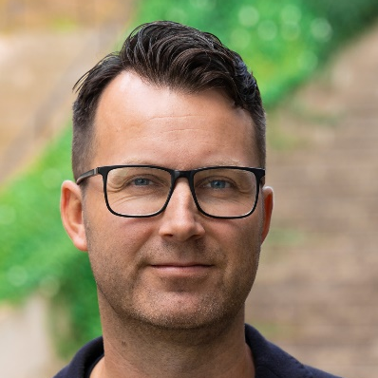
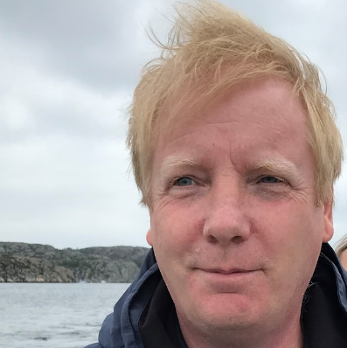
Lidwin van Velden
President of the European Association of Public Banks
Roman Roehrl
Climate change specialist at the European Investment Bank
Eleni Myrivili
Global Chief Heat Officer to UN Habitat and the Arsht Rock Resilience Center, Member of the Mission Board
Svetlana Zhekova
Climate adaptation policy expert, Member of the Mission Board
Andreas Larsson
Associate Professor and Deputy Vice-Chancellor at Blekinge Institute of Technology
Henrik Aspegren
CEO of Sweden Water Research and Professor at Lund University

Slide 51
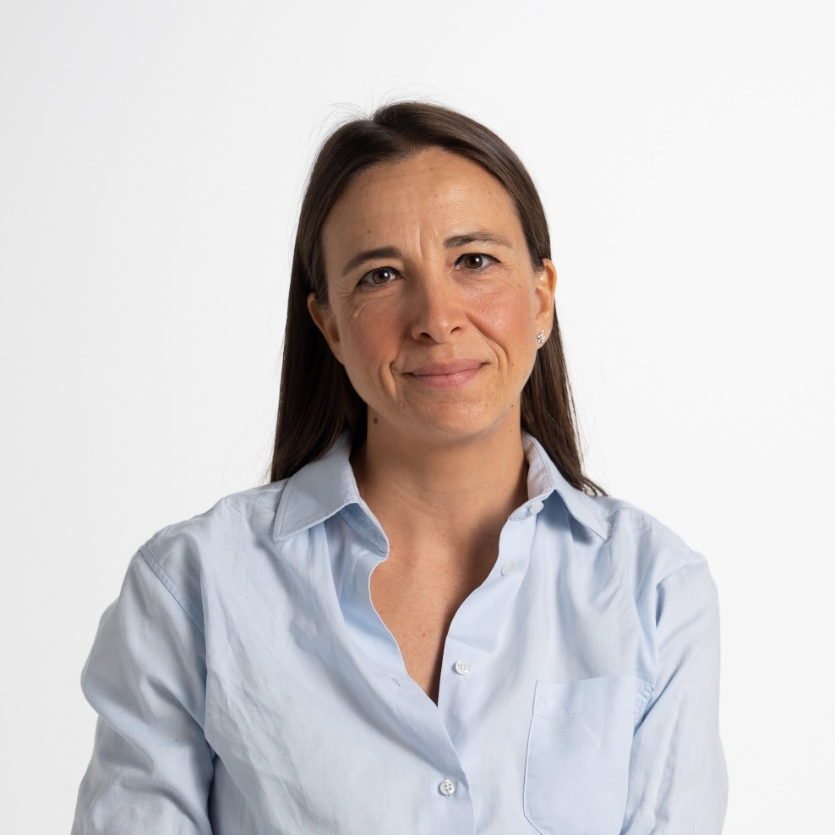
Project showcase
Giulia Balugani
Supervisor of the LIFE ADA project, Sustainability Manager at Unipolsai Assicurazioni

Slide 52

Life ADA – ADaptation in Agriculture
Second Forum for the Mission on Adaptation to Climate Change
13 June 2023
Con il contributo di LIFE, uno strumento finanziario
dell’Unione Europea LIFE: LIFE19CCA/IT/001257

Slide 53

THE LIFE ADA PROJECT IN A NUTSHELL
The LIFE ADA (ADaptation in Agriculture) project, of which UnipolSai Assicurazioni is the coordinating beneficiary, aims to increase the resilience of the agricultural sector to the impacts of climate change through a public-private partnership involving the public administration (Regions), insurers (UnipolSai) and producer organisations.

Slide 54
LIFE ADA’s SPECIFIC OBJECTIVES
The project aims to support producer organisations (POs or cooperatives) and farmers in identifying and planning actions to prevent and manage climate-related risks by:
transferring knowledge on climatic scenarios together with risk management and adaptive measures to enhance farmers´ capacity to tackle current and future climate risks;
building proper tools to support their decision-making process in shaping efficient adaptation plans at farm and supply chain level;
framing a coherent policy strategy at regional level to support farmers’ adaptive planning;
fostering an innovative approach of insurers to build capacity on risk reduction to maintain insurability of farmers in the long-term despite the increase of catastrophic and systemic risks.
Preliminary activities
Testing in the pilot region
Extension to three other regions
Replicability of the project
Text Here
Easy to change colors.
Risk maps, climate scenarios and best practice libraries
Involvement of 50 farmers, 3 producer organizations, training sessions, finalization of the tool
Involvement of 200 farmers, 3 producer organizations, provision of training
Final guidelines for the Regions, final guidelines for supply chain and producer organizations, final guidelines for the insurance sector, White paper with final recommendations

Slide 55

WHY AN INSURANCE COMPANY AS PROJECT LEADER?
The project will potentially involve the entire insurance sector, as the results could contribute to a substantial change in the way risks associated with climate change are managed in the agricultural sector, by defining an innovative model for incorporating societal needs (greater resilience to climate change) into insurance strategy by:
improving prevention and building risk management capabilities (including through insurance literacy)
developing innovative insurance solutions (not only products but also services) to reach farmers, building on existing and new insurance capabilities (such as big data analytics).
The triple role of the insurance industry in addressing climate change:
Investor role (asset management);
Risk carrier role (financial risk management);
Risk manager role (physical risk management).
Public-private partnership is a key element of the model.
By adopting the approach described above, insurers will be able to identify the most effective prevention measures and support the Pos and farmers in their implementation. The public sector, working with insurers, will be able to know which high-impact measures could be financed with public resources, with the aim of reducing the need for extraordinary interventions after climate disasters.

Slide 56
Thank you so much
www.LIFEADA.EU

Slide 57

Project showcase
Adolfo Uriarte
Director of Natural Heritage and Climate Change at the Basque Government

Slide 58


Slide 59


Slide 60


Slide 61


Slide 62


Slide 63


Slide 64


Slide 65


Slide 66


Slide 67


Slide 68

Project showcase
Karin de Beer
Climate Adaptation Coordinator at Värmland County Administrative Board

Slide 69





Värmland County
16 municipalities
280 000 inhabitants
65% forest land (most for producion of wood)
20% water (lakes and rivers)
5% farmland
3% buildings
Sweden
Norway
Karlstad, capital of Värmland County, built on the river delta where Sweden's longest river, Klarälven, runs into Sweden's largest lake, Vänern.

Slide 70

Värmland County Administrative Board
County Administrative Board: government authority that exists in each county
Responsible for ensuring that decisions from the Swedish parliament and the Government are implemented in the county, including:
  food inspections, animal welfare
  energy and climate
  cultural heritage
  protection against disaster, civil defence
  fishing
  equality
  Integration
  waterprotection
About 220 employees
Examples
Create nature reserves, developping conservation plans, managing protected nature
Supervision of Environmentally hazardous activities
Develop Water action plan (Water framework directive)
Develop Flood risk management plan (Floods directive)
Develop Action plan climate change adaptation

Slide 71



Climate risks in Värmland County
1. Risks for landslides increases with climate change

Slide 72


Climate risks in Värmland County
2. Flooding and heavy downpour
Kristinehamn, August 2014

Slide 73




Climate risks in Värmland County
3. Forest fires and spruce bark beetle

Slide 74






20-25% more
annual perceptation
Municipalities have the sovereign right to adopt land use plans (municipality's plan monopoly)
Karlstad, (like other municipalities) likes to attract new inhabitants with houses at the waterfront
Sparsely populated areas
Low tax income
No municipal employee on climate adaptation
Difficulties to find resources and to educate in the subject
Flooding of townhall in Kil
Addressing this challenge: learning Networks; meetings on climate adaptation for the municipalities in the county. Learning from eachother and learning from experts.

Slide 75
Update from Carlotta Cataldi

Slide 76
Breakout session 2
How to scale up adaptation solutions?

Slide 77
Breakout Session 2
Guiding questions:
What ideas do you have to strengthen adaptation in your region?
How can the Mission help shape these ideas?
Action:
Breakout groups (online) / Breakout tables (in person)
8 people per group/table:
  Introduce each other
  Discussion
  Record on Slido: each member can write key thoughts and take aways from the discussion.
Next steps: We will analyse all notes and generate a summary report of the Mission Forum, which will be available online. All this will help on the analyses of the current work under the Mission.
45 minutes
Notes:
The guiding questions are a way of supporitng discusison and unpacking
Each participant will be able to write down their take aways on Slido. The tables also have the choice of assigning one note-taker to record key thoughts and contributions from the other participants using Slido
The aim is not to fill as many sticky notes as possible, but rather discuss together and then write on Slido

Slide 78
Break
Breakout Session 2 will start in 15 minutes

Slide 79
Breakout session 2
How to scale up adaptation solutions
Online attendees, please go to
‘Breakout rooms’ area

Slide 80
Wrap-up from Breakout Session 2

Slide 81
Bullets to be added here

Slide 82
Slido - Poll 4
What should the Mission focus on?

Slide 83
Closing words
Elina Bardram
Mission Manager (Director DG CLIMA) European Commission

Slide 84
Update from Carlotta Cataldi

Slide 85
Thank you!
#EUmissions
#HorizonEU
#MissionClimateAdaptation
#MissionForum23
climate-adapt.eea.europa.eu/en/mission

Slide 86

Feedback form
Your views are very important so please complete the feedback form

Slide 87
Thank you !
#EUmissions
#HorizonEU
#MissionClimateAdaptation
#MissionForum23
© European Union, 2023
Reuse is authorised provided the source is acknowledged and the original meaning or message of the document are not distorted. The European Commission shall not be liable for any consequence stemming from the reuse. The reuse policy of the European Commission documents is implemented by Commission Decision 2011/833/EU of 12 December 2011 on the reuse of Commission documents (OJ L 330, 14.12.2011, p. 39).
All images © European Union, unless otherwise stated. Icons © Flaticon – all rights reserved.

