Slide 1
Launch of the Community of Practice
26 January 2023

Slide 2

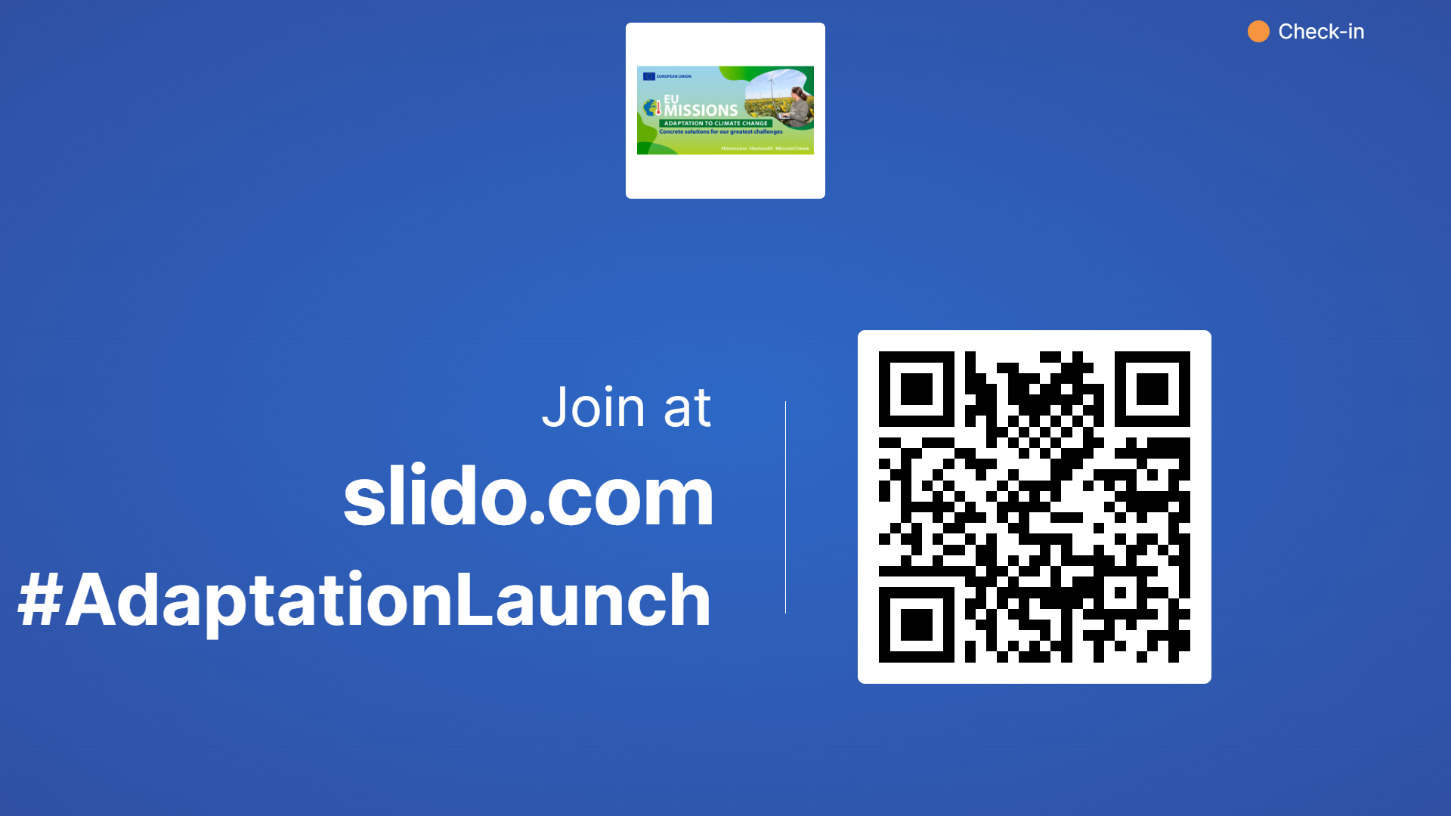

Slide 3
Opening of the Conference

Slide 4
Clara de la Torre
Deputy Director General – DG CLIMA
Manager of Mission on Adaptation to Climate Change

Slide 5
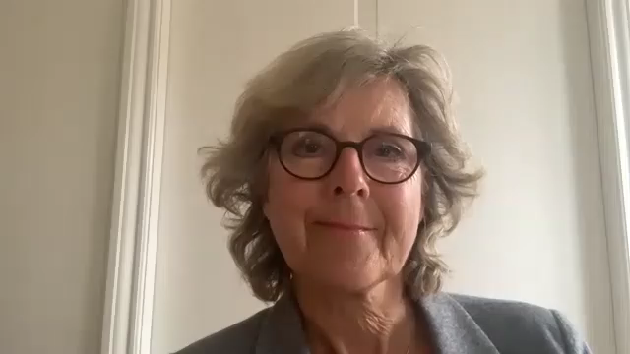
Connie Hedegaard
Chair of the Mission Board

Slide 6
Normunds Popens
Deputy Director General – DG REGIO

Slide 7
Mission Charter: Survey Results
Josh Lernihan
Mission Secretariat, DG CLIMA

Slide 8

Mission Charter
Commitment to
  strive towards climate resilience by 2030;
  boost regional and local adaptation efforts
  undertake adaptation actions
In September we announced 215 Signatories - expressions of interest closed 25/11
Final confirmation of this political commitment in progress
Notes:
All of you here today are familiar with the Mission Charter. This is a document you have signed that commits regions and local authorities to
strive towards climate resilience by 2030,
to boost regional and local adaptation efforts through involvement of citizens in the decision-making process and through stimulation of investments from public and private sources, and
to undertake adaptation actions to create the conditions to achieve climate resilience
In September, 215 regions and authorities who had manifested interest were announced, and the expressions of interest were received on 25th November
We are in the process of getting final confirmation of signature from all those who manifested interested, So far we have more that 250 confirmed signatures, and the final public list of signatories and friends will be announced at the end of February/ beginning of March.

Slide 9
Survey of Regions and Local Authorities
Purpose:
  to assess interest from regions and communities in joining the Mission;
  to understand key issues and challenges faced by local and regional authorities in adapting to the impacts of climate change.
Physical/Social/Economic Impacts
Adaptation Posture and Measures
Specific Challenges and Needs
Funding – Knowledge of Sources
Willingness to Act
Notes:
As you are all aware, to sign the Charter to join the Mission and to be part of this community, you were required to complete a Survey.
The purpose of this was twofold:
to gauge your interest in joining the Mission (and inviting you to sign the Charter), but also
to understand first hand what the key issues and challenges you are facing are.
The key information we wanted to understand was:
The impacts faced
Predisposition of regions to adaptation actions
Specific Challenges and Needs
Knowledge of funding sources; and
Willingness to undertake adaptation actions
So today, I want to tell you what you told us, in aggregate, and focus on each of these things
Today’s workshops have been organised directly as a response to the information you provided us with.
This information, along with the Slido that we will use to gather your responses today, will guide our interactions as we go forward.

Slide 10
Characteristics of CoP
Commitment and interest from >300 regions and authorities;
Potential signatory entities in 31 countries;
Diverse range of types and population sizes.
Notes:
So firstly, who makes up this Community?
We have regions and authorities from 31 countries (26 Member States and 5 associated countries
And we have a wide range of types of region among you – 21% rural, 32% Urban and 47% mixed
Size and population also varies greatly, we have representation across the board. Approximately 30% of our community come from territories of less than 50,000 individuals, and approximately 18% are from regions of over one million.

Slide 11
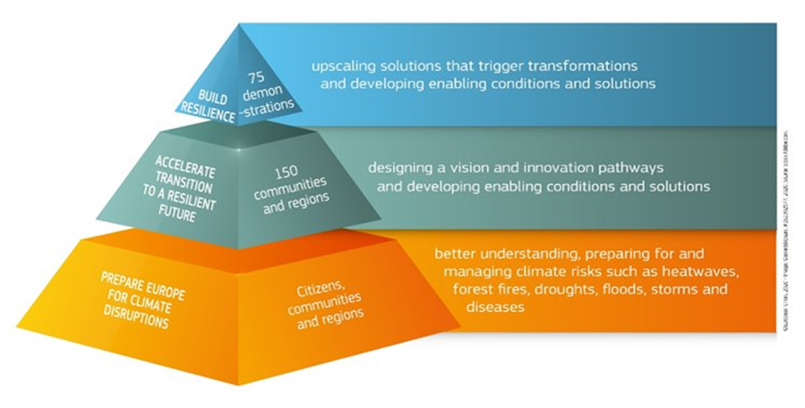
Adaptation Posture
Completed a risk assessment? (62% : Yes)
Have a regional or local adaptation strategy in place? (76% : Yes)
Have a dedicated team or person in place responsible for climate change adaptation? (67% : Yes)
Dedicated regional budget? (62% : Yes)
Notes:
Regarding the measures you have already taken, we were encouraged to know that the majority of respondents have:
completed a risk assessment (62%),
a regional or local adaptation strategy in place (76%),
a dedicated team or person in place responsible for climate change adaptation (67%), and
a dedicated regional budget for adaptation measures (62%).
This information gives us the impetus to support you where you are at:
For those who are yet to put these tools in place, access to better understanding, risk assessments, and data is available;
For those who have plans in place to accelerate transition, we can support the move to implementation;
For those who are already in the implementation phase, we can support further development and demonstration of solutions and use them to bring others along with you in this collective effort.

Slide 12
Collaboration on Adaptation
Q. With which of the following do you collaborate on adaptation measures?
Notes:
We also asked you about who you collaborate with and your responses for the most part show that the majority of you are collaborating with someone, whether it be research institutions and researchers, neighbouring local or regional authorities or businesses.
We hope that today’s event will provide you with a wider network of partner institutions, projects and authorities to work with and that these percentages will further increase.

Slide 13
Impacts
Physical
Social and Economic
Notes:
Regarding the impacts you are feeling in your territories; Of course, I don’t need to tell you what you have experienced, but this impact focus is useful to build links between yourselves, to link up with other regions who experience, for example coastal erosion or river flooding and discuss solutions.
In brief:
Temperature Increases, heatwaves were the most reported physical impact (83% of you), and storms and extreme rainfall are a close second.
Damage to buildings and infrastructure reported by 76% of signatories, losses in agriculture 72%

Slide 14
Challenges Specific Needs
Political support | 40%
Financial resources | 92%
Scientific data, risk assessment | 49%
Support of the regional/local community | 42%
Citizens' support | 39%
I don't know | 1%
Other | 11%
Risk assessment | 57%
Cross-border cooperation | 49%
Financial advice | 60%
Knowledge | 69%
Research | 56%
Private sector support | 54%
Support at national level | 63%
Other | 7%
Notes:
So those are your impacts, what are the specific challenges you report and what do you need specifically to address these challenges?
We’ve identified 3 trends from the responses:
Financial resources were cited as the biggest challenge to implementation of adaptation measures amongst signatories of the charter (92%).
Knowledge is cited as a specific need by 69%, and this pairs well with the fact that scientific data, risk assessment is an identified challenge among 29% of signatories and
There were a variety of other needs and challenges cited, and citizen engagement and support is a key theme, identified directly by 39%, but appearing as an element of other needs also, and referenced quite regularly in the additional material provided.
This information allows clustering and targeted follow up – you will already have seen that the workshops for today are focussed on targeting each of these challenges, and you will hear from some of the key organisations, projects, and your fellow regions who will provide you with clear information on what they can do, what they have done, and examples of good practices.
Furthermore, this kind of information will feed into the development of the community of practice and clustering by the Mission Implementation Platform who you will hear from in the next session.

Slide 15
Funding
Source | Familiarity/ Intention to Use
National funds | 80%
European Cohesion Policy funds (ERDF, Interreg) | 71%
Own local funds | 70%
Regional funds | 70%
Horizon Europe | 65%
LIFE programme | 61%
Other EU funds | 52%
European Rural Development funds | 41%
Other (not specified) | 19%
European Investment Bank financing | 18%
Private/commercial banking financing | 18%
Notes:
We asked a number of specific questions on funding issues. Given the prominence of this issue in the listed challenges, it is worth focussing a little bit on what you told us specifically.
We asked you about your familiarity and intention to use the various funding streams that have been used for financing adaptation and resilience measures, and I these results have fed directly into today’s programme.
Of the regions and local authorities who responded, you have a high level of familiarity and intention to use national local and regional funding, and with Cohesion funding.
It is worth noting that there is a relatively high level of familiarity also with Horizon Europe and LIFE. In fact, of all the sources, Horizon had the most reported intention to use. If there is any confusion about these sources, I am sure our speakers in the financing workshop today will be in a position to clarify some of that.
Finally to say that the European Investment Bank and private investment funding sources had the lowest level of familiarity. Our intention with the financing workshop is to raise this with the EIB in particular kindly offering to participate and talk about the services they can offer and the investments they make.

Slide 16
Key takeaways
Provides the Mission with context and contacts
Clear direction on challenges/needs:
  Financial resources
  Scientific data, risk assesments, knowledge
  Citizen support and engagement
Need for cooperation and coordination
Feed into the development of the Community of Practice
Thank you for your responses!
Notes:
To conclude, just to summarise a bit what we have taken away from these responses.
We now have a very useful first hand expression of the impacts of climate change that you are experiencing. We can see your region in context. We now know who is effected by what impact and have contact information for the right person to engage with in each region.
You have identified for us in general terms what your most pressing needs are. We can build on these, as we have today, to provide targeted support.
But we know from this survey and from other sources there is a major need for cooperation between all levels of government, with institutions, with partners, and with the private sector, and coordination of efforts across this network. You will hear from some of those partners directly following my session, and I echo Clara’s sentiments in encouraging you to make the most of this opportunity to network with your fellow participants. All of this will feed into the Community of Practice we are launching here today.
Finally, just to say thank you very much for your responses to this survey, I hope this information is of use to you going forward, and I look forward to following the workshop discussions later on today.

Slide 18
Key Mission actors: MIP contractor & Climate ADAPT

Slide 19





The Mission Implementation Platform: offer to the regions and key milestones
Richard Smithers
  Project Director, Ricardo Energy & Environment

Slide 20

The Mission Implementation Platform
The Mission Implementation Platform reports to:
  The Mission Secretariat
  The Mission Manager (DG CLIMA) and Deputy Mission Manager (DG RTD)
  The contracting authority, CINEA

Slide 21

The objectives of the platform are to:
Provide central support to Mission participants and the Commission to implement the Mission
Coordinate the broad range of activities and actors through the Community of Practice, including coordination with other European activities on climate adaptation
Provide support and technical assistance to regions and local authorities along their transformation process towards climate resilience
Communicate and connect activities and actors on adaptation, including through a media strategy and an annual Forum event
Monitor and report on progress
Promote and stimulate broader engagement with the Mission and other Missions.

Slide 22
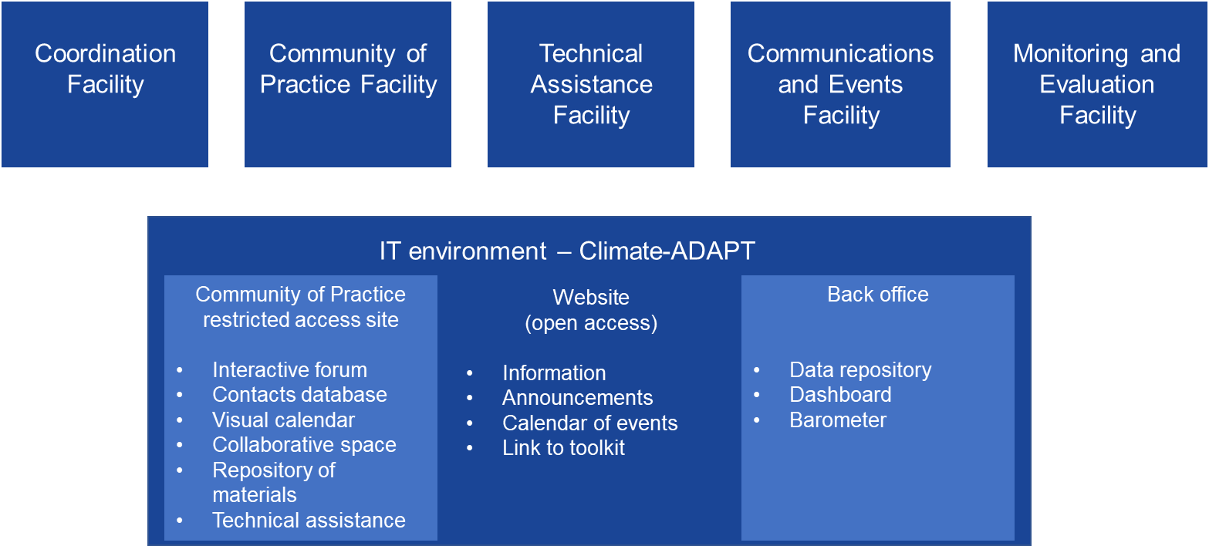
Building the Mission Implementation Platform
Five facilities supported by an IT environment in Climate-ADAPT

Slide 23
Benefits and support for charter signatories
Technical assistance:
Climate adaptation pathways and solutions
KNOWLEDGE
TOOLS
GUIDANCE
Training and support on engaging citizens
LISTENING
ENGAGING
COLLABORATING
Opportunities to participate and keep informed: webinars, dialogues,
Trainings, forums
CAPACITIES
CONTACTS
KNOWLEDGE
Technical assistance:
Access to funding for adaptation projects
ACCESS TO
FUNDING
Opportunities to network with similar regions and share experiences
NETWORK
INSPIRATION
Notes:
Assistance with developing your climate adaptation pathways and solutions – access and training on the latest tested tools from the Commission’s research and innovation
Assistance with accessing funding to implement some of these solutions/projects
Active support and training for engaging citizens in your adaptation process and accounting for their needs and views
Opportunities to network with other regions, find similar cases for inspiration, establish contacts and supporting networks
Opportunities to participate in a wide range of webinars, dialogues and trainings to stay connected, increase knowledge and capacities

Slide 24
How can charter signatories help us to help you
Explain your situation: pioneer, beginner, achievements, needs and interests
Actively share best practice:
  Contribute case studies
  Speak at our events
  Contribute to social media and newsletter content
Come to us if you have pilot projects in the pipeline – sign up to our services
Use the Platform and give us feedback: what and how can we improve?

Slide 25
How charter signatories can help each other
Engage with the Community of Practice (provisional outline):
Interregional node
Virtual Community of Practice gathering (annual)
“Bring and share” online events (every 3 months)
Mission project’s node
Kick-off seminar new Mission projects (annual)
Synergy and matchmaking workshop (3 per year)
EU-level node
Policy roundtable – exchange between projects and mission (annual)
Dialogue between nodes
Twinning ands mentorship programme (20 regions)
CDE Training (annual)
Cross-fertilisation workshop (monthly)
Policy update webinar (annual)
Matchmaking problem owners and solution providers (5 events in 3 years)
Legacy workshops (at the end of the 3 years)
Notes:
Engage with the Community of Practice:
Share your experience if you are ahead
Join the twinning programme for mutual support
Engage with other stakeholders:
Friends of the Mission
Mission Projects
European Commission

Slide 26
Mission Implementation Platform timeline
Activity | 1 | 2 | 3 | 4 | 5 | 6 | 7 | 8 | 9 | 10 | 11 | 12 | 2024 | 2025
Launch of Mission’s Community of Practice virtual site and activities
Launch of the call for applications for the Technical Assistances
Mission Implementation Platform website launch
Production of Mission Implementation Platform’s communication materials
Mission Forum

Slide 27
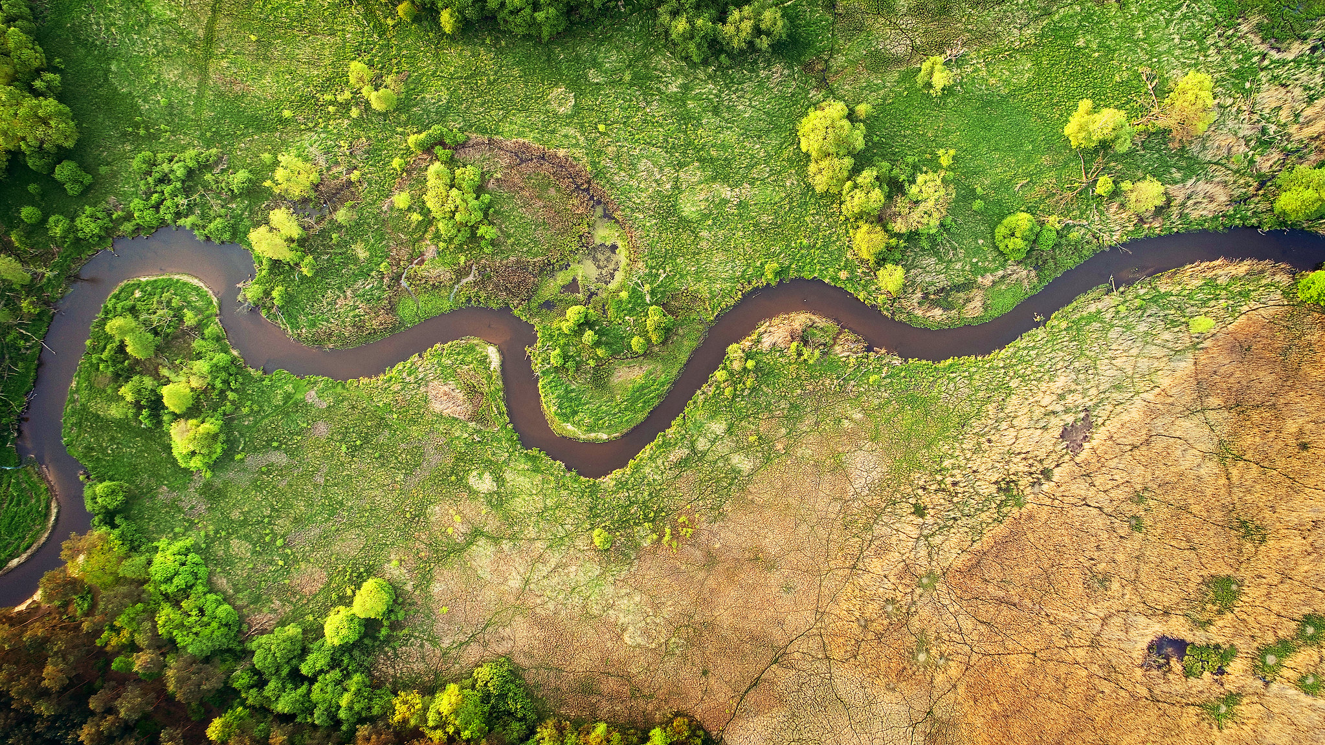

Climate-ADAPT: Mission on Adaptation related products
Lucy Gregersen/ Blaž Kurnik/ Christiana Photiadou
Community of Practice Launch / 26 January 2023
© Piotr Krześlak, WaterPIX EEA
Notes:
OPENING SLIDE – dark background and white logo

Slide 28
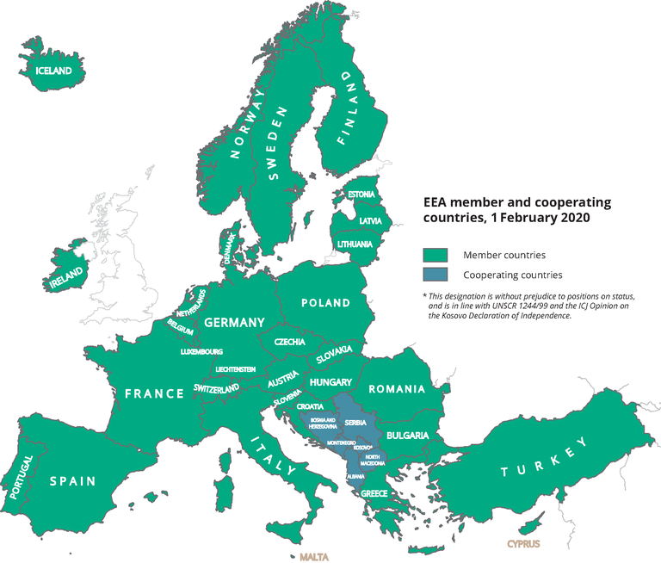
European Environment Agency
Agency of the European Union ​
32 member + 6 collaborating countries​
EEA gathers data and information from across Europe and translates them into assessments and knowledge to inform policy and decision-making
Support key EU policies and initiatives
EEA Climate Change Impacts & Adaptation
Provide actionable knowledge on climate change hazards and impacts to policy-makers in Europe
Support development and implementation of (sub-)national adaptation strategies

Slide 29
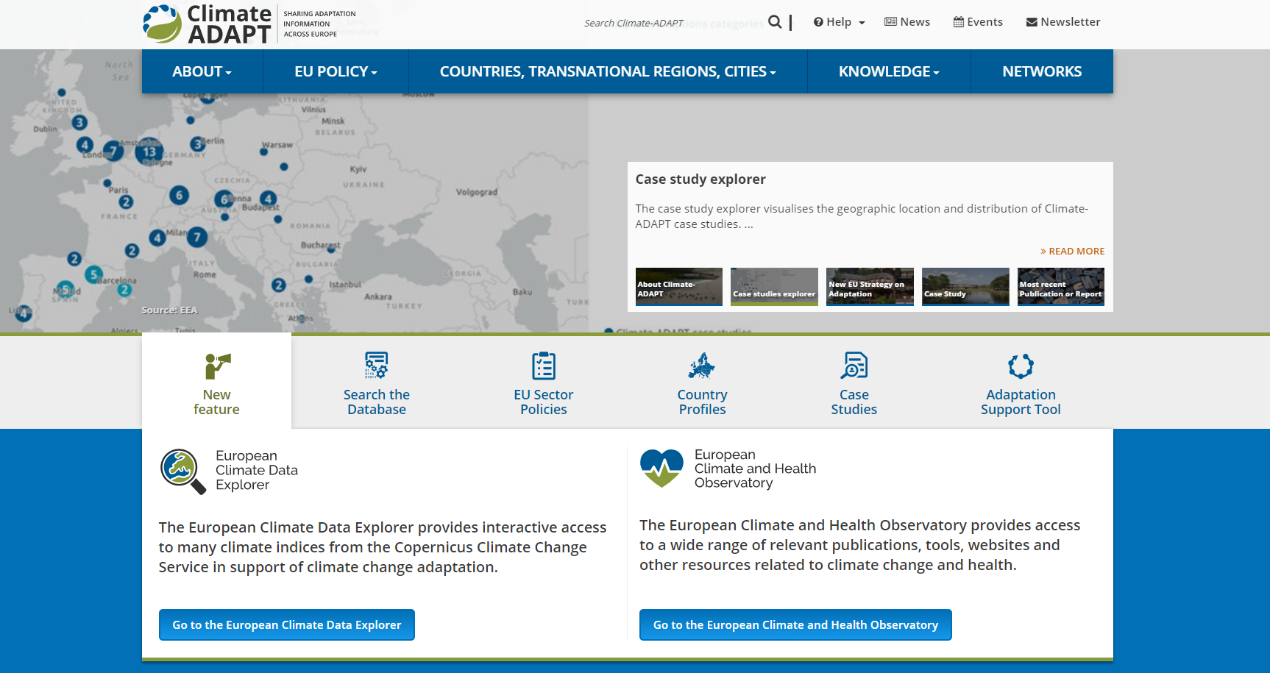
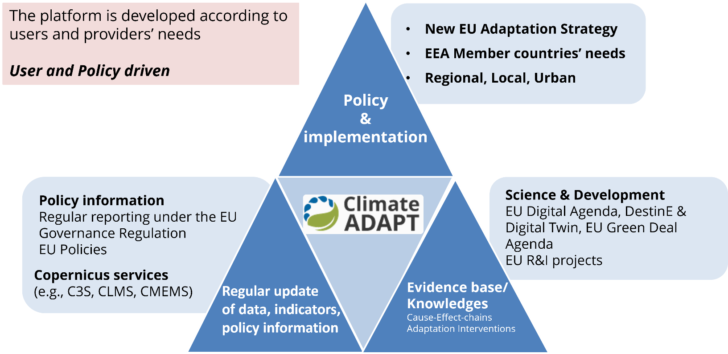
The role of EEA on Climate change adaptation
Provide actionable knowledge on climate change hazards and impacts to policy-makers in Europe
Support key EU policies and initiatives
Support development and implementation of
(sub-)national adaptation strategies
Climate-ADAPT: European adaptation platform​​
From climate data to actionable knowledge on adaptation

Slide 30

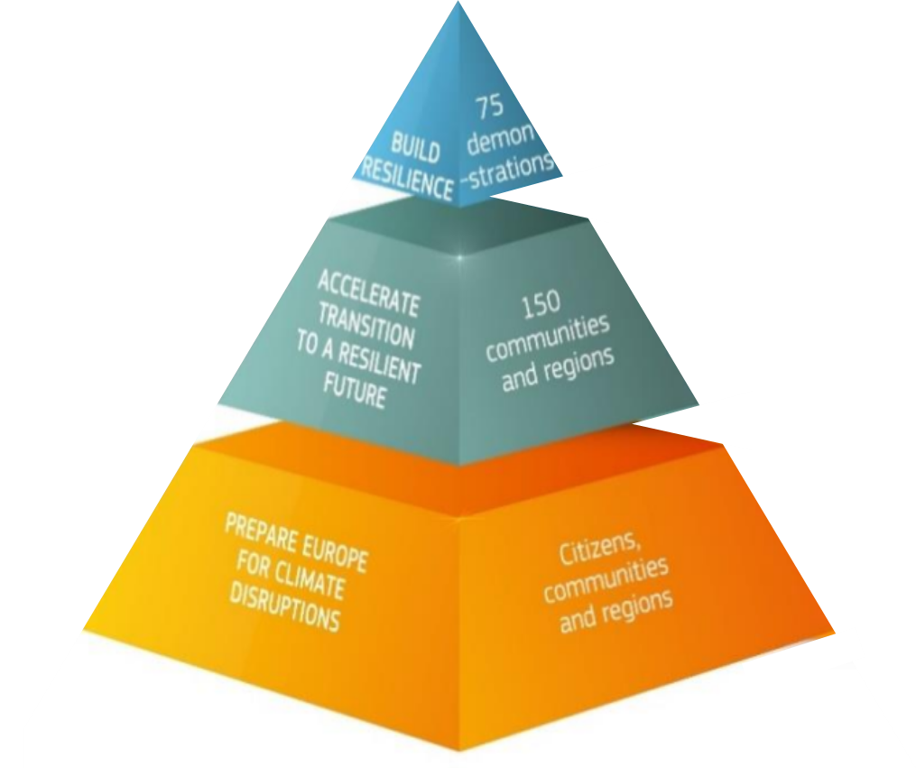
Climate-ADAPT as the Mission Knowledge Platform
Key objectives and tasks for EEA:
Developing inputs for regional information on the climate risks
Developing guidelines and tools for developing and implementing adaptation solutions
Monitoring, reporting, and the evaluation activities
Investments into new IT and communication tools for knowledge exchange
Involving EIONET
Climate-ADAPT will host:
Mission Knowledge Hub: combining
climate information with adaptation actions
The Mission Implementation Platform
EU Mission: Adaptation to Climate Change
Notes:
By 2030, the Mission will deliver upon the following objectives:
Objective 1: Preparing and planning for climate resilience
to provide general support to European regions and communities to better understand, prepare for and manage climate risks and opportunities, by providing local and regional administrative units access to climate risk profiles, early warning systems, and guidance for the development of comprehensive risk management plans
Objective 2: Accelerating transformations to climate resilience
to work with at least 150 regions and communities to accelerate their transformation to a climate resilient future,
Objective 3: Demonstrating systemic transformations to climate resilience
to deliver at least 75 large-scale demonstrations of systemic transformations to climate resilience across European regions and communities, by supporting regions and communities across the whole EU
EEA contributes to all objective above by providing inputs and knowledge and to upgrade Climate-ADAPT as the mission knowledge hub and as host of the mission implementation platform.
The hub will, when fully developed:
•serve as data and information provider to support development of regional climate risks assessments
•Provide adaptation support tools and guidelines to support implementing actions
•Monitoring the progress in adaptation implementation
•Facilitate implementation by mobilizing EIONET (the unique European network)

Slide 31
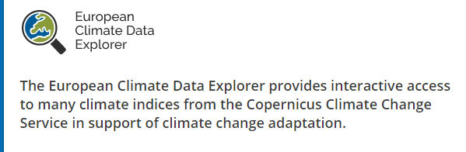
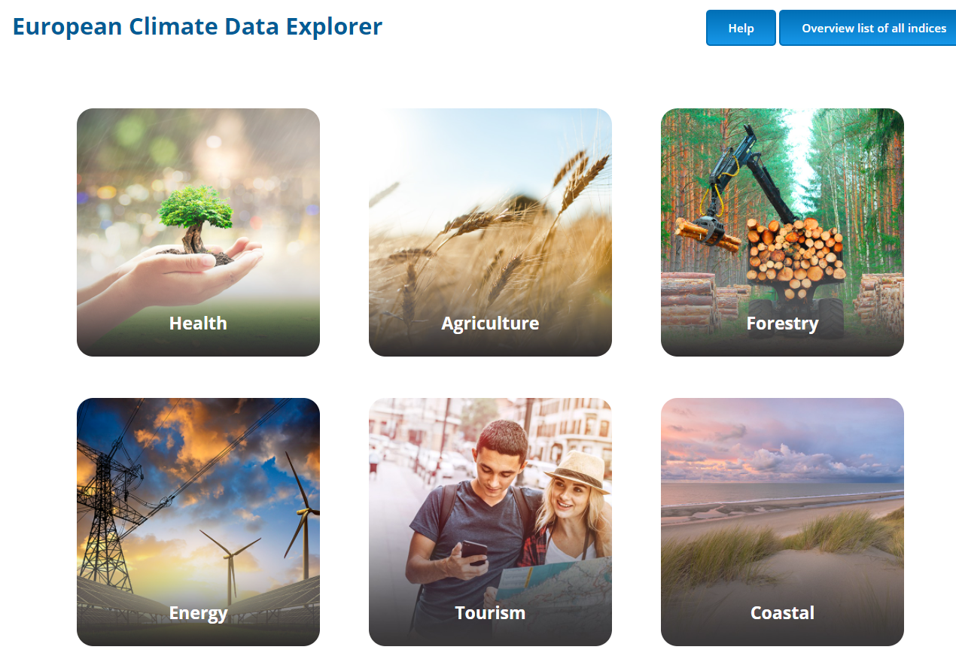
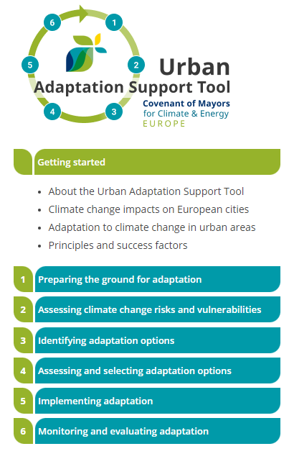
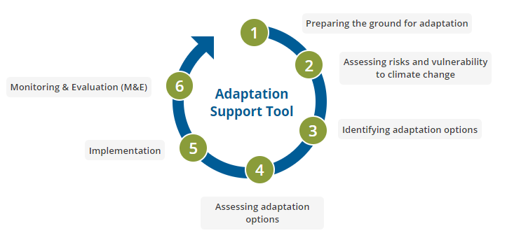

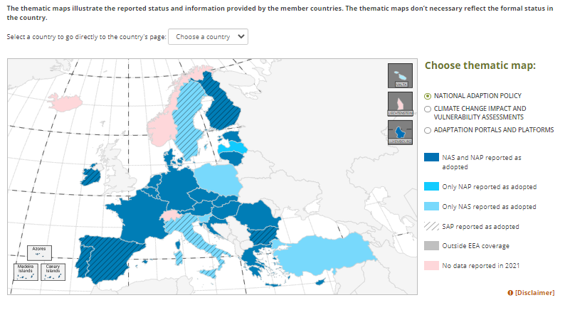

Climate-ADAPT key tools: AST/UAST, Country Profiles,
Climate Data Explorer, Health Observatory
Notes:
Urban landing page: https://climate-adapt.eea.europa.eu/en/countries-regions/local/#t-databases
UAST: https://climate-adapt.eea.europa.eu/en/knowledge/tools/urban-ast/step-0-0
UAMV: https://climate-adapt.eea.europa.eu/en/knowledge/tools/urban-adaptation
An important focus of the mission on adaptation is human health. The key climate risks related to heatwaves, pest and diseases affect heath and well being on humans contribute to increased mortality. According to the EEA indicators the heatwaves contributed to 90 000-145 000 fatalities in the last 40 years.
Launched in March 2021 under the EU Strategy on Adaptation to Climate Change to:
Improve the knowledge base for policy on climate change and human health
Bring together resources, expertise and tools from relevant organisations
Facilitate learning across countries and organisations
Climate ADAPT and the Climate & Health Observatory are information hubs with a wealth of data on the interface between climate adaptation/mitigation and human health, wellbeing and social vulnerabilities, and the policies that underpin current European approaches.

Slide 32
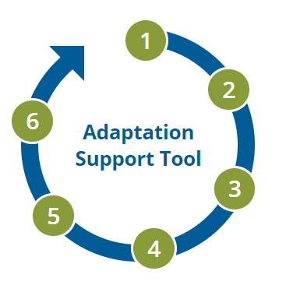
Regional Adaptation Support Tool
  An adaptation tool for the MIP Community of Practice – to be tested and approved by regions active in the Mission
  Takes you through all the steps to develop and implement an adaptation plan
  Contains references to valuable guidance materials, tools, reports, and case studies
Regional Adaptation
Notes:
To be developed by the European Environment Agency in collaboration with the team lead by Ricardo building on the experience available in Europe
Case studies from the pilot regions and local communities under the Mission, illustrating implementation of adaptation actions relevant to the Mission.
Cast studies: the EEA are proactively looking for case studies, please get in touch!

Slide 33
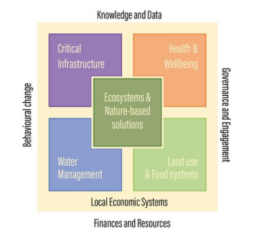
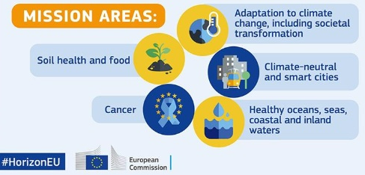
Case Studies
Objective
Create case studies from the regions, local authorities, and communities under the Mission on Adaptation demonstrating implementation of adaptation actions relevant to the Mission
Promoting knowledge sharing, synergies, and dissemination on these initiatives and what is possible to do.
What insights should the case studies focus on?
Recommendations on how to make adaptation actions in a holistic way for policy makers and adaptation practitioners
The Mission’s Key Community Systems
Cross-linkages with other EU Missions
Identifying case studies
The EEA would appreciate your views to help identify possible case studies and collect diverse experiences from the subnational levels to disseminate through Climate-ADAPT
Please get in touch on Lucy.Gregersen@eea.europea.eu!
Notes:
Case studies - Objectives:
Emphasizes importance of climate adaptation and mitigation at regional and local level
Emphasizes importance of the connection between the regions/urban scale and its Territory
Promotes knowledge sharing, synergies and coherence
Encourages peer-learning, visibility of initiatives
Practical guidance & inspiration for adaptation and mitigation strategies
Address in a holistic way adaptation and mitigation
Case studies from the pilot regions and local communities under the Mission, illustrating implementation of adaptation actions relevant to the Mission.
Cast studies: the EEA are proactively looking for case studies, please get in touch!

Slide 34
Sign up to receive EEA news, reports and alerts on your areas of interest at
http://eea-subscriptions.eu/subscribe
http://eea.europa.eu
Climate-ADAPT
http://climate-adapt.eea.europa.eu
European Climate and Health Observatory
https://climate-adapt.eea.europa.eu/observatory
European Climate Data Explorer
https://climate-adapt.eea.europa.eu/knowledge/european-climate-data-explorer/
Mission Knowledge Hub: launching later this year
Mission Implementation Platform: launching later this year
Thank you
Lucy Gregersen / Blaž Kurnik /Christiana Photiadou
Lucy.Gregersen@eea.europa.eu /Blaz.Kurnik@eea.europa.eu / Christiana.Photiadou@eea.europa.eu
Notes:
Closing slide: you may want to use the same image as in the opening slide and thank your listeners.

Slide 35
Mission Project CLIMAAX

Slide 36
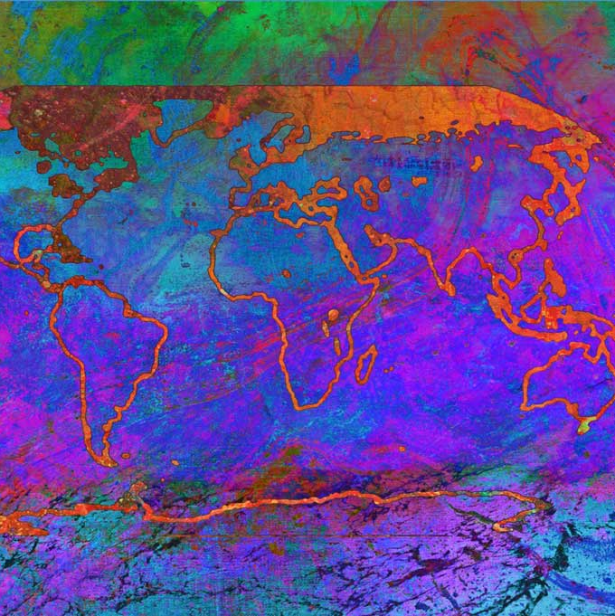


CLIMAAX
CLIMate risk And vulnerability Assessment framework and toolboX
26 January 2023
Frederiek Sperna Weiland
Bart van den Hurk

Slide 37
CLIMAAX deliverables
A standardized CRA framework building upon best practices
A toolbox with data, models and utilities providing access to global open data archives integrated with local data
Five pilot regional CRAs to shape the framework and toolset
Financial support for at least 50 regions to execute a context-specific CRA
CRA guidance material and online helpdesk for other European regions
A proposal to upscale results into future operationalization

Slide 38
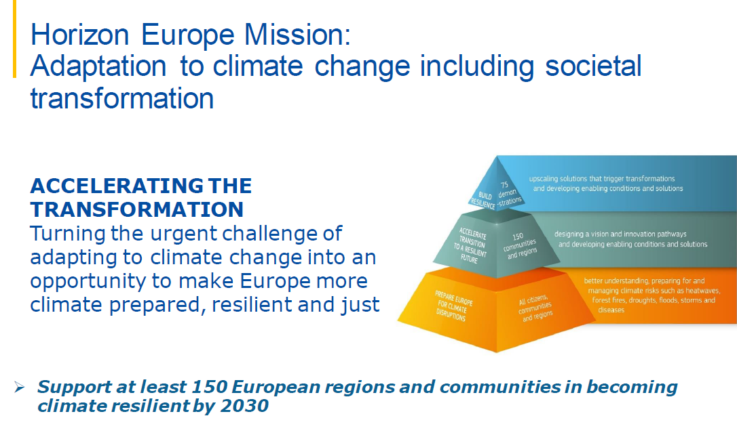
Starting point: EU Green Deal

Slide 39
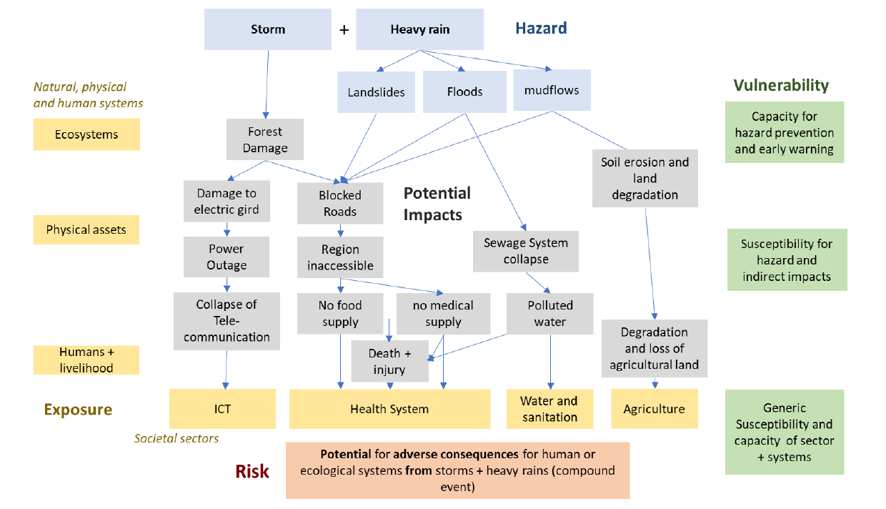
European CRA mapping cascade pathways

Slide 40
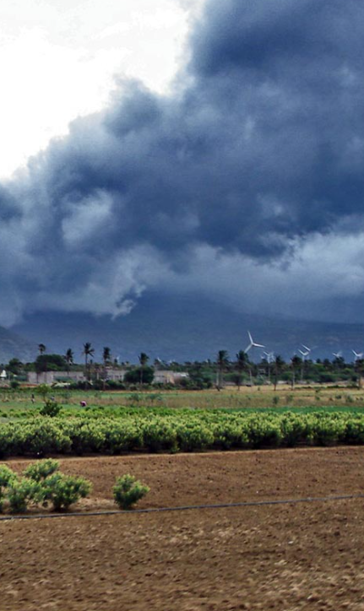
Our motto: standardized flexibility
Comply with large range of regional challenges and levels of experience
Facilitate range of
  Time scales
  Sectors
  Decision contexts
Merge with existing political and economical constraints
Build upon existing data and tools

Slide 41
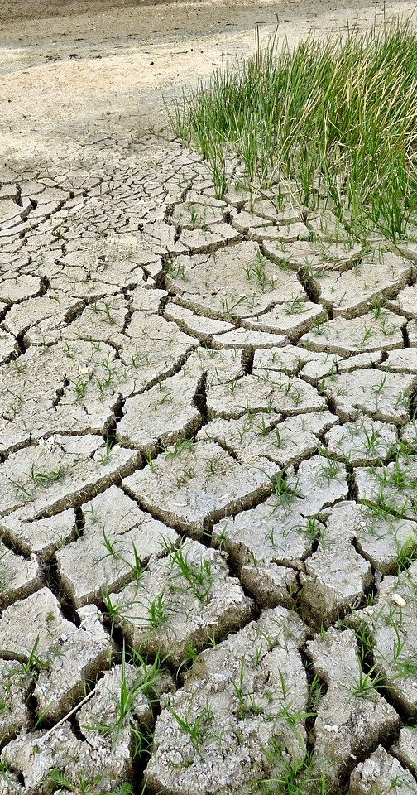
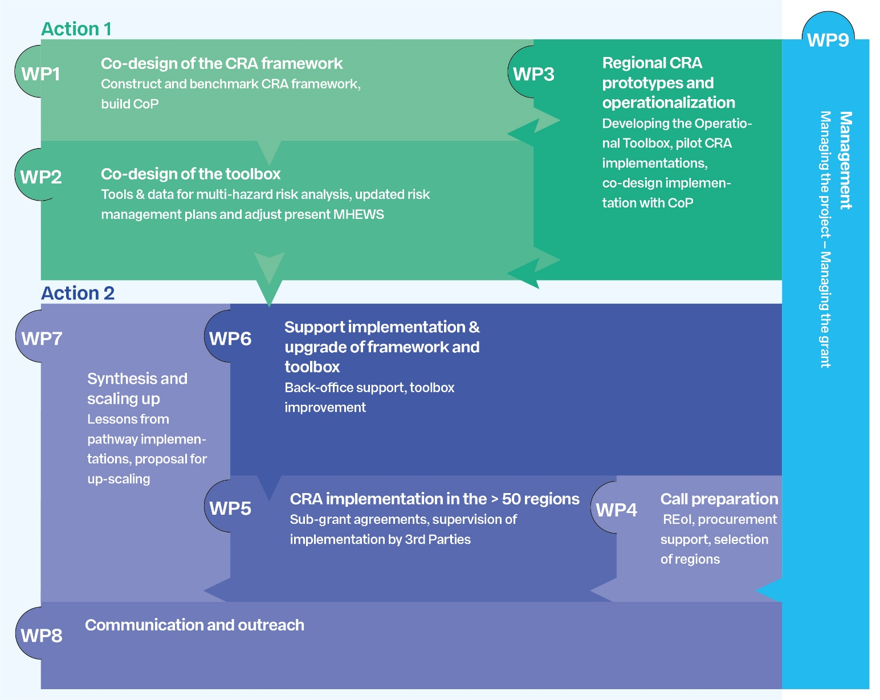
Project structure

Slide 42
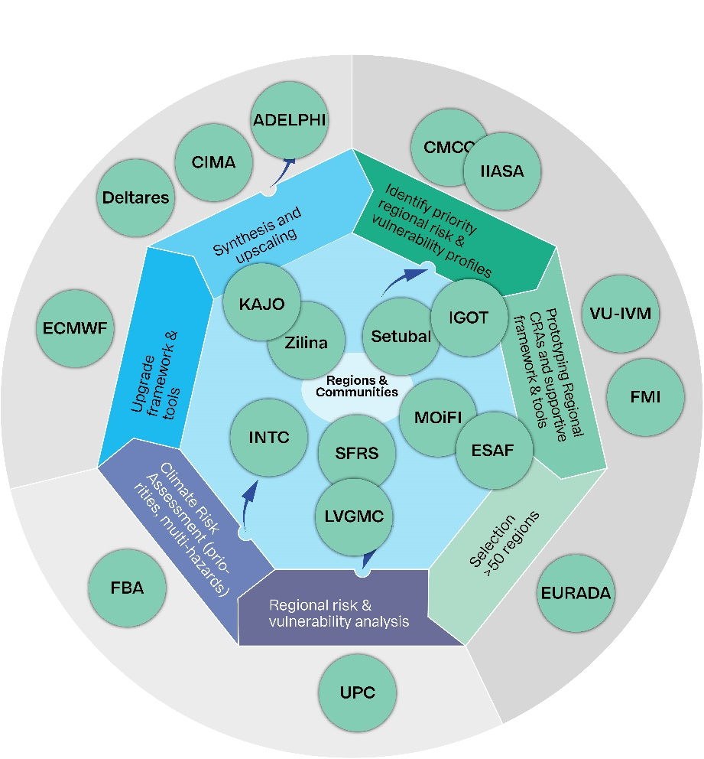
Consortium structure

Slide 43
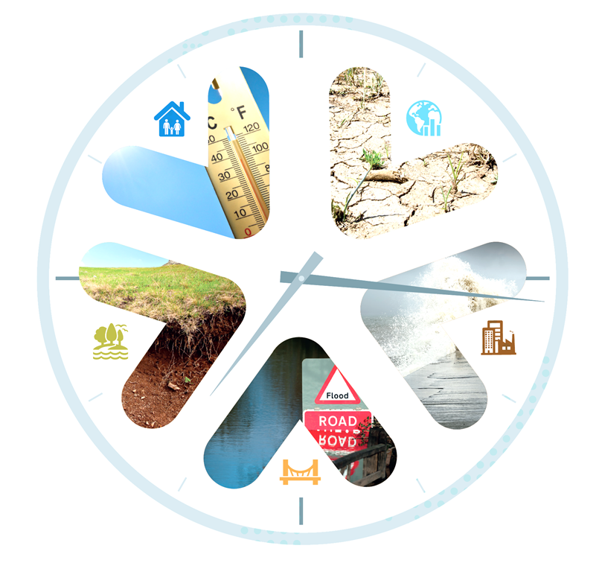
Step 1: Regional Climate Risk Assessment Framework
Scope: Develop an inclusive, harmonized and shared framework for local & regional climate risk assessment.
Based on technical and process-based principles and performance-related metrics for CRA
Build upon state of the art and bottom-up consensus of good practices and recommended approaches
Why is a new Framework needed?
Current standards only at national level not regional.
Support the ambitious Mission adaptation vision for transformational change
Ensure compatibility and comparability with existing NRAs
Provide a bottom-up mosaic complementing the continental scale risk assessments such as PESETA (now TRACE).
Image: CCC 2017

Slide 44
Step 2: CLIMAAX Toolbox
CRA toolbox should trigger systemic fast reacting adaptation on the local / regional level as part of the adaptation planning

Slide 45
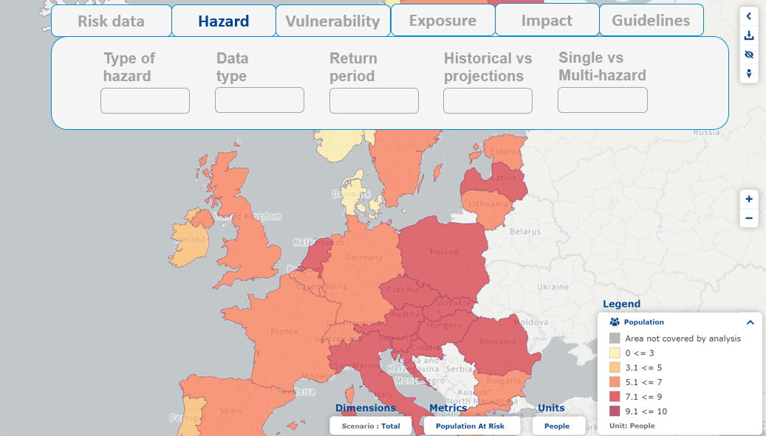


Step 2: CLIMAAX Toolbox
CRA toolbox should trigger systemic fast reacting adaptation on the local / regional level as part of the adaptation planning

Slide 46
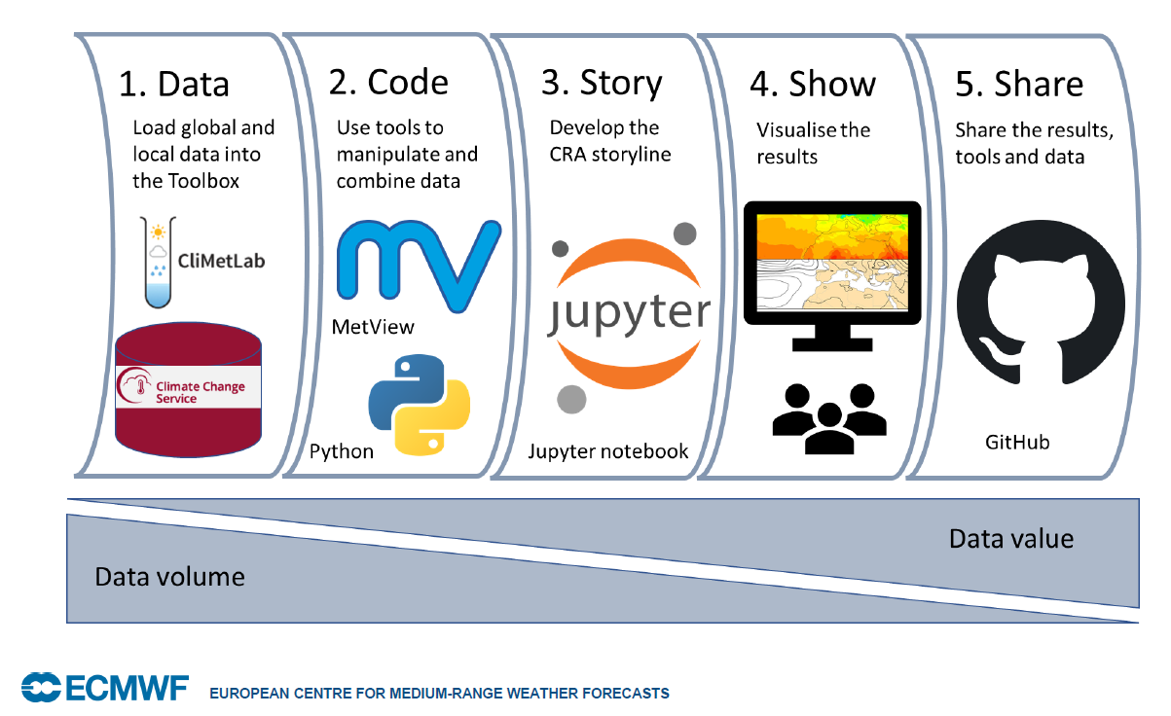
Step 2: CLIMAAX Toolbox

Slide 47
Financial Support for Third Parties (FSTP)
At least 50 regions / communities to replicate the approach
Around 200 – 300 k€ each (12 M€)
Raise at least 120 applicants
Scouting and promotion activities M9 – M15
2 open calls
  1st M10 – M12 → M14 start Sub-agreements
  2nd M13 – M15 → M17 start Sub-agreements
Responsibility with UPC-CRAHI and FundingBox

Slide 48
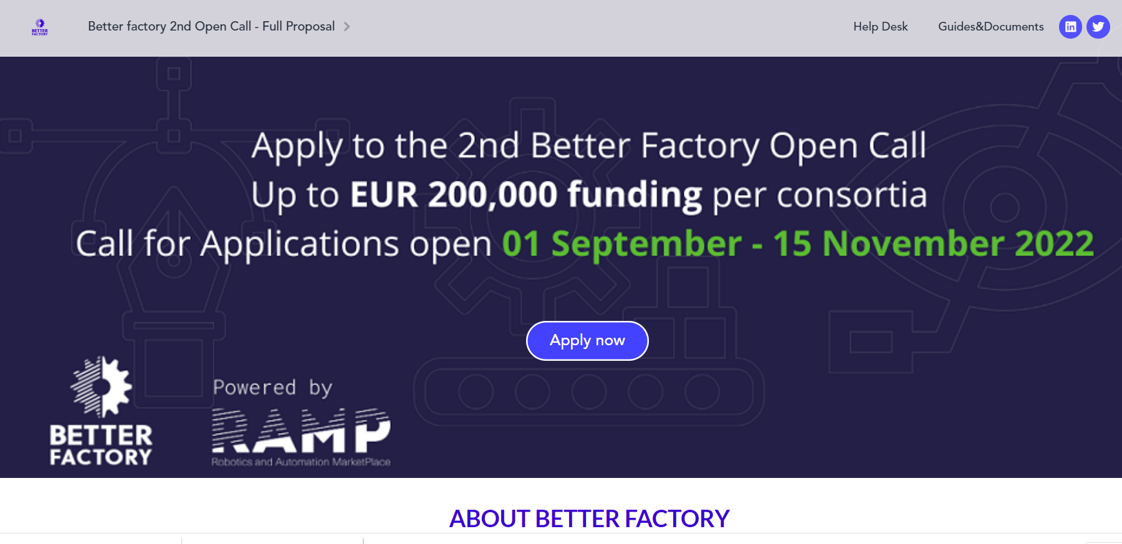
Connection to Mission Adaptation CoP
Presenting of CLIMAAX and its open call in:
  Webinairs
  Webstivals
  Conferences and events from ECCA, ClimateEurope2, etc.
Newsletter for amongst others CoP
Website dedicated to the launch of the Open Call
Online submission platform:

Slide 49
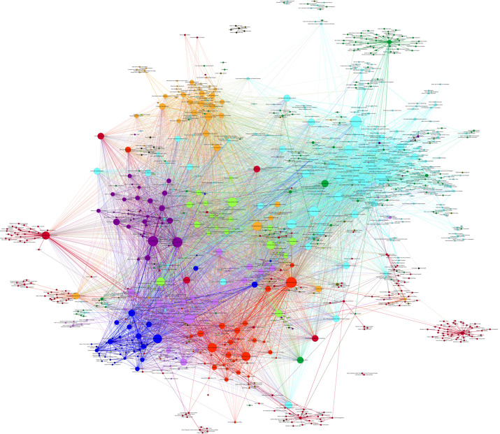
CLIMAAX community of Practice: A Network of Networks
“Knowledge networks” are expert groups who come together across organizational, spatial and disciplinary boundaries to devise and share knowledge.
Mission Adaptation – Community of Practice
Research organizations, research networks, e.g.:
EIOPA Technical Expert Network on Catastrophe Risks
Future Earth's Knowledge-Action Networks (KANs)
EC Disaster Risk Management Knowledge Centre (DRMKC)
EC Community of users for secure, safe and resilient societies (CERIS)
Copernicus Climate Change Service (C3S)
Global Risk Assessment Framework (GRAF)
Global Flood Partnership (GFP)
Image: Corlew et al 2015
Local and regional governments through alliances, e.g.:
ICLEI Local Governments for Sustainability European
Covenant of Mayors for Energy and Climate
Resilience City Network
European Regions Research & Innovation Network
UNDRR Making Cities Resilient initiative
Union Civil Protection Mechanism (UCPM)
Other HE/H2020 Projects, e.g.:
PEERS
MYRIAD EU
CLIMATEUROPE-2
Notes:
“Network of Networks”

Slide 50
Networking through participation in and invitations for EU events
January 26, 2023 Presentation at Mission Adaptation Implementation platform – Community of Practice meeting
March 24, 2023 Guest session in the context of the Climateurope2 webstival
Scope of the project, first info on open Call for the FSTP
Initial outline of the Framework & Toolbox
June 19-21 Session in the context of the European Climate change Adaptation Conference (ECCA), Dublin, complemented by virtual workshop
  Draft Framework & Outline of the Toolbox
  Synthesis of the consultation and input received
September 2023 Stand alone event or Climateurope2 webstival

Slide 51
Questions ?
Contacts:
CoP:
Jaroslav Mysiak jaroslav.mysiak@cmcc.it
Jeremy Pal jeremy.pal@cmcc.it
Project coordination:
Frederiek Sperna Weiland Frederiek.sperna@deltares.nl
Bart van den Hurk Bart.vandenHurk@deltares.nl

Slide 52
Workshop 1: Access to Data

Slide 53
Philippe Tulkens
Deputy Mission Manager
DG RTD

Slide 54
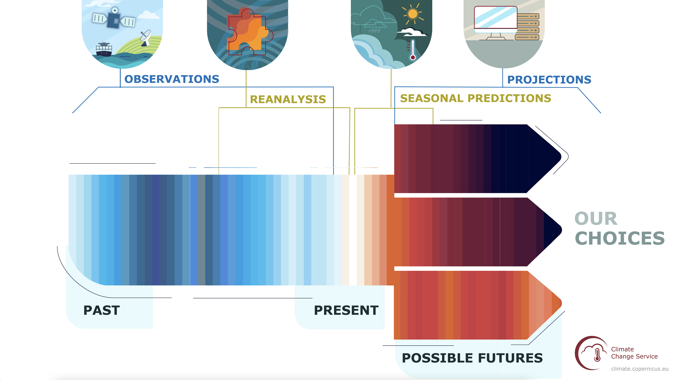
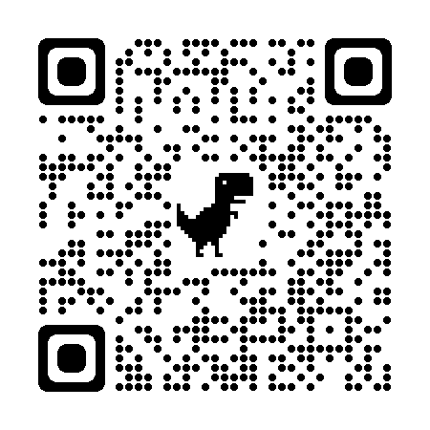

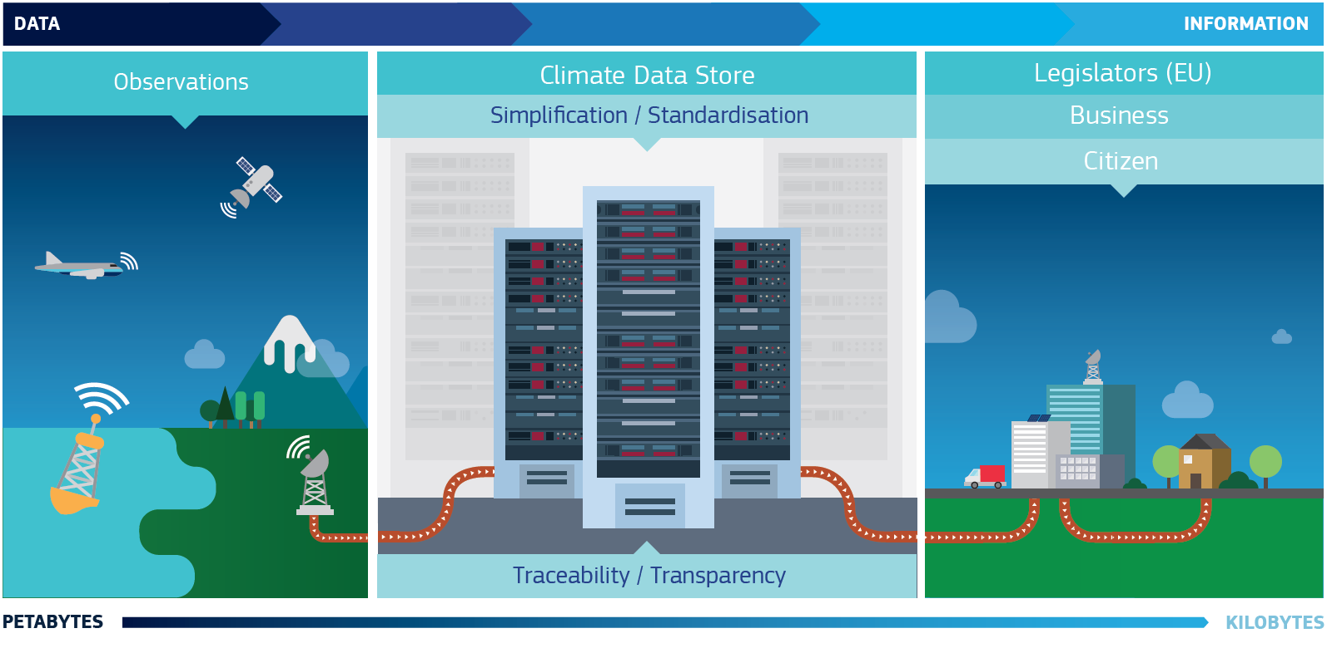
climate.copernicus.eu
cds.climate.copernicus.eu
Operational (not research)
Unrestricted OPEN AND FREE
Copernicus Climate Change Service (C3S): all climate data you had always dreamed of and never dared asking.
˜170,000 users
Regional climate datasets
Sectoral datasets (energy, water, agriculture, extremes,..)
Open source applications running on a cloud platform and able to generate tailored indicators on the fly
Typical download: ~100 TB /day
Typical number of requests: 500k/day

Slide 55
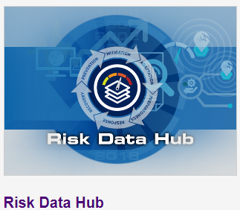
DRMKC Risk Data Hub – based on scientific partnership
Hosts and shares harmonized climate risk data* from Europe-wide to local scale (regions and cities)
Accounts on existing knowledge, networks, scientific partnerships within the CCA and DRR community
Link sectors, organizations, EU/national institutions with a common objective on risk assessment and adaptation to changing climate
Supports developments that matches the needs and realities expressed at local/national level (Mission on adaptation, NRA)
Access:
Website:
https://drmkc.jrc.ec.europa.eu/risk-data-hub/#/
Email:
JRC-RISK-DATA-HUB@ec.europa.eu
* EU Strategy on Adaptation to Climate Change: …Risk Data Hub to harmonize the recording and collection of comprehensive and granular climate-related risk and losses data, and promote national level public private partnerships to collect and share such data;
CCA- Climate Change Adaptation
DRR- Disaster Risk Reduction
NRA- National, Risk Assessment (under RecEU)

Slide 56

The Mission on Adaptation to Climate Change:
Knowledge to drive resilience and equality
Climate Change and adaptation data
Christiana Photiadou, Blaž Kurnik, Lucy Gregersen
Community of Practice launch / 26 January 2023
Notes:
OPENING SLIDE – dark background and white logo

Slide 57
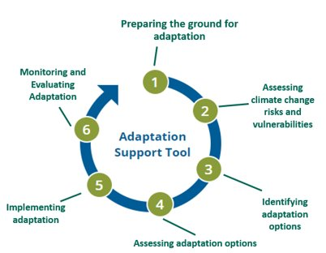

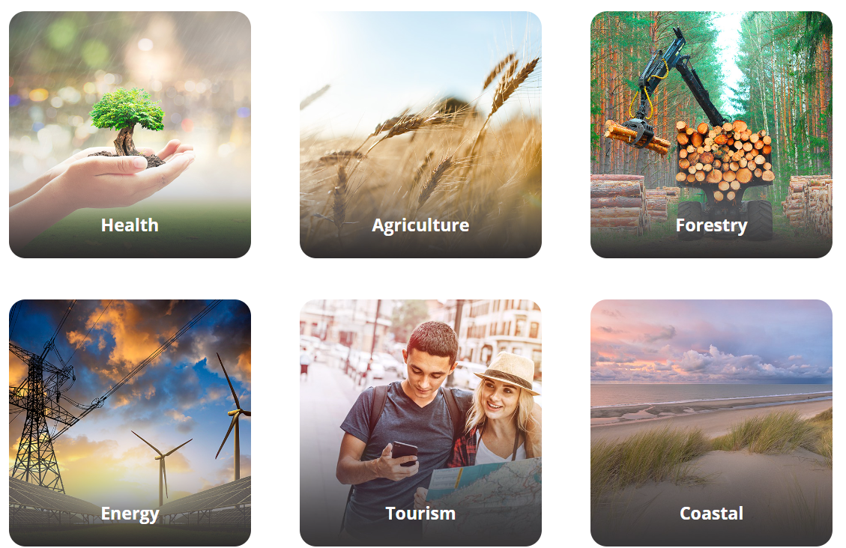
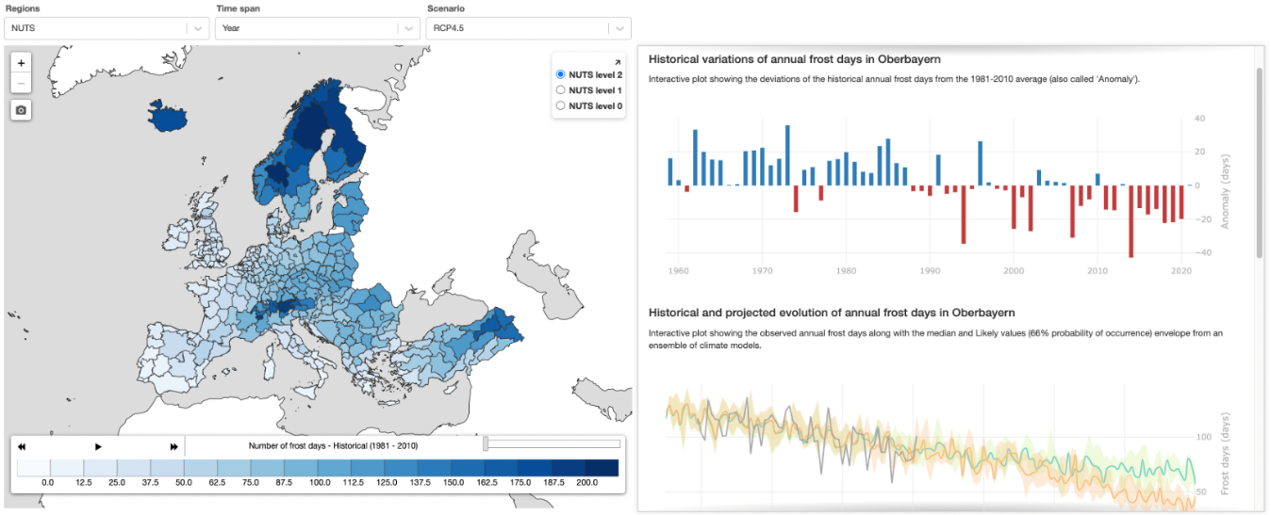
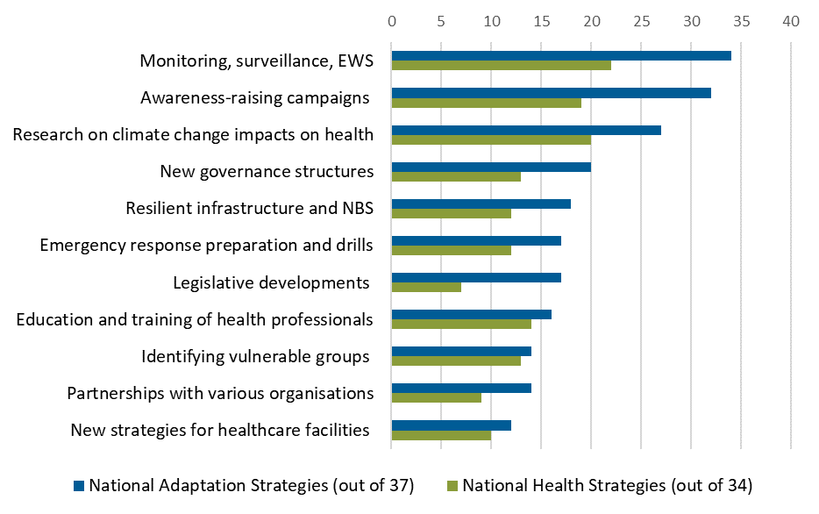

National reported information on adaptation
Climate hazards (past & future trends, national & subnational)
European Climate Risk Assessment Mandated by 2021 EU Strategy on Adaptation to Climate Change
https://maps.eea.europa.eu/wab/NationalAdaptation/

Slide 58
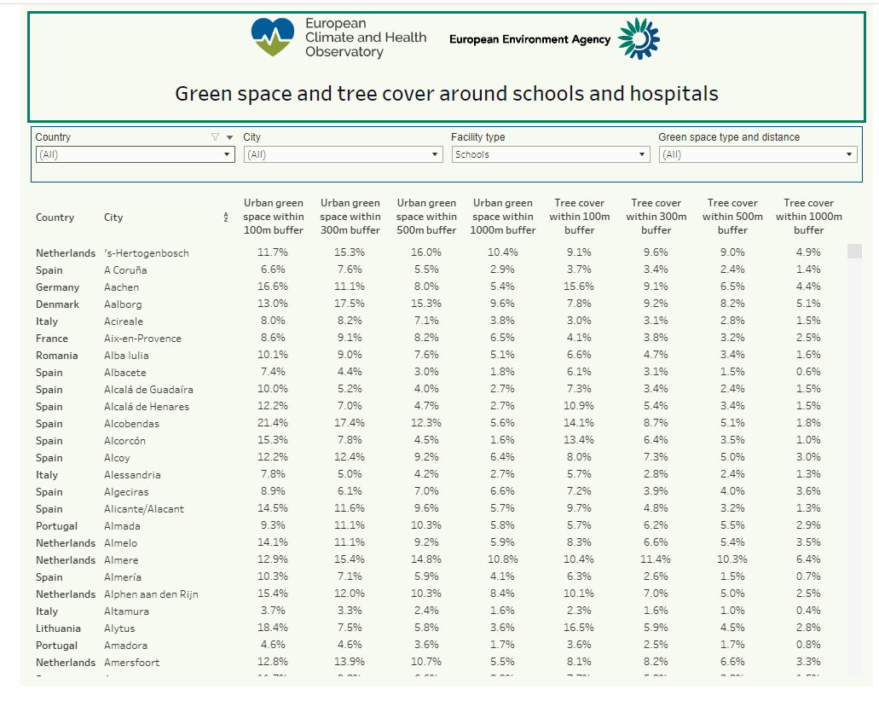
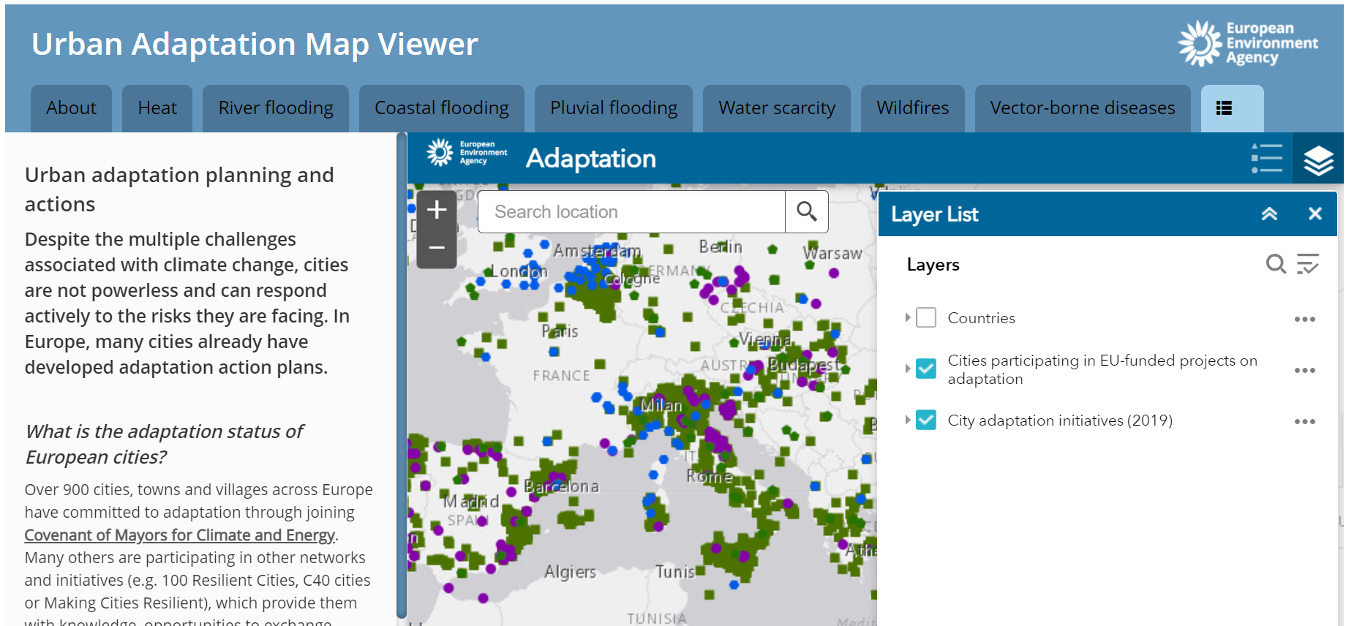
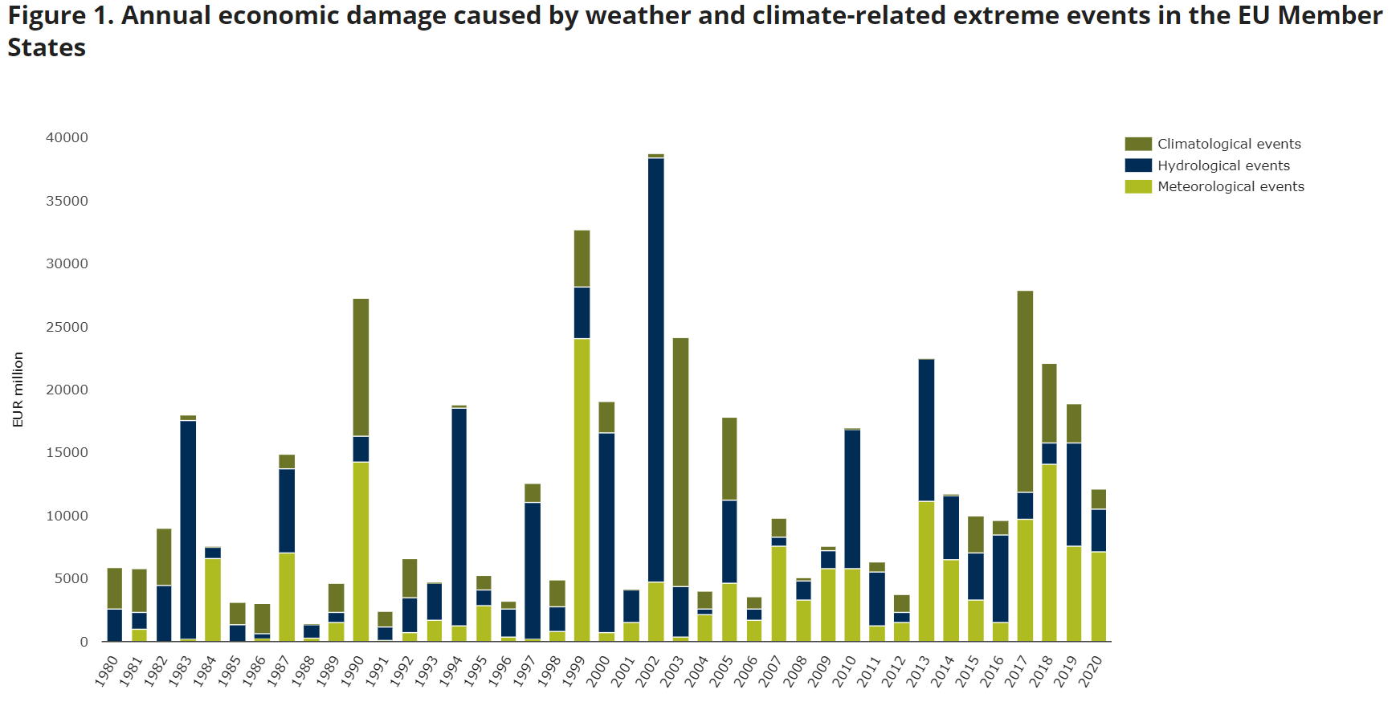
European Climate and Health Observatory
Urban adaptation
Economic losses and fatalities
https://www.eea.europa.eu/ims/economic-losses-from-climate-related
Derived indicators on:
Exposure of population
Vulnerability
Adaptive Capacity
Just Resilience
Adaptation actions

Slide 59
Sign up to receive EEA news, reports and alerts on your areas of interest at
http://eea-subscriptions.eu/subscribe
http://eea.europa.eu
Climate-ADAPT
http://climate-adapt.eea.europa.eu
European Climate and Health Observatory
https://climate-adapt.eea.europa.eu/observatory
European Climate Data Explorer
https://climate-adapt.eea.europa.eu/knowledge/european-climate-data-explorer/
Mission Knowledge Hub: available in 2023
Thank you!
Christiana Photiadou / Blaž Kurnik / Lucy Gregersen ​
Christiana.Photiadou@eea.europa.eu

Slide 60
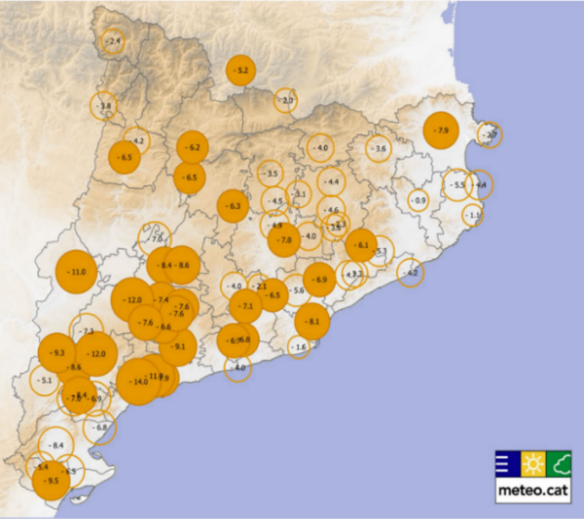
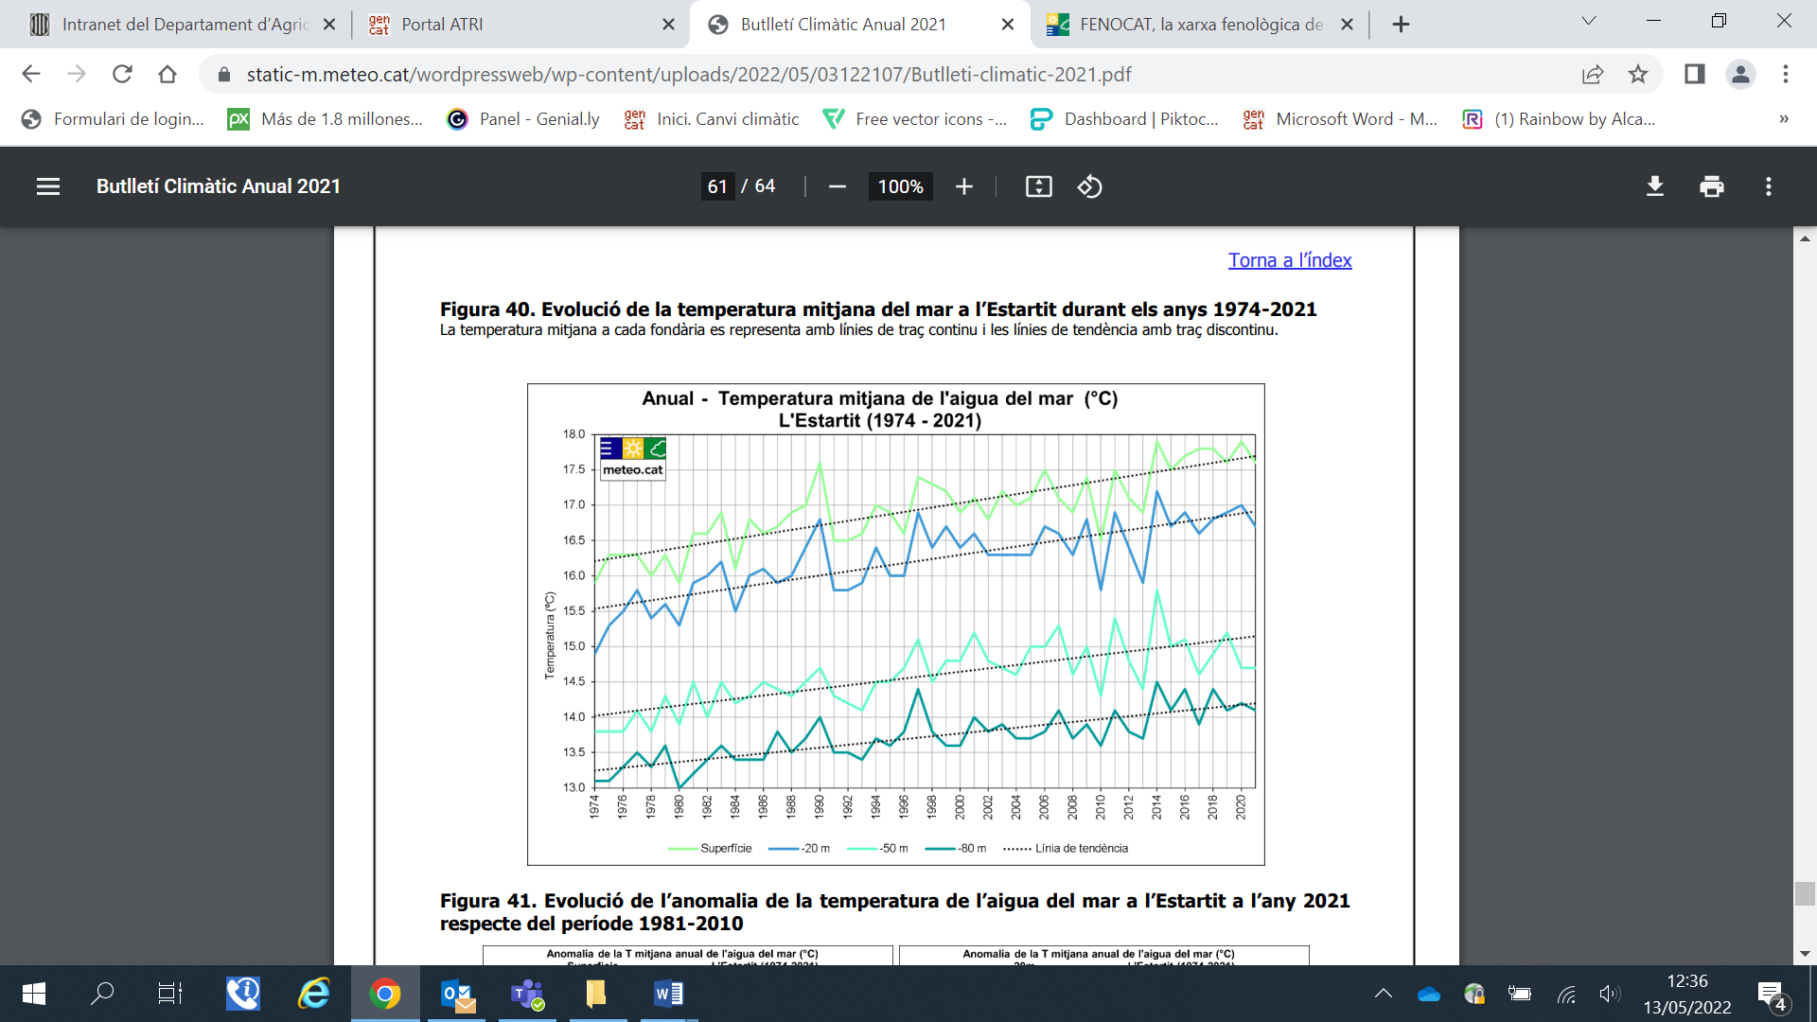
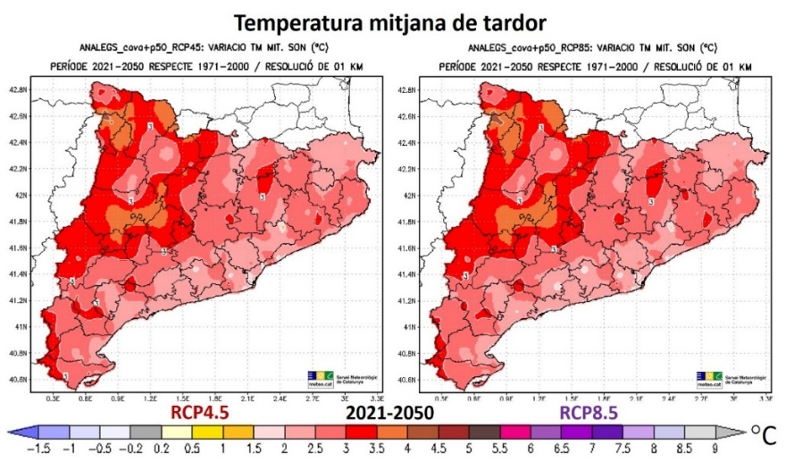
EU Region: Catalonia
Workshop 1: Acces to climate data
Catalonia present climate: Annual Bulletin of Climate Indicators (BAIC 2021) by Meteocat. Data collected: air temperature, precipitation, extreme weather indicators, sea water temperature, sea level rise and phenology.
Catalonia’s climate projections:
Catalonia 2030–2050 (ESCAT 2020) by Meteocat and Barcelona Supercomputing Center. High resolution (1km). RCP4.5 & RCP8.5 scenarios. Data projected: air temperature, precipitation and extreme weather indicators.
Sea level rise 2050-2100 (Catalan coast map viewer) by ICGC. Data projected: state of coast line, beaches, bathymetry. Under RCP4.5 & RCP8.5 SLR scenarios: 18 to 84 cm and under High End SLR scenarios: 1m – 5m (flooding bathtub model). Identification of economic sectors and natural systems at risk.
Summer precipitation trend (1950-2020): < 5,5% / decade
Annual sea water temp. average (1974-2021):
> 0,30ºC / decade
Catalonia’s challenges: the integration of sectoral policies - Catalan Strategy for Adapting to Climate Change (ESCACC30)
New flood areas included in the Flood Risk Management Plan; Drought Plan; Forest Management policy;
Health policies - Heat Waves Plan; urban planning and biodiversity; new infrastructure design and adaptation of existing infrastructures (water, energy, transport...); insurance sector;
Adapting Common Agricultural Policy; maritime fishing strategy; biodiversity strategy.
More information: Catalan Office for the Climate Change OCCC@gencat.cat
https://canviclimatic.gencat.cat/en/inici/
Variation of the average temperature in autumn 2021-2050 compared to 1971-2000 for the two global emission scenarios: between 2 and 4ºC increase

Slide 61
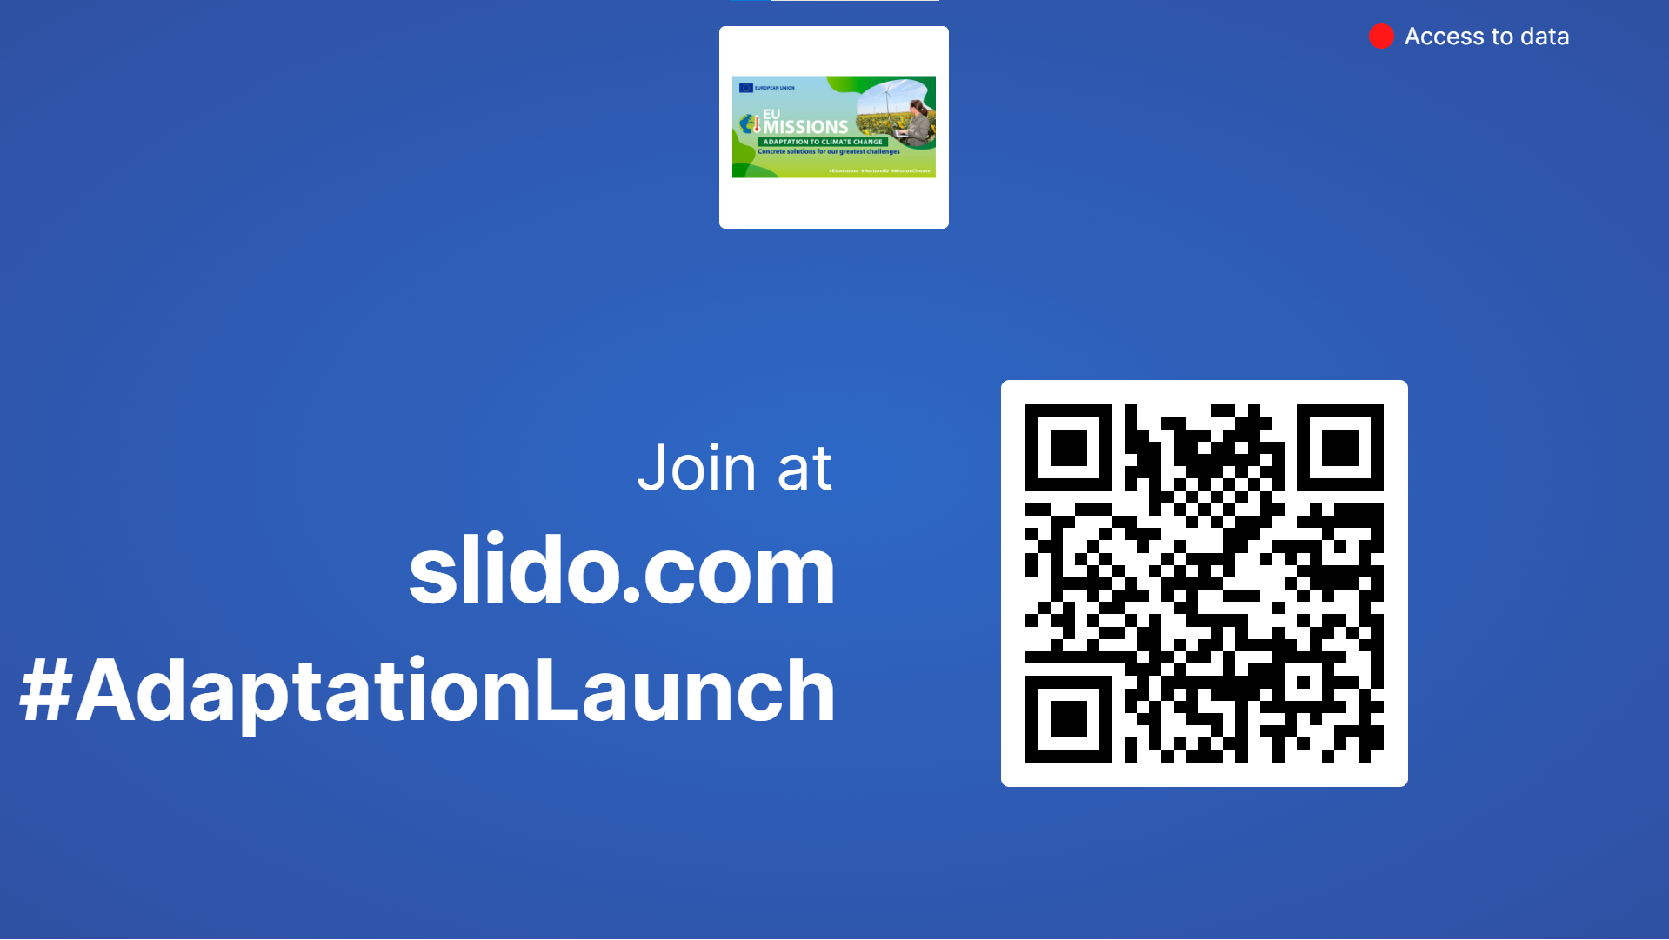

Slide 62
Mission Project PEERS

Slide 63
Co-developing pathways towards Climate resilient regions in Europe (Pathways2Resilience)
What is Pathways2Resilience?
Pathways2Resilience is the brand name of the PEERS project - HORIZON-MISS-2021-CLIMA-02-02 (Grant Agreement 101093942),
A 60-month programme (running until Dec 2027) contributing towards the realisation of the EU mission of adaptation to climate change for building a movement of at least 150 regions and communities on ambitious resilience building actions.
The main activity of the project is the support to regions and communities in their work to design climate resilience pathways / strategies and corresponding innovation agendas, including shared visions, increased capabilities and investment options.

Slide 64

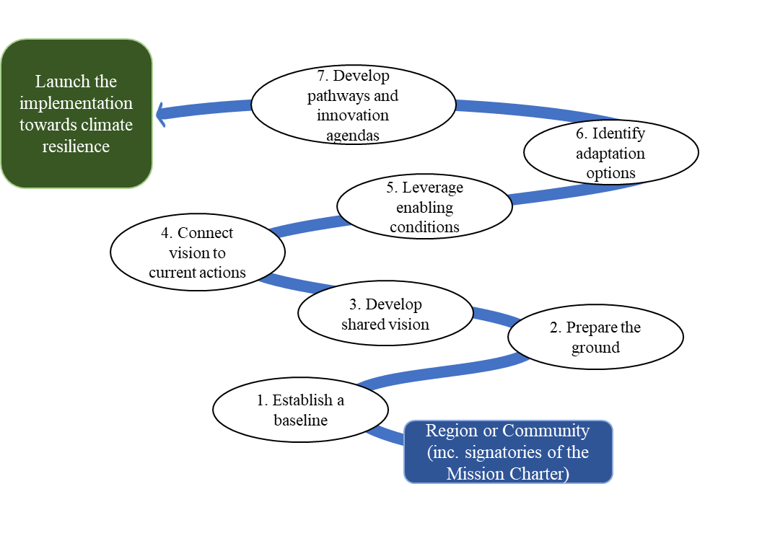


Co-developing pathways towards Climate resilient regions in Europe (Pathways2Resilience)
How will Pathways2Resilience support the CoP?
The project will mobilise interest and progressively elevate the ambition and capability of 150 regions and community to co-design climate resilience pathways, through:
Engagement and communication campaigns to activate regions and communities
21 Mio EUR funding and assistance (to 100 regions) to create climate resilience journeys
Innovation Practice Groups, Climate Finance Groups and a Climate Finance Lab
Learning and capacities platform
peers, cross-regional and mentoring

Slide 65
Regional Resilience Journeys

Slide 66

Co-developing pathways towards Climate resilient regions in Europe (Pathways2Resilience)
How can the CoP ask for support/ benefit from Pathways2Resilience?
Regions and communities, members of the COP need to express interest to start an ambitious resilience journey, ensuring there is strong political will for transformational change..
Express your interest through the different campaigns and activities
Create a self-assessment regional resilience capacity profile as a pre-condition to participate in 2 rounds of competitive funding
Actively engage in different support services provided by the programme, including matchmaking
Actively participate in the different learning and capacity building activities

Slide 67



Co-developing pathways towards Climate resilient regions in Europe (Pathways2Resilience)
How to contact Pathways2Resilience?
Coordinator:
Dr Fernando DIAZ LOPEZ, Ph.D.
EIT Climate-KIC
fernando.diaz-lopez@climate-kic.org
www.climate-kic.org
Information and contact:
Pathways2Resilience@climate-kic.org
Website & Social Media
    www.Pathways2resilience.eu/ coming soon!
  @Pathways2resilience
@P2Resilience

Slide 68
Workshop 2: Financing

Slide 69
Johannes Klumpers
Head of Mission Secretariat
DG CLIMA

Slide 70


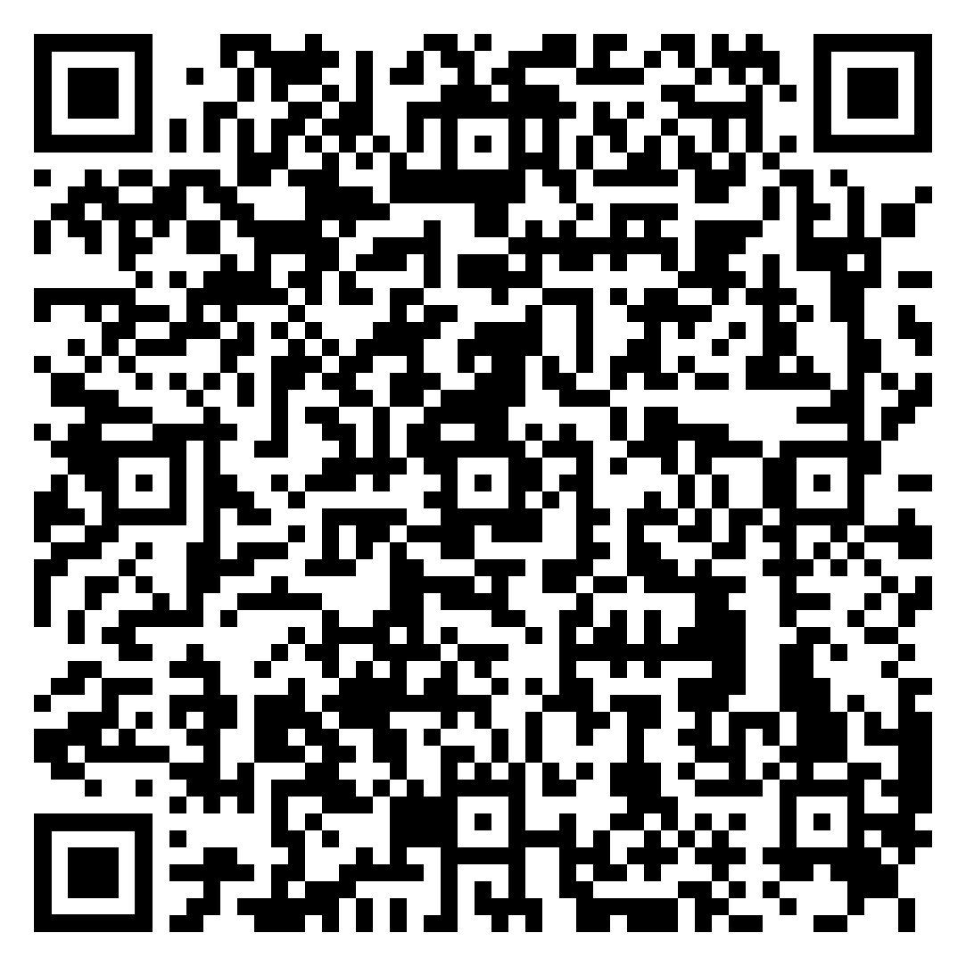
European Funding Opportunities for Adaptation Measures
Europe’s largest research and innovation funding programme is also for you!
Open and upcoming calls for Horizon Europe
Horizon NCPs
LIFE 2021-2027 has a Climate Change Mitigation and Adaptation Sub-Programme.
Open and upcoming calls for LIFE
LIFE NCPs
Support for applicants
Johannes Klumpers
Head of Mission Secretariat
Contact: EU-CLIMATE-ADAPTATION-MISSION@ec.europa.eu
Website

Slide 71
Financing via the Recovery and Resilience Facility
RRP measures defined by Member State central governments: diversity
  Consultation of stakeholders is required by the RRF Regulation
  Renegotiations under RePower EU…
Some measures extremely specific: e.g. re-naturing a specific water-course in a closely defined geographical area
Others broad, e.g.:
  Training on adaptation measures for farmers in areas exposed to water scarcity; mapping areas where power infrastructure needs reinforcement for resilience
  Investments targeting a number of buildings benefitting from deep renovation; number of hectares benefitting from nature-based solutions
Notes:
MS chosen allocations to adaptation add up to 5% of overall climate spending from the RRF. But a) potentially significant overlaps with mitigation, b) a big fund and can be locally important.

Slide 72
Cohesion Policy 2021 – 2027 and Climate Adaptation
EUR 392 billion (European Regional Development Fund, Interreg, Cohesion Fund, European Social Fund Plus, Just Transition Fund) to:
Reduce disparities between Europe's regions, strengthening economic, social and territorial cohesion
Contribute to EU priorities, including the European Green Deal
Policy Objective 2: A Greener Europe
EUR 127 billion (32% of total) dedicated to Policy Objective 2
Specific Objective 2.4: Promoting climate change adaptation, risk prevention and disaster resilience
Technical Assistance: Cohesion for Transitions (C4T)
To help EU MS and regions in implementing funds for Policy Objective 2
Tailor-made technical assistance with expert support, 3 Working Groups (energy, environment, climate)
Kick-off on 30 January 2023 – until January 2025
Contact point: Luis.GALIANO-BASTARRICA@ec.europa.eu

Slide 73
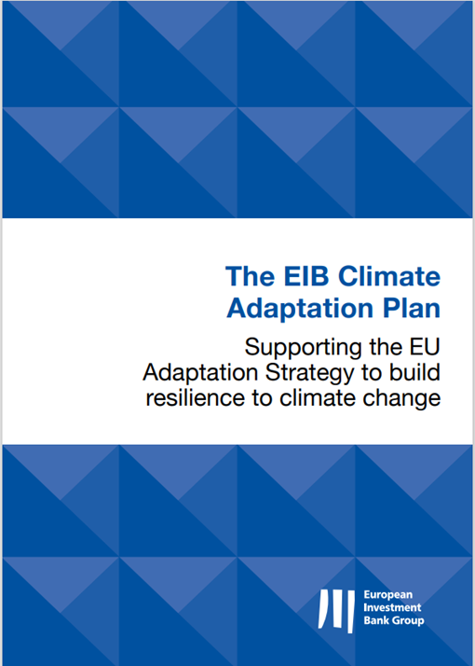


EIB Lending and Advisory to Build Resilience to Climate Change
The Climate Adaptation Plan, anchored in the Climate Bank Roadmap, described the enhanced ambitions of EIB support for Adaptation.
The Bank has a lending target of 15% for Adaptation until 2025 (of Climate Action) and increased its share of finance for adaptation financing operations from 50% to up to 75%.
EIB supports smarter, more systemic and faster adaptation in key investment areas, in line with the EU Adaptation Strategy.
The ADAPT Advisory Platform is an integral part of the EIB Adaptation Plan, building on the JASPERS and InvestEU Advisory Hub mandates. It provides advisory services advisory services throughout the whole project cycle for both public and private promoters.
EIB is ready to support regions participating in the EU Mission Adaptation to Climate Change with financing and advisory services. Interested project promoters are invited to reach out to EIB to discuss their financing or advisory needs.
Website: https://advisory.eib.org/about/adapt.htm
Contact: ADAPT@eib.org

Slide 74

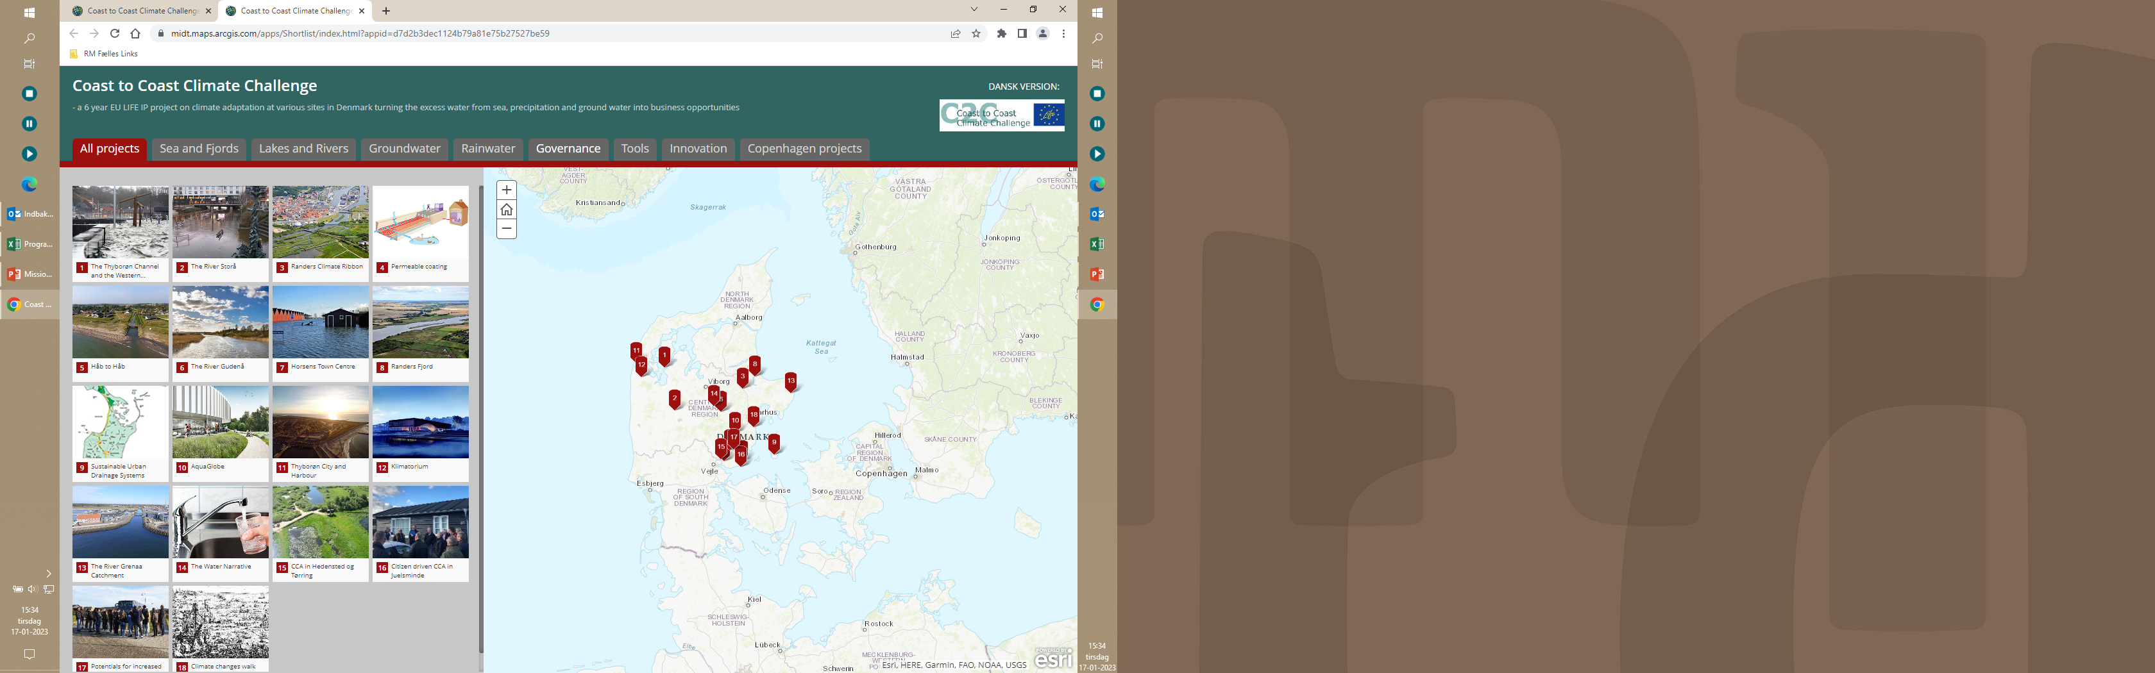

Financial instruments
Integration in planing, construction and focus on added value
National and international funding
Light houses and show rooms
Financial and insurance sector

Slide 75


Slide 76
Workshop 3: Citizen Engagement

Slide 77
Irene Bonvissuto
Mission Secretariat
DG CLIMA

Slide 78
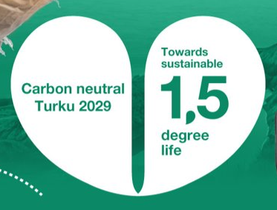
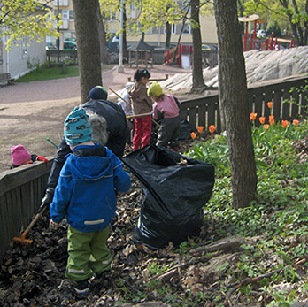





Climate Adaptation & Citizen engagement in Turku
Photo: Jonne Linna-alho

Slide 79
Mission Project AGORA

Slide 80
AGORA
A Gathering place to cO-design and co-cReate Adaptation
Paola Mercogliano (Fondazione CMCC)
Principal Coordinator
Community of Practice of the Mission Adaptation - 26/01/2023 Brussels

Slide 81

AGORA
A Gathering place to cO-design and co-cReate Adaptation
Funded by the European community within the framework of the Mission 'Adaptation to Climate Change: support at least 150 European regions and communities to become climate resilient by 2030' and, in particular, in response to the call HORIZON-MISS-2021-CLIMA-02-051.
https://cordis.europa.eu/project/id/101093921

Slide 82











AGORA
A Gathering place to cO-design and co-cReate Adaptation

Slide 83

AGORA
A Gathering place to cO-design and co-cReate Adaptation
AGORA will support the overall objectives of the Mission on Adaptation to Climate Change by leveraging and step forwarding best practices, innovative approaches, policy instruments and governance mechanisms to meaningfully and effectively engage communities and regions in climate actions, accelerating and upscaling adaptation process for building a climate resilient Europe.
It will promote democracy, climate justice, gender equality, equity, and foster adaptive capacity and citizens’ empowerment to proactively support decision-making processes.
AGORA’s main ambition, beyond the state of the art, is to promote societal transformational processes in different social, economic and political contexts through transdisciplinary tools and approaches.
Citizens, civil society organizations, academics, experts, policymakers, entrepreneurs and other relevant actors will be engaged in the co-design and co-creation of innovative problem oriented climate adaptation solutions that could be extensively adopted in Europe also considering the deep social changes on going and the awareness that no one size fits all solution.

Slide 84

AGORA
A Gathering place to cO-design and co-cReate Adaptation
Specifically, AGORA will provide:
A package of digital tools and co-developed frameworks relying on multi-directional communication technologies.
Innovative problem-oriented climate adaptation solutions.
Blueprints for effective decision making and collaborative processes that build on the dialogue among stakeholders and on the integration of different types of knowledge.
A set of pilot regions will constitute the co-production arena to co-design, co-develop and co-implement climate adaptation solutions.
AGORA will also develop a roadmap for transformational change and upscale of citizen engagement, for transferability of effective policy instruments and for ensuring long term legacy.

Slide 85

AGORA Conceptual Workflow to support CoP

Slide 86
AGORA Pilot Case
AGORA will engage with communities and regions that are or will be joining the EU Mission on Adaptation to Climate Change by signing the Mission Charter.
AGORA will perform specific-context in-person activities (for engagement, capacity building, governance and tackling disinformation) in four key pilot regions in Germany, Sweden, Italy, and Spain.
Pilot Regions identified in the early stage of the Project (Milestone at M6 to share the Pilot lists).
AGORA strategy will ensure a broader involvement of communities and regions in the Mission's framework, and it will turn AGORA into a vehicle to serve the Mission itself.

Slide 87
AGORA Pilot Case: our vision
Pilot Case
Pilot Case: involvement of potential users and stakeholders + a physical meeting place (venue for workshops, in-person activities, events) with the endorsement of local Authorities
Followers: those following the project process, sharing their experiences and initiatives, learning from our experience to further replicate the actions taken in AGORA (e.g. CoP participants!)
«Followers»
AGORA environment
GOAL: Create a network of followers (regions, communities, citizens, users) to foster dialogue between people, enabling them to connect with peers with shared challenges, in similar contexts, and implementing equivalent solutions to strengthen the Mission

Slide 88




AGORA KOM: 16/17 January 2023 (Rome, Italy)

Slide 89
Thank You for your Attention!
Contact point: paola.mercogliano@cmcc.it
For further details: https://cordis.europa.eu/project/id/101093921

Slide 90
Mission Project CLIMAS

Slide 91


CLIMAS
CLIMAte change citizens engagement toolbox for dealing with Societal resilience
dr. Floridea DI CIOMMO
cambiaMO | changing MObility
Mission on Adaptation
Community of Practice
26th January 2023
Brussels
This project has received funding from European Union’s Horizon Europe programme under Grant Agreement No. 101094021
91

Slide 92

policymakers, experts and stakeholders' actions
are not
ENOUGH
a 360º citizens engagement
NEEDS
to support climate adaptation measures
to help the 150 European regions and local communities to resist
tools to stimulate deliberative democracy
CLIMAS
Climate assemblies
to support a transformation to climate resilience
Living Labs
by offering an innovative
co-designed with stakeholders
by applying
problem-oriented climate adoption TOOLBOX
a values-based approach
design thinking methods
citizen science mechanisms
Notes:
The last climate change events show that the policymakers, experts and stakeholders' actions are not enough, and a 360º citizens engagement is urgently needed. Therefore, we need to learn from the good experience in citizens' engagement in climate change action and build up citizens` supporting infrastructure for climate adaptation measures to help the 150 European regions and local communities to resist.
CA and LL are considered as sustainable and reasonable tools to stimulate deliberative democracy in climate policymaking. The ambition of the current project is to support a transformation to climate resilience by offering an innovative problem-oriented climate adoption Toolbox, co-designed together with stakeholders by applying a values-based approach, design thinking methods and citizen science mechanisms.
It is expected that the use of the Toolbox will anticipate possible tensions and dilemmas vis-a-vis the adaptation to resilience - therefore enabling empowerment and engagement strategies that produce a society "resilient by design".

Slide 93















CLIMAS geography
Duration: 36 months
(January 2023- 31 December 2025)
Budget/Funding: 2,8M
This project has received funding from European Union’s Horizon Europe programme under Grant Agreement No. 101094021

Slide 94

CLIMAS methodology
This project has received funding from European Union’s Horizon Europe programme under Grant Agreement No. 101094021
CLIMAS will:
co-design an innovative problem-oriented climate adoption Toolbox within the Living Labs with a design thinking approach and calibrated through the Climate Assemblies
test the Toolbox, formulating scientific-based guidelines for policymakers on how to shift Climate Assemblies from technical deliberations that belong to climate change experts to multi-stakeholders deliberations based on solving the dilemmas from a bottom-up, more societal and value-based perspective.
CLIMAS outcomes will:
positively influence policy development and awareness- raising process and
offer sustainable strategies to enhance the acceptance of citizens' led decisions by policymakers
Notes:
In addition, CLIMAS will test the Toolbox and formulating scientific-based guidelines for policymakers on how to shift CA from technical deliberations that belong to climate change experts to multi-stakeholders deliberations based on solving the dilemmas from a bottom-up, more societal and value-based perspective.
CLIMAS outcomes will positively influence policy development and awareness- raising process and offer sustainable strategies to enhance the acceptance of citizens' led decisions by policymakers.

Slide 95

CLIMAS structure
This project has received funding from European Union’s Horizon Europe programme under Grant Agreement No. 101094021

Slide 96

CLIMAS
Thank you for your attention!
Floridea DI CIOMMO
cambiaMO | changing MObility
floridea.diciommo@cambiaMO.net
This project has received funding from European Union’s Horizon Europe programme under Grant Agreement No. 101094021
96

Slide 97

Climate Pact Ambassadors and Citizen Engagement
Solutions can only succeed if people, communities and organisations are all involved in the process (EU Climate Pact).
European Climate Pact is an opportunity for people to participate in climate action.
Climate Pact Ambassadors is a network with around 1.000 volunteers.
Ambassadors can play a double role, as interested citizens and facilitating the Stakeholder Engagement.
Jose Segarra Murria
Member of Mission Board
EU Climate Pact Ambassador
jsegarra@lowcarboneconomy.org

Slide 98



European Commission’s Competence Centre on Participatory and Deliberative Democracy
EU-CITIZEN-ENGAGEMENT@EC.EUROPA.EU
Anna Paola Quaglia

Slide 99


TransformAr Adaptive Pathway Transformation Playbook
A step by step guide to co-construct Adaptation Pathways
Based on participatory workshop sessions
Involving scientific and local knowledge
Application within the 6 demonstrators of TransformAr project
Session 1 :
Climate perception, challenges, solutions
Session 2
Climate vulnerability, Impacts and Projections
Session 3
Vision solutions and Way forward
Result example of the application of the Playbook method
(case of Guadeloupe demonstrator for agriculture sector)

Slide 100




Stakeholder Engagement: next 12 months
Replication: 10 more regions
in 2023 by Regilience
Challenge: embracing Adaptational Pathways
Solutions follow-up measures
in the methodology along
best practices
Stakeholder Advisory Board
aligned with the CoP
Networking with facilitators and empowering stakeholders: interactive innovation
Discrete Choice Experiment
+ focus groups + scenario games for behavioural change

Slide 101


Thank you for your attention
Jan Cools – Project Coordinator
jan.cools@uantwerp.be

Slide 102



Citizen-driven climate action in Occitanie
A local green-deal constructed after a citizen convention
  100 citizens selected randomly on representative criteria
  A contribution of 52 proposals consensually approved by the group
Participative budgeting on climate since 2019
  « My solution for climate change » : 3 sessions in 2019, 2020 and 2021, 64 projects supported with 2,3M€
  A new session in 2023, reinforced with a new 2M€ budget and developping adaptation concerns

Slide 103


Slide 104
Closing address

Slide 105
Philippe Tulkens
Deputy Mission Manager
DG RTD

Slide 106

    Channel Adaptation to Climate Change

Slide 107
Important websites
Mission website
https://research-and-innovation.ec.europa.eu/funding/funding-opportunities/funding-programmes-and-open-calls/horizon-europe/eu-missions-horizon-europe/adaptation-climate-change_en
National Contact Points (NCPs)
https://ec.europa.eu/info/funding-tenders/opportunities/portal/screen/support/ncp
EU Missions info days
https://research-innovation-community.ec.europa.eu/events/1nVczf9ihgPdOg3zyoLyuC/overview
Funding & Tender Portal
https://ec.europa.eu/info/funding-tenders/opportunities/portal/screen/programmes/horizon

Slide 108
Adaptation to climate change (europa.eu)
#EUmissions #HorizonEU #MissionClimate
Notes:
Find out more here:
https://myintracomm.ec.europa.eu/dg/RTD/eu-missions/Pages/default.aspx (internal)

